Slide 1
Motivation of Cut-In Requirements
Submitted by expert from Germany
Informal document GRVA-05-36
5th GRVA, 10-14 February 2020
Agenda item 4(a)
Additional explanation to paragraph 5.2.5.2.
of the draft UN Regulation for ALKS (GRVA-05-07)

Slide 2
Cut-In Requirements: Model for ADS Behavior
Intervention assumed for original proposal
Intervention assumed for new proposal
No intervention required
ALKS Vehicle
ALKS Vehicle
ALKS Vehicle
30 cm
Intruding Vehicle
Intruding Vehicle
Intruding Vehicle

Slide 3
Cut-In Requirements: Intervention Concept
Monitor other traffic (continuously)
Decide Brake Intervention (instantanuously)
Transmission delay
Increase brake force
Full braking phase
Unpreventable: Avoidance not required. Do not switch strategy!
1st Parameter: Ass. decision strategy
3rd Parameter: typical jerk
Decision too late TTC<TTC_{min}
Decision in time TTC$≥$TTC_{min}
2nd Parameter: typical delay
4th Parameter: available deceleration
Preventable: Avoidance required

Slide 4
Cut-In Requirements: Intervention Model
ALKS decides intervention: other traffic enters lane by > 30 cm
Start of Intervention
ALKS Vehicle
30 cm
deceleration
Intruding Vehicle
relative speed
ALKS monitors other traffic
0
0

Slide 5
Cut-In Requirements: Intervention Model (2)
Decision in time TTC$≥$TTC_{min}
ALKS decides intervention: other traffic enters lane by > 30 cm
Start of Intervention
deceleration
relative speed (avoidance case)
ALKS Vehicle
30 cm
t_{increase,} _{deceleration}
Intruding Vehicle
t_{delay}
decel_{max}
ALKS monitors other traffic
0
0

Slide 6
Cut-In Requirements: Intervention Model (3)
Decision too late TTC<TTC_{min}
ALKS decides intervention: other traffic enters lane by > 30 cm
Start of Intervention
deceleration
ALKS Vehicle
relative speed (mitigation case)
30 cm
t_{increase,} _{deceleration}
Intruding Vehicle
t_{delay}
decel_{max}
ALKS monitors other traffic
0
0

Slide 7
Mathematical Model for Edge TTC
TTC for brake start to avoid collision with deceleration d:
Approximation (avoiding numeric integration) for jerk influence:
Take „dead time“ delay (command transmission etc) into accout:
${TTC}_{avoidance}=\frac{v_{rel}}{2∙d}$= $\frac{v_{rel}}{2∙\left|\ddot{x}max\right|}$
$${TTC}_{avoidance}=\frac{v_{rel}}{2∙\left|\ddot{x}max\right|}+\frac{1}{2}t_{increase}$$
$$t_{increase}=\frac{\ddot{x}max}{\overset{⃛}{x}available}$$
$${TTC}_{avoidance}=\frac{v_{rel}}{2∙\left|\ddot{x}max\right|}+\frac{1}{2}t_{increase}+t_{delay}$$

Slide 8
Parameter Derivation
1st Parameter: Ass. decision strategy
Assume an intrusion of 30 cm into lane can be considered critical (intrusion continuously monitored!)
2nd Parameter: typical delay
Transmission in bus system, overcome actuator friction, …
100 ms (confirmed by manuf.)
3rd Parameter: typical jerk
Typical (own measurement): 0.4 – 0.6 s from 0 to 10 m/s²
New brake systems (own measurement): 0.15 s from 0 to 10 m/s² Assumed (conservative!) in DE/FR prop.: 0.5 s from 0 to 6 m/s²
4th Parameter: available deceleration
Typical value from field data: 6 m/s² availabe also on wet roads.
$${TTC}_{avoidance}=\frac{v_{rel}}{2∙6 m/s²}+\frac{1}{2}0.5s+0.1s=\frac{v_{rel}}{2∙6 m/s²}+0.35s$$
$${TTC}_{avoidance}=\frac{v_{rel}}{2∙\left|\ddot{x}max\right|}+\frac{1}{2}t_{increase}+t_{delay}$$

Slide 9
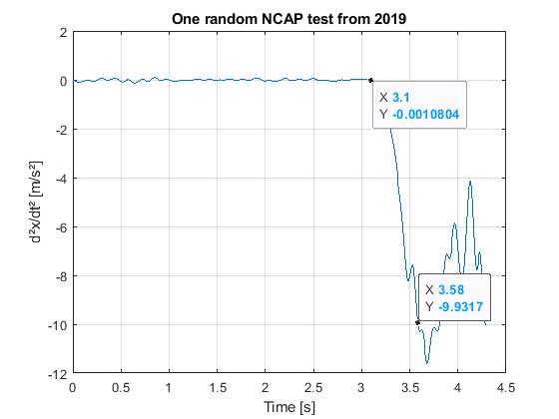
Parameter
3rd Parameter: typical jerk
0.48 s from 0 to 9.9 m/s²

Slide 10
Parameter
4th Parameter: available deceleration

Slide 11
Summary
DE/FR model assumes a continuous monitoring of traffic in adjacent lanes
DE/FR model assumes a critical condition and consequently a brake intervention when other traffic enters > 30 cm into ego lane
DE/FR model assumes a plausible delay (transmission, actuator friction) of 0.1 s
DE/FR model assumes a brake intervention with 6 m/s² reached in 0.5 seconds
These values have been shown to be realistic
DE/FR position: Automated vehicles should not be required to have a weaker perfomance than current ADAS-equipped vehicles

Slide 12
Comparison of JP and DE/FR DTC values
V_{rel} (km/h) V_{Lateral} (m/s) | 0 | 10 | 20 | 30 | 40 | 50
0 | N/A | N/A | N/A | N/A | N/A | N/A
0.5 | 5.0 | 9.6 3.28 | 19.8 7.85 | 31.0 13.7 | 45.0 20.84 | N/A 29.27
1.0 | 5.0 | 6.6 2.45 | 13.7 6.18 | 22.0 11.20 | 32.3 17.51 | N/A 25.1
1.5 | 5.0 | 5.6 2.17 | 11.6 5.63 | 18.4 10.37 | 26.4 16.40 | N/A 23.71
1.8 | N/A | N/A 2.08 | N/A 5.44 | N/A 10.09 | N/A 16.03 | N/A 23.25

