Slide 1
Evidence regarding the proposed amendments to UN-R79 ACSF of Cat. C
Informal document GRVA-05-52 5th GRVA, 10-14 February 2020
Agenda item 6(a)

Slide 2
What is the basis of this data?
Assessment of 47.000 lane changes on highway roads across Europe
The assisted lane change refered to is performed by a system that was EU exemption approved in 2017 and differs from current UN-R79 Cat. C provisions to the following extend:
The system is designed to wait up to 10s for a sufficient gap before it starts the lane change maneuver.
The system only automatically deactivates the turn indicator if the lever has not been fully engaged.
The system uses a more flexible calculation in order to assess the criticality of a situation, allowing it to find appropriate gaps more easily. → lane change times would be longer for systems approved to UN-R79 ACSF Cat. C and the rate of suppressed lane changes would be drastically increased
The system provides assistance even if the driver starts to change lanes before the system would begin the lateral movement.
There are several hundred thousand vehicles worldwide equipped with this assisted lane change system and there are no known reported safety issues.

Slide 3
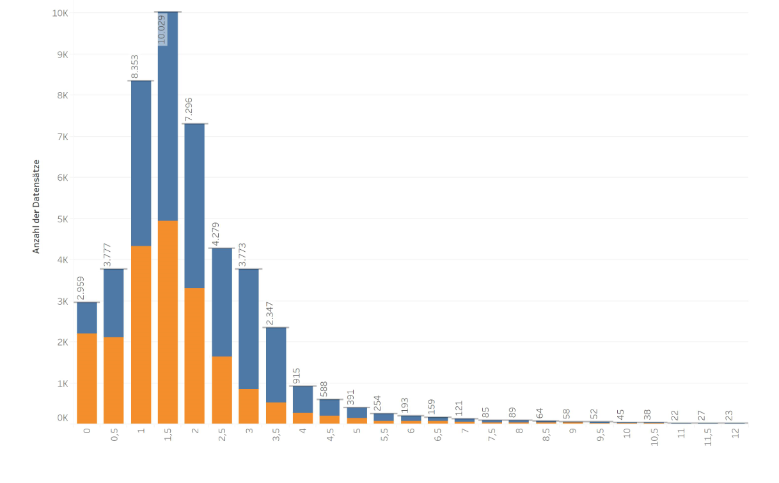
Proposal to extend the time within which the lane change maneouvre must commence to 10s
How long does it take from the start of the lane change procedure until the vehicle crosses the lane marking?
Data
Conclusion
Time between turn indicator activation
and when the front wheel tyre touches the lane marking
Drivers naturally change lanes quicker than the mandated 3s.
There is thousands of lane changes that take between 3 to 4,5s to cross the lane marking.
Due to the specification of lane change timing according to UN-R79, the values shown would increase by at least an additional 1s to 3s, due to the delay after which the lateral movement is allowed to start, and/or to the 3s minimum time before lane change manoeuver can start.
Based on the definition of a critical situation according to UN-R79, finding a suitable gap would take longer than shown here, so values would increase additionally compared to what is shown on the left.
While data shows that many lane changes happen quite early, there still is a relevant number of lane changes that take longer and drivers would not understand why system activation is sucessful at 4,5s but not at 5,5s.
Extensive on-road experience shows that the time to cross the lane marking should be increased in order to cover more situations and allow more consistent system behavior.
1s delay before lateral movement is allowed to start +
3s before the LC manoeuver can start + conservative definition of critical situation will push lane change times towards even higher durations
Number of data sets
time [s]
blue … assisted lane change
orange … manual lane change

Slide 4
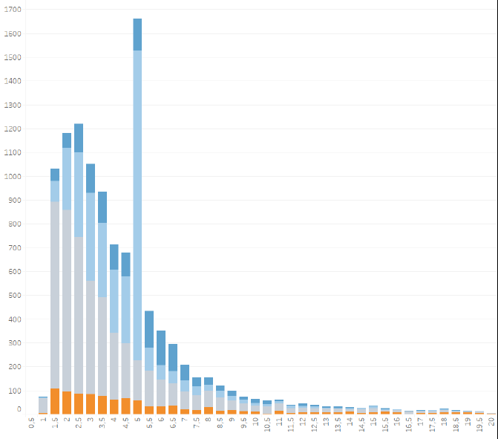
Proposal to amend the provisions regarding automatic deactivation of the direction indicator
Do drivers deactivate an engaged direction indicator after an assisted lane change themselves?
Data
Conclusion
Overall duration of direction indicator being active
The system did not disengage a fully enganged direction indicator automatically, yet you see no increased number of direction indicators being active unreasonably long.
The existing indication that the direction indicator is active is sufficient information to the driver.
Drivers disengage a fully engaged direction indicator after a completed assisted lane change themselves.
Peak at 5s is due to system design related to tipp blinking.
Number of data sets
No increased direction indicator times, even though the system does not automatically disengage a fully engaged lever.
time [s]
blue … assisted lane change
(dark blue = lane change was delayed by the situation
light blue = lane change could start immediately)
Orange … manual lane change during the assisted lane change
Grey … manual lane change

Slide 5
Further evidence
Customer Feedback from systems already approved according UN-R79 ACSF of Cat. C provisions
Theoretical analysis
How long would it take another vehicle that had just entered the critical distance at 10km/h greater speed than the Cat. C vehicle to exit out of that space by passing the Cat. C vehicle?
„Lane change support is suppressed too often.“
„Lane change assist is hardly ever available.“
„Why doesn‘t it assist the lane change even when there is so much free space?“
Index | Speed of ego vehicle (Vs)
 | 80 km/h | 100 km/h | 120 km/h
S_{critical} for the vehicle (Vs+10 km/h) | 24.6 m | 30.2 m | 35.7 m
Required time for that the approaching vehicle escapes from the area of S_{critical} | 8.8 sec | 10.8 sec | 12.8 sec
Cat. C vehicle
Vehicle in the critical distance

Slide 6
Summary
Automatic deactivation of a fully engaged turn indicator doesn‘t seem necessary, because data shows that drivers deactivate turn indicators themselves, and this manual deactivation could even be understood as a way of ensuring the driver stays engaged during the assisted lane change.
The time limit within which the system has to start the lane change maneuver should be increased to 10s, because
There are situations, especially in dense traffic, in which the large suitable gap as defined by the current provisions are difficult to impossible to find. (Keep in mind, the driver must initiate the lane change procedure, so it is not only about the system finding an appropriate gap, but about the driver activating the system at the right point in time!)
Under some situations, e.g. when there is a faster vehicle passing by, it takes some time for a suitable gap to open up.
Understanding why one lane change was assisted sucessfully and the other was not based on the timing is impossible to the driver, so with the number of supressed lane changes going up, customer acceptance is going to go down.
If customer acceptance goes down, the system will not be used and safety benefits cannot be harvested.
Field data and experience from several manufacturers should help to resolve any concerns regarding potential effects of enlarged timing – it is already proven in use!

