Slide 2
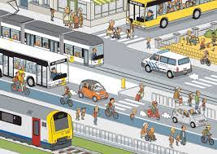
https://vlietnieuws.nl/wp-content/uploads/2017/01/vervoer.jpg
Public transport
issues in data collection
Peter Smeets
UNECE WP6. 17/19 June 2020

Slide 3
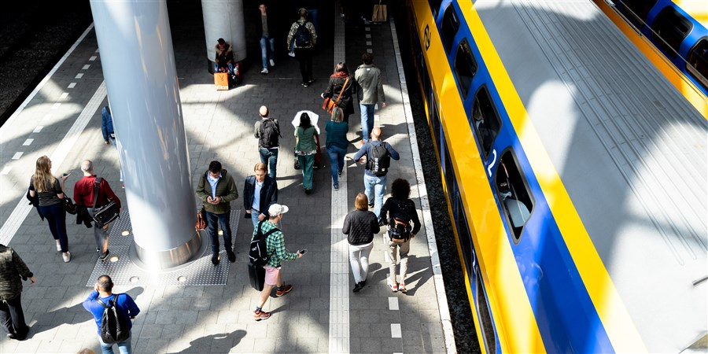
Situation:
Mobility Survey (ODiN) not sufficient to collect reliable data (passengers/passengerkm) on:
Buses
Trams published as one figure
Metros
Trains
Other sources are not available (yet)

Slide 4
future:
Mobility Survey in combination with
other sources :
The most suitable source is the check-in and check-out data of the transport companies managed by the private company Translink.

Slide 5
Step 1: monitor
“Translink and Statistics Netherlands are working together on the development of a public transportation monitor : OV monitor. In the OV monitor, national figures on public transport are made accessible, and relationships are established with other forms of transport. Various sources are used for this, including public transport chip card data from Translink and data from Statistics Netherlands collected through registers and national surveys.”

Slide 6
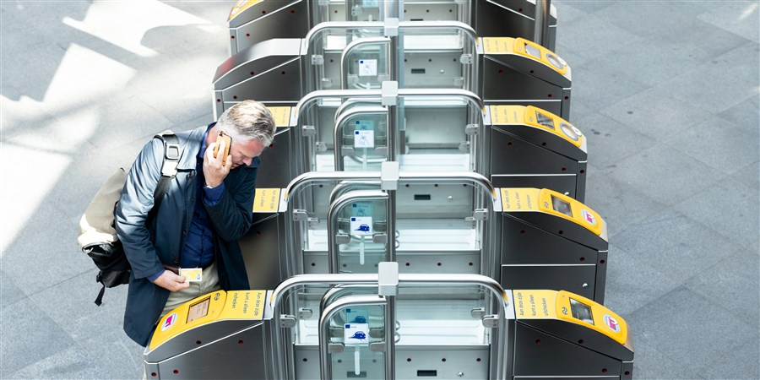
OV monitor (1)
Number of check-ins per day compared to reference period
(source: https://www.cbs.nl/nl-nl/nieuws/2020/14/veel-minder-druk-in-openbaar-vervoer-in-maart-2020)

Slide 7
OV monitor (2)
Number of check-ins per hour on 15-6-2020

Slide 8
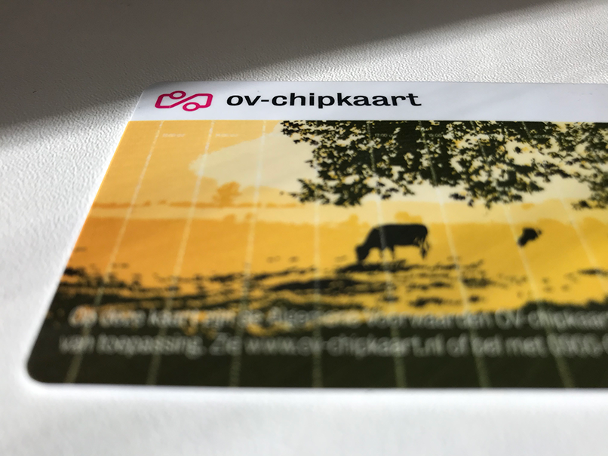
Next step : detailed info on check-ins/-outs
Public transport data (OV-data) about check-ins and check-outs is held by private transport companies and managed by Translink
These data are necessary to estimate the number of train passengers (EU-legislation, (EU) 2018/643)
And the number of bus, tram and metro passengers
“Statistics Netherlands can then act as a data hub for other government services and the private sector.”

Slide 9
challenge: access to adequate microdata
Microdata to CBS :
Businesses (transport companies) have concerns about:
Data security
Privacy aspects
Their Competitive position
-> Statistics Netherlands is negotiating with the ministry, the transport companies and the data manager to overcome legal, privacy and other obstacles…

Slide 10
Thank you for your attention

