Slide 1
COVID-19 Related
Transportation Data in the
United States
Steven Beningo
June 17, 2020

Slide 2
New Paradigm
Addition of flash indicators to the Bureau of Transportation Statistics (BTS) website – A new product line of provisional indicators of transportation activity.
Differs from traditional statistical products because timeliness is more of a focus than statistical quality. BTS continues to maintain traditional statistical products that require a highly deliberative process.

Slide 3
Data Acquisition
BTS acquired real time and near real time transportation data from public and private sources.
Examples
Movement of Persons: The University of Maryland leverages location-based services data from mobile devices to provide daily stay-at-home and trip statistics by county.
Border Crossing: The Niagara Falls Bridge Commission provides previous day data on the number personal vehicles, trucks, and buses crossing from the U.S. to Canada. Customs and Border Protection provides data on the number of passenger vehicles entering the U.S. at all border ports of entry on both the Canadian and Mexican Borders.
The quality of the acquired data were reviewed by BTS staff.

Slide 4
Internal Transportation Demand Data Card
BTS developed an Internal Transportation Demand Data Card showing daily and weekly data on:
People Staying Home and Personal Travel by Trip Length
Passenger Throughput
Roadway Volume
The Number and Capacity of Airline Flights
Transit, Intercity Bus, and Intercity Train Ridership
Border Crossings
Freight Vessel Activity
Ferry Routes
Spot Market Lorry Rates
Capacity of Containerships Calling at U.S. Ports

Slide 5
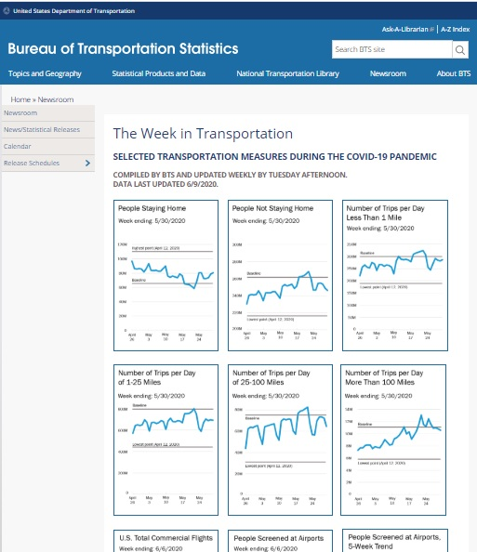
The Week in Transportation
BTS quickly developed The Week in Transportation dashboard using new and innovative methods with the latest data from our partners to provide the public with an understanding of how the transportation system is operating in response to COVID-19.

Slide 6
The Week in Transportation
Found at:
https://www.bts.gov/newsroom/week-transportation
Indicators:
Personal Travel by Trip Length
U.S. Commercial Flights
People Screened at Airports
Weekly Railroad Activity
Spot Market Rates for Dry Van Linehaul
Freight Vessel Activity Near Top 10 U.S. Ports
Border Crossing Data
Subway Ridership in New York City, Washington D.C., and the San Francisco Bay Area

Slide 7
Thank you for your attention

