Slide 1



Slide 2
Regional Road Map on Power System Connectivity: Relevant strategies and projects
Almaty Energy Forum, 16 November 2022
Randi Kristiansen
Economic Affairs Officer, Energy Connectivity

Slide 3

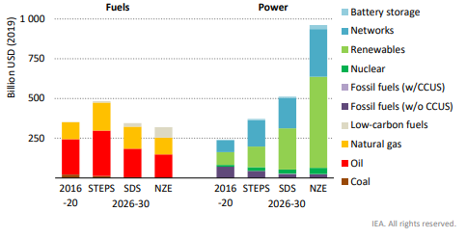
Why talk about connectivity?
In order to reach sustainability targets and long-term Net Zero targets investments needs to be scaled up massively

Slide 4

Why talk about connectivity?
In 2021 ESCAP member states endorsed the regional road map on power system connectivity

Slide 5
Regional Roadmap on Power System Connectivity - Strategies
Vision, principles and nine strategies to enable sustainable connectivity
Planning
Develop a regional master plan (Strategy 2)
Financing and development
Mobilize investment in cross-border infrastructure (Strategy 7)
Operations
Move toward multilateral trading and competitive markets (Strategy 5)
Cross-cutting
Co-ordinate cross-border system operations (Strategy 6)
Build trust and political consensus (Strategy 1)
Develop intergovernmental agreements (Strategy 3)
Build capacity and share information, data, best practices (strategy 8)
Ensure coherence of connectivity with the SDGs (Strategy 9)
Coordinate cross-border transmission planning (Strategy 6)
Coordinate, harmonize, and institutionalize policy and reg frameworks (Strategy 4)

Slide 6
Regional Roadmap on Power System Connectivity - Milestones
S1 | Regional meeting on grid integration convened regularly | S6 | Coordinated mechanisms for system operation and transmission utility cooperation
S2 | Map region’s existing high voltage transmission by 2022 Regional grid master plan might be agreed on by 2025. | S7 | Subregional platforms created to advance financing of power system connectivity projects
S3 | At least one intra-sub-regional high-level meeting by 2022 At least one additional grid interconnection agreement for all sub-regions by 2025 | S8 | Capacity building, knowledge generation and data support plans developed and resources identified
S4 | Analysis of gaps in grid policies, regulations and standards in each sub-region by 2023 Sub-regional associations of national regulators by 2025 | S9 | Set of principles to enable the assessment of interconnection projects against economic outcomes, efficiency and sustainability criteria and coherence with SDGs agreed by member States by 2023
S5 | Studies evaluating economic, energy security, social, and environmental aspects of MPT

Slide 7
ENERGY CONNECTIVITY PROJECTS
Regulatory harmonization and capacity building (with Florence School of Regulation)
Trainings for regulators (South Asia and North-East Asia in 2022, third sub-region in 2023)
  Regional regulator forum, 19-20 July 2022 (virtual)
North-East Asia Green Power Corridor Road Map (with Stockholm Environment Institute)
Modelling of Green Power Corridor scenarios (Modelling workshop: 17 May 2022 – virtual)
Capacity building trainings on transmission planning, financing, and operations
Green Power Corridor Road Map publication
Green Power Corridor Framework
Set of principles and an actionable implementation plan to improve the sustainability of connectivity projects (Strategy 9)

Slide 8
Green Power Corridor Framework
Connectivity is not a guarantee for sustainable development
  Grids help transport the resources deployed in the system
  They are a tool to help integrate sustainable generation
Connectivity needs to take into account national priorities
Important to note that for a country to export another needs to import
Even with strong export targets, imports can also help the local economy
Green Power Corridor Framework will be discussed at ESCAP exert working group meeting 6 and 7 of December in Bangkok
EWG is a place where ESCAP member states can provide feedback on ESCAP work

Slide 9
Regulatory Capacity Building
Currently implementing regulatory capacity building project
  Northeast Asia focus on governance and RE integration
  South Asia focus on regional governance
Regional regulatory forum
Forum for regulators of Asia-Pacific to discuss relevant issues – next forum in June 2023
Topics included: regional collaboration, storage, energy security and low carbon fuels
Regulators are important to the connectivity discussion
Ensure connectivity is in the best interest of consumers
Set guidelines for utilities to develop market design

Slide 10
Mobilizing finance
Grids need to be strengthened
  Is there enough finance available?
  Most finance rely on governments
Climate finance
Paper launched at COP26 showed that only 20 % of grid development needs in emerging economies are relevant for climate finance
Understanding this issue and adapting policies is key to increased finance
Private sources of finance
Private capital can be mobilized for grid investments
Will be context specific so ESCAP published a working paper with different models

Slide 11
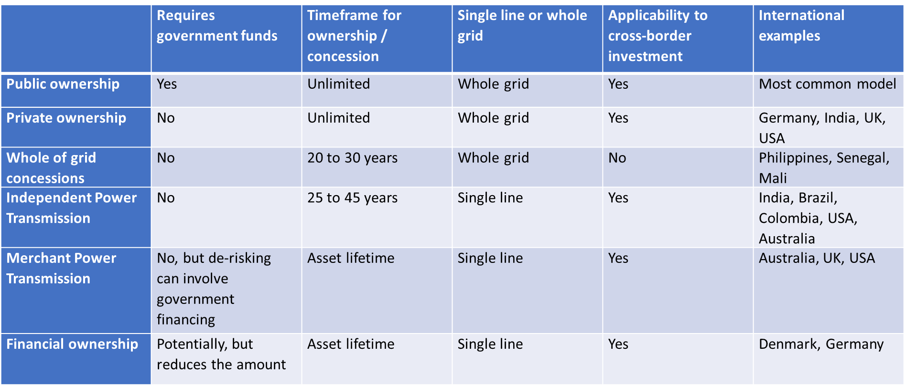
Overview of models

Slide 12
Driving forward connectivity in Central Asia
Specific historical context
  Legacy systems and assets
  Political will
Participation in wider efforts vs regional efforts
ESCAP EWG
What is useful in this region

