Slide 1
OICA Position Paper on new 02 Series of Amendments to UN Regulation No. 138
Submitted by the experts of OICA
Informal Document GRBP-79-44
79th GRBP, 06 – 09 February 2024
Agenda Item 6
GRBP/2024/02 and GRBP-79-34

Slide 2
Original Idea of TF QRTV shown in GRBP-79-06 Revised List of GRBP Priorities
STEP 1 at 79th GRBP (Feb. 2024):
STEP 2 at 83rd GRBP (Feb. 2026):
Review of UN-R138 for AVAS (technical, language, consistency, interpretation, operation range)
To be considered:
US FMVSS 141 & UN-R138 AVAS.
Review sound specifications & test conditions.
ISO 16254 Technical results expected
Ensure compatibility/ consistency between UN R138 and Draft UN R51.03 RD-ASEP
Ramp-up max. sound level curve under any driving condition to establish a handshake between UN R138 maximum sound and RD-ASEP of UN R51.
2nd step linked to RD-ASEP from UN R51.
GRBP
N° | Title | Tasks / Deliverables | References | Allocations / IWGs | Timeline | Chair/Initiator | Comments
Priority | Revision of UN-R138 -AVAS | Review of UN-R138 for AVAS (technical, language, consistency, interpretation, operation range) Ensure compatibility/ consistency between UN R138 and Draft UN R51.03 RD-ASEP Ramp-up max. sound level curve under any driving condition to establish a handshake between UN R138 maximum sound and RD-ASEP of UN R51. | UN-R138 Draft UN-R51-03 (including RD-ASEP) | TF QRTV | 1st step: GRBP-78 (Sept.2023): Informal doc. GRBP-79 (Jan./Feb.2024): Working doc. 2nd step: GRBP-82 (Sept.2025): Informal doc. GRBP-83 (Jan./Feb.2026): Working doc. | Chair: Germany Secretariat OICA | To be considered: - US FMVSS 141 & UN R138 AVAS. - Review sound specifications & test conditions. - ISO 16254 Technical results expected 2nd step linked to RD-ASEP from UN R51.

Slide 3
Work of TF Quiet Road Transport Vehicle Scope changed from Safety to Environmental
OICA is concerned that the initial concept for a 2-stage approach as agreed among all stake holders in TF-QRTV has been given up for going immediately to a new series of amendments.
We deem this step pre-mature, as the draft UN R138.02 raises more questions and open grey zones, rather that it helps to solve issues.
Considerations of safety have mainly been suppressed – changes are not sufficiently validated in that direction.
Other topics, such as uncertainty have been addressed, but it is still unclear, what could be the real improvement.
The biggest concern of OICA is about non-validated new definitions regarding the maximum sound level.
We see no need for such stringent cutting of AVAS sound
What is the environmental benefit? For societies' health? For “single vehicle annoyance”?
Source: TF-QRTV-10-03 OICA concerns on draft UNR138-02.pdf
Notes:
Requirement between the reported speeds, not all methods can be used for all requirements, natural sound definition
What are the benefits for safety

Slide 4
Output of TF Quiet Road Transport Vehicle Documents presented in 79th GRBP
GRBP/2024/2
Supporting Documents:
OICA understanding of agreed direction as of TF-QRTV #10:
Requirements when AVAS Sound shall be respectively, may be emitted.
Agreed AVAS Sound Limitations including additional microphone locations for demonstrating maximum sound level compliance.
Handshake to UN R51 defined
ISO proposals to improve that measurement results reflect pedestrian perception and reduces measurement variations. (supp. by GRBP-79-30)
GRBP-79-yy (OICA) OICA-review of the working document for inconsistencies and conflicts (not finished)
Technical clarifications to facilitate measurement of maximum sound.
review of document to ensure consistent use of fonts, text size, and symbols.
GRBP-78-10 & GRBP 79-43 (OICA) OICA agreed to bring proposals for including EV under UN R51.03 Annex 7 (Working Document expected for 80th GRBP)

Slide 5
Output of TF Quiet Road Transport Vehicle Documents presented in 79th GRBP
New Document GRBP-79-34
ISO proposals (GRBP-79-30) have been incorporated.
Agreed direction as of TF-QRTV #10 has been modified by some Contracting Parties only:
Handshake to UN R51 has been deleted.
New Requirements to limit and forbid any “non-natural” sound.
Document GRBP-79-34 - (TF QRTV) Proposal to amend ECE/TRANS/WP.29/GRBP/2024/2
was created by some Contracting Parties only without any input/attendance of NGOs.
brings back the concerns already expressed by OICA (TF-QRTV-10-03 OICA concerns on draft UNR138-02)
is therefore not an output of TF QRTV!

Slide 6
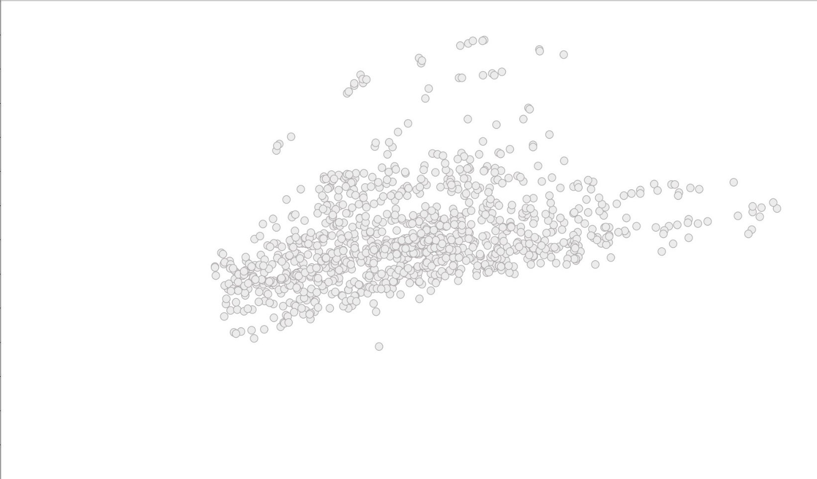
Classification of EV’s Sound Emission ASEP Database compared with EMISIA and TF QRTV Limits
ASEP Database shows a wide spread of vehicle sound emission during all driving conditions.
EMISIA-Study by EC confirmed: Sound pressure levels lower than or equal to 75 dB(A)* are no subject of concern!
Vehicle Sound Emission 2007
ASEP DB - IWG ASEP 2005-2010
* Regarding UN R51.03 Annex 7 at 7.5m distance in the control range of Annex 7

Slide 7
Classification of EV’s Sound Emission Electric vehicles have no need for stricter limits!
EVs are substantially below the quietest vehicle that have been used during the ASEP development work of the years 2005-2010.
Even when equipped with sound enhance-ment systems operating beyond the scope of UN R138.01
OICA sees no need for such stringent cutting of AVAS sound!
Vehicle Sound Emission 2007
ASEP DB - IWG ASEP 2005-2010
Test Data of only Electric Vehicles 2020-2023

Slide 8
Classification of the Sound Emission Maximum sound limits shall not jeopardize safe minimum sound!
“Safe Minimum Sound” (NHTSA scientific approach*) with a safety margin of 6 dB is just reached by cruising EVs.
Higher “Safe Minimum Sound” for accelerating EVs needed (see study Perception of electric vehicles with AVAS (udv.de) )
From 32 km/h proposed cutting of AVAS sound will jeopardize a “Safe Minimum Sound”
Vehicle Sound Emission 2007
ASEP DB - IWG ASEP 2005-2010
Test Data of only Electric Vehicles 2020-2023
* described in and published with the New Proposal for Rule Making (NPRM) Docket No. NHTSA-2011-0148, RIN 2127-AK93, presented by OICA in TF-QRTV-08-03

Slide 9
Alternative Concept for Electric Vehicles UN R51.03 Annex 7 ASEP provisions
OICA suggests to mandate for EVs fitted with sound enhancement systems compliance with UN R51.03 Annex 7 ASEP provisions (up to 80 km/h). GRBP-79-43
Vehicle Sound Emission 2007
ASEP DB - IWG ASEP 2005-2010
Test Data of only Electric Vehicles 2020-2023

Slide 10
Alternative Concept for Electric Vehicles UN R51.03 Annex 7 ASEP provisions
This provision will
connect and close any open area between UN R138 and UN R51.
avoid overlapping regulations for Hybrids.
sufficiently ensure, that EVs are designed to ensure a significant benefit.
welcome your comments for improvement and be presented as a working document to 80th GRBP in Sept. 2024.
ASEP Maximum SPL
AVAS Max. SPL
Safe Minimum SPL for acceleration
Safe Minimum SPL for cruise
Notes:
Green lines are shown in the control range
Tyres

Slide 11
What could be achieved with a bit more time for finding a solution acceptable to all stakeholders?
Moving to a new series 02 of UN R138 will have limited effect in Europe, if it is not introduced into EU Regulation 540/2014, since there is no delegated act for the EU Commission any more since 2019.
OICA proposal can be applied sooner by splitting safety and environment requirements with Supplement in each Regulation (UN R51 & UN R138).
Avoid regulatory conflict between safety and environmental aspects – sufficient margin between sound levels for UN R138 and UN R51.
Use in each discipline the required individual scientific approaches:
Safety sound levels are derived from considerations on audibility and recognition described by frequency bands and masking effects. This is addressed by UN R138 Annex 3, UN R28, UN R165, …
Environmental aspects are addressed by UN R51.03 Annex 3 (L_{eq} & health effects) and Annex 7 (annoyance).
Quality of documents will be improved:
Avoid overlapping of max sound level requirements for Hybrids from UN R138 and UN R51 Annex 7.
Exclude ambiguous definition “natural sound”. Replace them with performance-based requirements.
Consistently address whole vehicle sound, avoid requirements that cannot be proven in real life.
Check requirements regarding the support of upcoming/needed developments, e.g. AD vehicles, quieter tyres/roads, low budget EVs.
Notes:
Headline important, All the europeans are fighting for that, but no effect on market, big loopwhole is in EU540/2014

Slide 12
OICA’s Position Summary
Classification of EV’s sound emission
Sound pressure levels lower than or equal to 75 dB(A)* are no subject of concern (EMISIA Study, 2021).
EVs are substantially below the quietest vehicles (ASEP Database 2005-2010), even when equipped with sound enhancement systems beyond the scope of UN R138.01.
“Safe Minimum Sound”** with a margin of 6 dB is just reached by cruising EVs, while even higher level of “Safe Minimum Sound” for accelerating EVs is needed.
Proposals of GRBP-79-34 need more development:
Proposed cutting of AVAS sound above 32 km/h will preclude an improved “Safe Minimum Sound”**.
Proposed definition of “natural sound” prevents performance-based requirements, preferred by OICA.
Proposed requirements above 32 km/h
create overlapping regulations for Hybrids with potential conflicts.
need test-modes or indoor testing. OICA recommends compliance can be proven in real life.
ignore/hinder upcoming/needed developments, e.g. ADV, low-cost-EVs, etc.
* Regarding UN R51.03 Annex 7 at 7.5m distance
** based on NHTSA Scientific Approach

Slide 13
OICA’s Alternative Concept Summary
First step: Introduce Supplements that
address BEVs with extended* Sound Enhancement Systems by UN R51.03, Annex 7 (ASEP).
refrain from changes to requirements – limit values, speed range and new definitions of sound types.
clarify min./max. sound requirements as function of vehicle speed and operating conditions to UN R138.01 suggested by ISO, OICA, TF-QRTV, …
Second step: Mature the new series of amendments that
address environmental aspects through Annex 9 (RD-ASEP) of UN R51 (await analysis of the monitoring data).
secure/improve safety aspects through UN R138.
What’s the catch?
Industry would commit to accept the required Supplement to UN R51.03 with shorter transitional provisions.
Freeze improved technical requirements of UN R138.01 in the first step.
Develop a viable and feasible solution for EVs in cooperation with industry.
* “extended” means sound exceeding the mandatory operation range (RD-ASEP draft definition to be refined)

