Slide 1
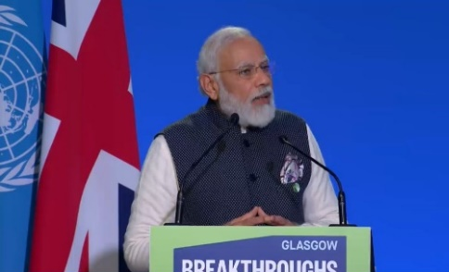
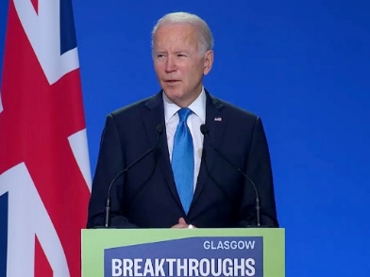
The Breakthrough Agenda
Informal Document WP.29-192-14
192nd session of WP.29, 5 – 8 March 2024
Agenda item 8.6.
The Breakthrough Agenda is a global framework to strengthen international collaboration
Through inclusive collaboration it aims to make clean technologies and sustainable solutions the most affordable, accessible and attractive option in key sectors and in all regions by 2030.
Launched by world leaders at COP26.
Led by developing and developed countries
Backed by 57 countries covering over 80% of global GDP
Reinforces & connects successive COP action agendas, (underpins many of the COP28 Presidency’s major announcements)
Engages and focuses the work of 100+ major international initiatives
Works across seven key sectors covering over 60% of global emissions.

Slide 2
What we do
The Breakthrough Agenda provides a global collaborative framework comprising three pillars: Commitments, an annual Process and a Service to the international community.
Commitments
Commitments from Breakthrough signatory countries to the Breakthrough Goals for 2030
Annual commitments from countries and key initiatives to support delivery of annual Priority Actions.
Annual Process
Prioritise: based on independent advice, building consensus on the top priority actions needed internationally in each sector, annually.
Coordinate: between initiatives and governments, and from COP to COP, reviewing collective efforts, aligning progress on priority actions and identifying ways to plug gaps.
Enhance: by convening decision-makers to crowd in efforts and funding behind the highest priorities
Track: through an annual cycle of independent tracking of progress against plans and towards goals, strengthening accountability.
Service
Assisting initiatives to more efficiently understand and connect with each other’s priorities and strengthen their outcomes.
Helping engaged countries prioritise and guide their engagements.
Helping countries wishing to engage more understand how and where to focus.
Helping climate leadership (e.g. COP Presidencies) understand and connect with the full landscape to inform choices on new or enhanced activities.

Slide 3
Tracking and accountability
The Breakthrough Agenda Report is a yearly report to track progress on how well international collaboration is being advanced to accelerate sectoral transitions
The 2023 report showed that current efforts on clean energy and sustainable solutions, while improving, are not yet delivering the levels of investment and deployment required to meet international climate goals. In response, it calls on governments to strengthen collaboration in key areas – such as standards and regulation, financial and technical assistance and market creation – to turbocharge the transition.
https://www.iea.org/reports/breakthrough-agenda-report-2023

Slide 4
Overview of the Breakthrough Agenda sectors​
Co-leads: Morocco and UK
Launched: COP26
Signatories: 36
Co-leads: India, US and UK
Launched: COP26
Signatories: 34
Co-leads: Germany and UK
Launched: COP26
Signatories: 31
Power
Clean power is the most affordable and reliable option for all countries to meet their power needs efficiently by 2030.
Road Transport
Zero emission vehicles are the new normal and accessible, affordable, and sustainable in all regions by 2030.
Steel
Near-zero emission steel is the preferred choice in global markets, with efficient use and near-zero emission steel production established and growing in every region by 2030.
Buildings (new)
Co-leads: US and UK
Launched: COP26
Signatories: 37
Hydrogen
Agriculture
Co-leads: Egypt and UK
Launched: COP26
Signatories: 17
Co-leads: France and Morocco
Launch: at COP28
Signatories: 28 confirmed
Affordable renewable and low carbon hydrogen is globally available by 2030.
Climate-resilient, sustainable agriculture is the most attractive and widely adopted option for farmers everywhere by 2030.
Make “near zero-emission and resilient buildings the new normal by 2030”
Co-leads: Canada and UAE
Launch: at COP28
Signatories: 5 confirmed
Cement
Make “near zero-emission and resilient buildings the new normal by 2030”
(new)

Slide 5
Countries who have endorsed the Road Transport Breakthrough Goal
Australia
Belgium
Cambodia
Canada
Denmark
Egypt
European Commission
Finland
France
Germany
Guinea Bissau
Holy See
India
Israel
Poland
Portugal
Korea
Serbia
Sweden
USA
UK
Italy
Japan
Kenya
Latvia
Lithuania
Luxembourg
Malta
Morocco
Namibia
Netherlands
New Zealand
Nigeria
Norway

Slide 6
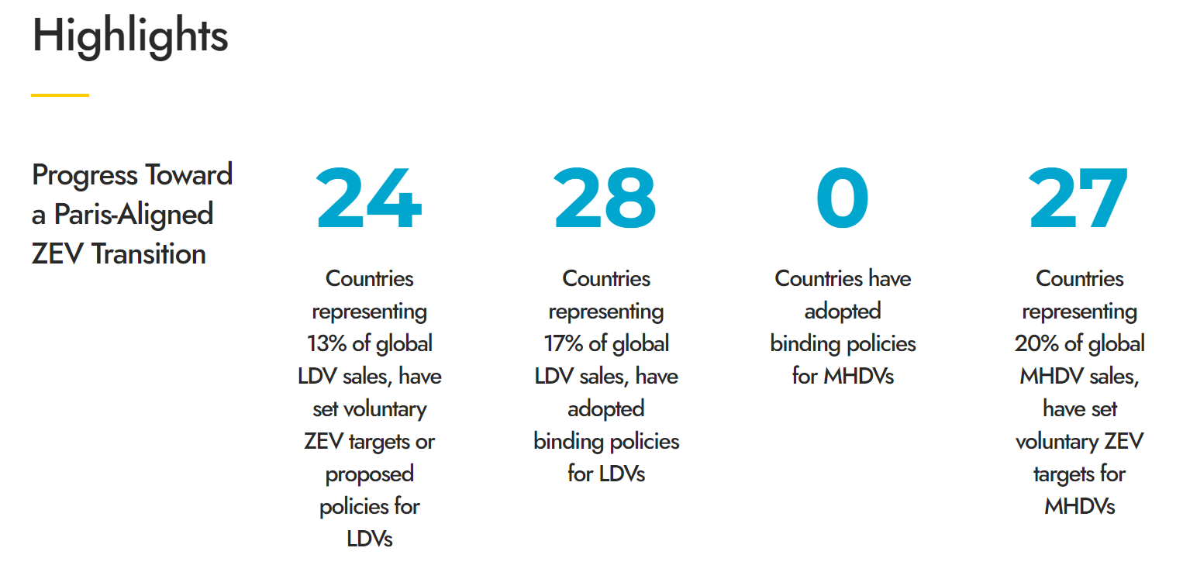
Priority Action delivery plan RT1. Demand Creation
Priority Action
Demand Creation / Long-term Vision / Market Structures: Work together to set and implement common and coordinated targets and measures that send an unequivocal collective global market signal in support of a Paris-aligned Zero Emission Vehicles (ZEV) transition, and review progress at COP29
How this will be taken forward
By countries, sub-nationals and businesses joining one or more of the following leading initiatives focused on sending global ZEV market signals consistent with the Paris Agreement’s goals, working together to implement action and grow their memberships, and review progress by COP29:
- Accelerating to Zero Coalition
- Global MoU on ZE-M/HDVs
- CEM Electric Vehicles Initiative
- EV100 & EV100+
- First Movers Coalition
By inviting the Accelerating to Zero Coalition, Global MoU and other partners to provide a report for COP29 on progress towards a global Paris-aligned ZEV transition in terms of both setting targets and implementation of those targets, and to include more information on all vehicle types.
Coordinating initiatives
Accelerating to Zero Coalition
Global MoU ZE-M/HDV
CEM EVI
The Climate Group (EV100 & EV100+)
First Movers Coalition
Fleet Electrification Coalition
Endorsing countries:
Australia
Azerbaijan
Cambodia
Canada
European Commission
France
Guinea Bissau
India
Netherlands
New Zealand
Norway
Panama
United Kingdom
United States

Slide 7
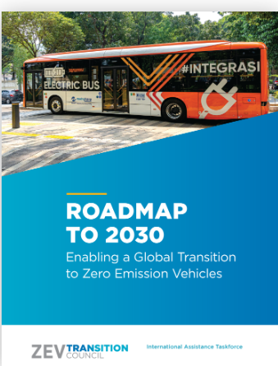
Priority Action delivery plan RT2. Finance and Investment
Priority Action
Launch a shared roadmap to significantly strengthen the overall offer of international technical assistance and finance available to support the ZEV transition of Emerging Markets and Developing Economies (EMDEs), and review progress at COP29.
How this will be taken forward
By launching the Global ZEV Transition Roadmap at COP28 to outline how the international community intends to strengthen international technical and financial support – including in areas related to the other four priority actions – to accelerate the transition to zero emission vehicles.
By reviewing progress under the Roadmap on an annual basis, with activities being informed by the ZEV Transition Council International Assistance Taskforce, including its recent report on EMDE Country needs.
Coordinating initiatives
International
Assistance Taskforce
(members include governments, UNEP, World Bank, FIA Foundation, ICCT, WBCSD, UC Davis and the Global Fuel Economy Initiative, and others).
Endorsing countries:
Cambodia
Canada
European Commission
Finland
Germany
Guinea Bissau
India
Lithuania
New Zealand
Norway
Panama
Republic of Korea
Sweden
United Kingdom
United States

Slide 8
Priority Action delivery plan RT3. Supply chains
Priority Action
Accelerate work to improve the sustainability of ZEV battery supply chains globally, by working together to establish a mechanism for countries and businesses to share best practice and knowledge, support implementation and explore opportunities to increase comparability of standards and policies by COP29.
How this will be taken forward
By inviting the Global Battery Alliance, with other leading expert organisations and initiatives, to launch recommendations across the public and private sector defining policy priorities to improve ZEV battery sustainability globally, continue to collaborate on those towards COP29.
By working with countries to explore opportunities to increase comparability of standards and policies, including by assessing the feasibility of a global harmonization of existing sustainable battery regulations at the World Forum for Harmonization of Vehicle Regulation (UNECE/WP.29).
Coordinating initiatives
Global Battery Alliance (GBA)
World Economic Forums (WEF)
Circular Cars Initiative (CCI)
United Nations Environment Programme (UNEP)
UNECE
The Environmental Collaboratory at Drexel University, amongst others as/where relevant
Endorsing countries:
Australia
Cambodia
Canada
European Commission
Finland
France
Germany
Guinea Bissau
India
Ireland
Japan
Netherlands
New Zealand
Norway
Panama
Republic of Korea
Sweden
United Kingdom
United States

Slide 9
Priority Action delivery plan RT4. Infrastructure
Priority Action
Infrastructure: Accelerate the development and deployment of ZEV infrastructure globally by working together to establish a mechanism for sharing best practice, knowledge and supporting implementation by countries and businesses at national and regional levels by COP29.
How this will be taken forward
By countries working with the coordinating and partner initiatives to continue to establish a specialist best practice sharing and coordination mechanism on ZEV infrastructure to support policy implementation. This includes providing insights on long-term ZEV infrastructure needs and exploring the development of new standardised tools and products to support ZEV infrastructure planning and modelling at different levels, including recommendations on how to scale technical and financial assistance.
By, countries continuing to engage actively in ongoing international discussions, support vehicles manufacturer discussions on the alignment of charging types and invite partner initiatives as part of the above to review progress in the development of international standards for vehicle charging types by COP29.
By countries strengthening engagement with the private sector, including fleet operators and infrastructure investors, to optimize planning and infrastructure investment through mapping infrastructure needs.
Coordinating initiatives
Endorsing countries:
Australia
Azerbaijan
Cambodia
Canada
European Commission
Finland
Germany
Guinea Bissau
India
Ireland
Japan
Lithuania
New Zealand
Norway
Panama
Republic of Korea
Sweden
United Kingdom
United States

Slide 10
Priority Action delivery plan RT5. Trade Conditions
Priority Action
Enable dialogue with a coalition of importer and exporter countries to seek to increase comparability of quality standards and policies for used Internal Combustion Engine (ICE) vehicles and engagements to support the international trade of second-hand ZEVs, and publish forward plans.
How this will be taken forward
By countries working with existing multilateral organisations and initiatives, such as such as UNEP (amongst others) and the UNECE WP.29 working group on Safer and Cleaner Used and New Vehicles, to continue to convene and develop strategies to define and evaluate quality standards and ensure publicly accessible databases are available for tracking cross-border used vehicle trade.
Coordinating initiatives
UNEP, ITF, UNECE and WEF CCI, amongst others as/where relevant
Endorsing countries:
Azerbaijan
Cambodia
Canada
European Commission
Finland
Germany
Guinea Bissau
India
Japan
Lithuania
Netherlands
New Zealand
Norway
Panama
Republic of Korea
Sweden
United Kingdom
United States

