Slide 1
Commission report of DAP according to new GB standard
Informal document GRE-90-41
90th GRE, 29 Apri-3 May 2024
agenda item 7(b)
Submitted by the expert from China

Slide 2
Document background: China market show high interest on new technology DAP, OEMs have varies of ideas on headlamp projection, the new GB standard is going to take effect soon, DAP will be allowed and expected a rapid growth of integration; this documents was prepared to parallel information with all experts in time, to have your ideas on DAP function test/verification procedure, and also the use of symbols/patterns.
Copyright [30.04.2024] [LAI Lan], all rights reserved. For reproduction permission and all other issues, please contact [lailan@huawei.com].

Slide 3
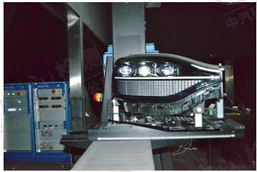
Information of Commission report
LB/HB module
Pixel module
Sample information: 1 set of headlamps integrated with LB/HB module + pixel module
Content of report: to check if the driver assistant projections can fulfill the new GB headlamp device standard 《汽车道路照明装置及系统》报批稿；
Steps：commission report → function development → certification report under new GB → functional release to vehicle
Notes:
To have your idea about if we are doing in the correct way;

Slide 4
Projected symbols/patterns and their conditions -1
Projection of left headlamp
Projection of right headlamp
Symbol 1: driving speed limit warning, projection activate when vehicle speed exceed road limits;
Symbol 2: lane departure warning, projection activate when detected vehicle unintended leaving its lane;
Symbol 3: auto driving notice, projection activate when automatic/autonomous driving is working;

Slide 5
Projected symbols/patterns and their conditions -2
Projection of left headlamp
Projection of right headlamp
Symbol 4: right turning notice, projection activate when navigation system giving right turn message;
Right corner, left projection
Right corner, right projection
Pattern 5: predicted trajectory light, transforming according to the predicted trajectory of the vehicle.
Check corner cases of predicted trajectory when photometry test.
Left corner, left projection
Left corner, right projection

Slide 6
Check photometric performance for headlamps with DAP
Photometry test：for left headlamp，LB module on + pixel module on, check photometry value according to the new GB standard draft for approval 8.2.9; same process for the right headlamp;
Width limit on road: supplier provide document to show if the function can fulfill 5.5.4.

Slide 7
THANK YOU.

