Slide 1
Welcome to this national training workshop on
Sustainable Forest Management for Greener Economies
Introductions
Pair up with someone you do not know, or do not know so well.
Spend 5 minutes getting to know each others’;
  Name,
  Organisational background,
  Expertise/experience related to forestry ,
  One sentence to describe their expectations for this training workshop.
  After 5 minutes you will be asked to introduce the other person within a period of 30 seconds maximum. Please listen well, you may want to take some notes.

Slide 2
Rules and norms for the training workshop
1. Please take part but do not dominate - provide opportunity for the quieter people to take part especially in group work.
2. A sheet is provided for continuous feedback – for what you like and don’t like about the training workshop.
3. ‘Parking lot’ sheet where arguments that become circular or block progress in the training workshop will be placed.
4. Please try to avoid too many acronyms and always explain the acronym the first time you use it.
5. No laptops switched on during the sessions, only during breaks please and please switch off/put mobile phones on silent .
6. Come on time for all sessions.
7. Give people a round of applause if their mobile phone rings or they come late!!
Notes:
The aim would be to have no desks in front of people to avoid the temptation of using their lap tops. Also encourages people to engage and pay attention more

Slide 3
Continuous feedback and road block issues sheets.
What I like☺
What I don’t like☹
Parking lot issues
Notes:
BIG SHEET PREPARATION: ALL HEADINGS MUST BE VISIBLE FROM OTHER SIDE OF ROOM – AROUND FONT 100 OR SO, BUT USE YOUR DESCRETION. USE GLUE STICK TO STICK HEADINGS TO BIG SHEETS. What I like sheets what I don’t like should be the size of 2 flip charts each. Parking lot issues about the size of 3 flip charts.

Slide 4
Handing over responsibilities for key tasks
Responsible teams. Teams will rotate/change every day
1. Time keeping team: Task - They keep strict time using time cards – must clarify with the facilitator and other presenters how long presentations and exercises will take and ensure that they stick to the agreed times. If we finish late – this is the team to blame!
2. Helping and social team: Task – Helping facilitator with materials and keeping people energized with some sort of activity/exercise if they get tired. If anyone falls asleep, this is the team to blame!
3. Lesson team: Task – Documenting what are the key approaches/methods/insights from the workshop that are relevant to the development of a forestry strategy for the green economy. I would suggest that this team meets at the end of the day to prepare their short presentation for the following morning on a flip chart.

Slide 5
Handing over responsibilities for key tasks
Responsible teams – will rotate every day
Time keeping team | 1.
Helping and social team | 2.
Training Lessons team | 3.
Notes:
BIG SHEET PREPARATION: Prepare the three team headings each on a piece of A4 paper, stick them to a flip chart. On the ride side using masking tape( so can be removable) stick 3 A4 sheets with the numbers 1,2 and 3. In addition to go along with this, prepare a set of time cards. Each one should be A4 size, with the following 20 MINUTES, 10 MINUTES, 5 MINUTES, 3 MINUTES, 2 MINUTES, 1 MINUTES, STOP!!( ideally on red paper or writing). QUIET PLEASE.
Participants will be divided into the three teams, either by counting 1,2,3 or dividing countries up. Will rotate each day.

Slide 6
Tentative timings
Start - sharp: 9.00
Break: 10.30 - 11.00
Lunch: 12.30 -13.30
Break: 15.00 - 15.30
Close: 18.00
Please note due to the participatory nature of the workshop flexibility will be required☺
Notes:
BIG SHEET GUIDE: to be prepared clearly on one flip chart.
To be adjusted in discussion with venue and participants to local norms.

Slide 7
Sustainable Forest Management for Greener Economies
Why an initiative on this topic of forestry for a Green Economy?
Globally governments have increased the pace of change towards more sustainable development through policies for greener economies.
Forestry is not fulfilling its potential to meet Green Economy principles in the Caucasus and Central Asian Region(CCA).
With reform Sustainable Forestry Management (SFM) can deliver a full range of interconnected economic, social and ecological benefits on a sustainable basis, perfectly in line with green economy principles – maybe more so than any other sector.
This initiative is designed to assist countries fully unlock this potential through advisory and capacity development support.
A key expected outcome of the initiative is support to develop or enhance a forestry strategy/plan for the green economy.

Slide 8
Objectives and of this training
Objectives for the national training workshop
To enable key decision makers to analyse the challenges and opportunities with regards to promoting Sustainable Forest Management for Greener Economies and apply and adapt any relevant lessons from the training.
Components of the training workshop
To examine;
    Principles of Sustainable Forest Management for Greener Economies.
    Forestry context analysis, data gathering and management
    Wood energy production and efficiency
    Effective stakeholder engagement and negotiation methods
    Enhanced forest policy processes for Greener Economies

Slide 9
Purpose of initiative –analysis and identifying ways to bridge the gap between green economy principles and potential of sustainable forestry
Green
economy/
Sustainable
development
strategies
Sustainable
forest
management
potential
Analysis of gap and identifying potential linkages

Slide 10
Process of the initiative to develop an analysis- scoping paper on linkages between forestry and the green economy
Outcome: Analysis- scoping paper and process documentation
Communication and participation throughout
(1 participatory workshop) Drafting and review of analysis paper. Putting together the analysis in coherent paper.
(3 participatory regional workshops) Analysis –Analysis and data gathering with stakeholder to identify gaps and potential linkages
(National Workshop) Preparing and planning. National workshop, understanding principles, skills and methods for participatory analysis

Slide 11
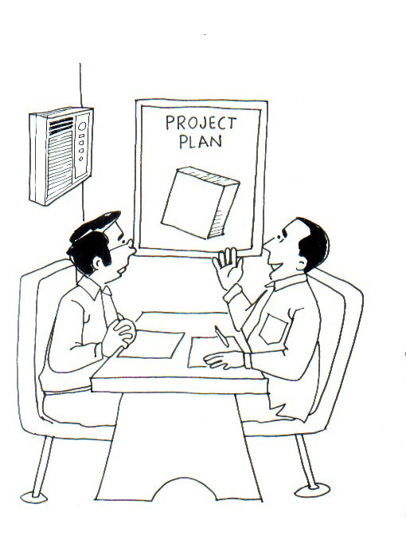
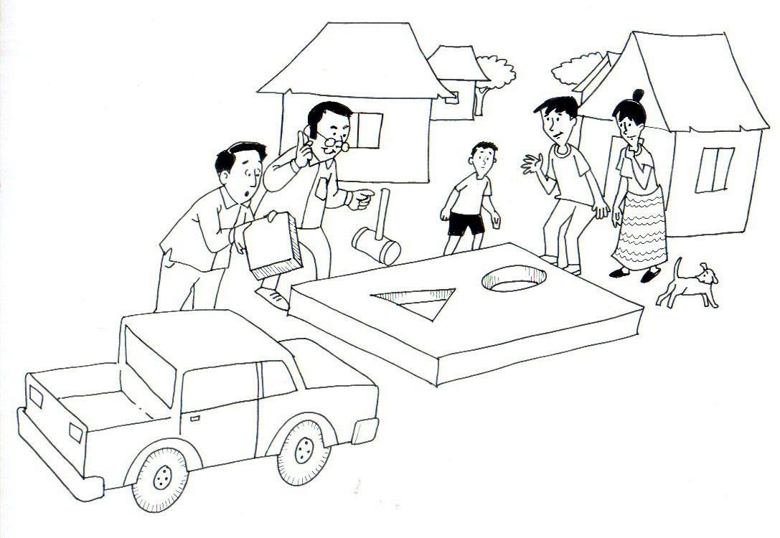
Why stakeholder engagement so important?
Why didn’t they ask us our opinions first
Nice plan boss.
This is the green economy action plan our country needs, now lets implement.
The plan doesn’t fit the realities on the ground, what do we do now?
Green economy plan
Planning based on office assumption
Stakeholder realities

Slide 12
Expected outcomes of this training workshop
    Enhanced understanding of how to practically unlock the potential of forestry to fully meet green economy principles
    To be familiarized with participatory skills and methods necessary to conduct a gap analysis between green economy principles and forestry.

Slide 13
Training flow and structure – where are we?
Components of the training | Content-topics of the training
Intro to the training SFM and green economy principles
Review and analysis skills and methods. Spotlight on data gathering and analysis
Spotlight on wood energy Policy priority negotiation Policy drafting and review
Planning the process and methods for forestry plan/strategy for the green economy development. Training evaluation
Preliminaries and principles
Review and analysis
Policy development
Outcome: Improved understanding and skills

Slide 14
Approach of the training
Facilitated expert workshop approach.
Emphasis on sharing among experts not a teacher/pupil training. The vast expertise of all participants will be respected and harnessed in this workshop – this is not a teacher/pupil type training but an expert workshop.
Guidance not prescriptions. This workshop will provide some ideas and guidance, but no prescriptions will be made for the forest sectors in your countries, application/adaptation is determined by country contexts.
Focus on interaction. A balance has been sought in the training workshop to mix lectures with exercises. We will try to avoid overloading with information and provide opportunity for analysis and maximising interaction and cross country sharing.

Slide 15
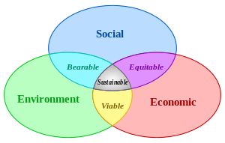
Session 2. Key principles of Sustainable Forest Management for Greener Economies.
Definition of sustainable development.
“development that
meets the needs of the present without compromising the ability of future generations to meet their needs”.
Brundtland Commission of the United Nations on March 20, 1987
Realisation of the interconnectedness of social, environmental and economic factors in delivering more sustainable economies.

Slide 16
Many countries around the world have committed to moving towards the goal of sustainable development. The means – the way to achieve sustainable development is increasingly referred to as a ‘Green Economy’ or ‘Green Growth’.
Goal: Sustainable Development
Means: Green Economy
Component:
E.g. Promoting Sustainable forest management
Component: E.g. Promoting renewable technologies
Component E.g. consumer/
citizen education on environment.
Although it is an open ended concept with many different definitions and national refinements, the most widely quoted definition of a Green Economy is the following...
‘ The Green Economy is one that results in improved human well‐being and social equity, while significantly reducing environmental risks and ecological scarcities. It is low carbon, resource efficient, and socially inclusive’
(UNEP 2011).
Notes:
List of links to reference materials on the green economy will be provided for all participants in the handouts.

Slide 17
Sustainable Forest Management is seen as one important pathway that can contribute to a Green Economy in the following ways
Vision of Green Economy: low carbon, resource efficient and socially inclusive.
Sustainable production and consumption of forest products
A low carbon
forest sector, minimizing use of non renewable resources
Decent green
Jobs/
livelihoods in the
forest sector
Long term provision of forest ecosystem services – ecological functions
Cross cutting: Policy development and monitoring of the forest sector in relation to a green economy
Note to only see this as a general generic guide to be modified depending on context.
Notes:
BIG SHEET: This must be prepared on about 2 to 3 flip charts with the text boxes each at least A4 size, ensure arrows are included.

Slide 18
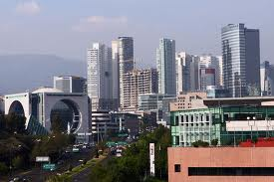
How sustainable forest management fits perfectly within green economy and sustainable development principles
Shift to Greener Economy
MORE SUSTAINABLE DEVELOPMENT THROUGH GREENING ECONOMIES e.g. more reliance on renewable energy from sources such as sustainably managed forests
UNSUSTINABLE DEVELOPMENT:
e.g. Reliance on non-renewable energy such as oil and gas
Development is based on resource depletion as population and economies grow
There can be development based on a sustainable off-take without diminishing the resource

Slide 19
Sustainable Forest Management is of key importance to sustainable development
Forest goods directly support the economic livelihoods and needs, including energy needs of over 2 billion people.
Public goods and services derived from forest ecosystems have substantial economic value estimated in the trillions of dollars
Forests sustain more than 50 per cent of
terrestrial species, they regulate global climate through carbon storage and protect watersheds.
Most important source of renewable energy globally, especially for the world’s poorer people.
The Rio+20 Outcome Document (UN
2012, paragraph 52) acknowledges that:
“…the wide range of products and services that forests provide creates opportunities to address many of the most pressing sustainable development challenges.
We call for enhanced efforts to achieve the sustainable management of forests’’

Slide 20
Example interconnected building blocks of sustainable forest management – as with sustainable development key foundations are social, economic and ecological.
Social
Participation and social justice
Tenure and use right security
Good governance
Economic
Efficient and productive forest sector promoting and optimising production of renewable materials and wood energy
Forests ‘paying their way’ through multi-functional use and services.
Decent livelihoods and income for forestry employees and forest dependent people
Ecological
Health and resilience of forest ecosystem maintained in the long term.
Climate mitigation and adaptation roles optimized.
Sustainable forest management
Notes:
BIG SHEET: This should be prepared on about two flip chart size. Text large enough to see from a distance.

Slide 21
Definition of sustainable forest management –
Definition of Sustainable forest Management:
Sustainable forest management is the stewardship and use of forests and forest lands in a way, and at a rate, that maintains their biological diversity, productivity, regeneration capacity, vitality and their potential to fulfil, now and in the future, relevant ecological, economic and social functions, at local, national and global levels, and that does not cause damage on other ecosystems. FAO, 2000
Like green economy no definitive definition but there is agreement on some of the key principles and on the need to consider ecological, social and economic factors.

Slide 22
Key ways how to release potential of forestry for a green economy ( gleaned from a literature review)
Getting the legal and procedural foundations in place:
Forestry is a long term investment and thus people require asset security.
Secure long term tenure and user rights.
People have little incentive to protect and maintain government controlled forest.
Putting in place a supportive enabling environment that makes forestry attractive.
Moving away from disabling governance environments that often indirectly encourage illegality to an enabling governance environment that encourages sustainable forest management and legal use.
Make long term sustainable forest management attractive to individuals and private enterprises, streamline bureaucracy, procedures and transaction costs.
Monitoring and control of forest management is important but must be done in a user friendly and constructive way.

Slide 23
Key ways how to release potential of forestry for a green economy
Helping forests pay their way:
Use forests sustainably or lose them completely.
The biggest threat to forests is clearance and conversion to more profitable land uses.
The biggest threat is not forest use in itself especially if tenure is secure.
Therefore it is essential to work harder at releasing the full financial potential of sustainable forest management, the full and wide range of products and services to help forests compete better with other land uses and be a more attractive investment for people and enterprises.
Support forest based enterprise development.

Slide 24
Key ways how to release potential of forestry for a green economy
Challenging and changing mindsets to see forest resources as sources of green- carbon friendly renewable materials and energy:
Sustainable forest use can be carbon neutral or negative:
A growing tree captures carbon in its trunk, branches and soil.
Sustainably managed forest where growth and productivity are encouraged can produce a sustained offtake of materials and wood fuel that releases less carbon into the atmosphere than it captures, thus having a negative carbon footprint.
A managed and used forest which promotes more growth, can capture more carbon than a stagnant unmanaged and unused forest.

Slide 25
Key ways how to release potential of forestry for a green economy
Promote sustainable timber.
Promote sustainably produced timber as a preferable alternative to non-renewable and high carbon footprint materials like concrete, steel and plastic.
Carbon is not only captured in the growth of the wood, but kept in the wood itself when used in products.

Slide 26
Key ways how to release potential of forestry for a green economy
Promote sustainable wood fuel as an opportunity, don’t see it as only a threat
Promote sustainably produced wood fuel which is much more carbon friendly than natural gas and also potentially more carbon friendly than other so called renewable energies like hydro.
Sustainable wood fuel may be the only true carbon negative energy source as its production in growing captures more carbon than is released in burning – especially if wood for energy is a by-product of timber production.
Sustainable wood fuel should be equally promoted and rewarded in tax regimes etc. as other renewable energies.
Challenge the widespread assumption that wood use is a major cause of deforestation, and instead promote its development within sustainable forest management as a way to make forestry more attractive and provide locally available ‘green’ energy source and incomes.

Slide 27
Key ways how to release potential of forestry for a green economy
Climate finance for forests.
Climate finance can be sought for afforestation and reforestation through the Clean Development Mechanism (CDM) which is an obligation for countries under the Kyoto Protocol.
Climate finance can be sought for maintaining natural forest through Reduced Emissions from avoided Deforestation and Degradation (REDD+).
Note of caution: Climate finance should only ever been seen as an extra, a complement to the previous actions that provide incentives for sustainable forest management that are within the control of the nation.
If climate finance does not come or stops it is important that there are other incentives to manage the forests to fall back on.

Slide 28
Key ways how to release potential of forestry for a green economy
Raising profile of forests as fitting green economy principles best.
Forestry, if its full potential as a renewable resource is released through sustainable forest management can tick all key green economy principles...
Carbon
Social
Economy
Ecology and climate
What other sector can offer so many of the principles?
Why is forestry often neglected in green economies and green growth strategies?

