Slide 1
Agenda for Day 2 afternoon
Afternoon.
III. Policy development
Spotlight on wood energy, practice and policy. Presentation, Questions and Answers.
Rationale and key principles of forest policy priority multi-stakeholder negotiations. Presentation.
Practical exercise. Multi-stakeholder role play on policy priorities negotiation – topic of wood energy.

Slide 2
Training flow and structure – where are we?
Components of the training | Content-topics of the training
Intro to the training SFM and green economy principles
Review and analysis skills and methods. Spotlight on data gathering and analysis
Spotlight on wood energy Policy priority negotiation Policy drafting and review
Planning the process and methods for forestry plan/strategy for the green economy development. Training evaluation
Preliminaries and principles
Review and analysis
Policy development
Outcome: Improved understanding and skills

Slide 3


Wood Energy for Greener Economies in the Caucasus and Central Asia Region
Francisco X Aguilar
Associate Professor
Department of Forestry
University of Missouri, USA

Slide 4
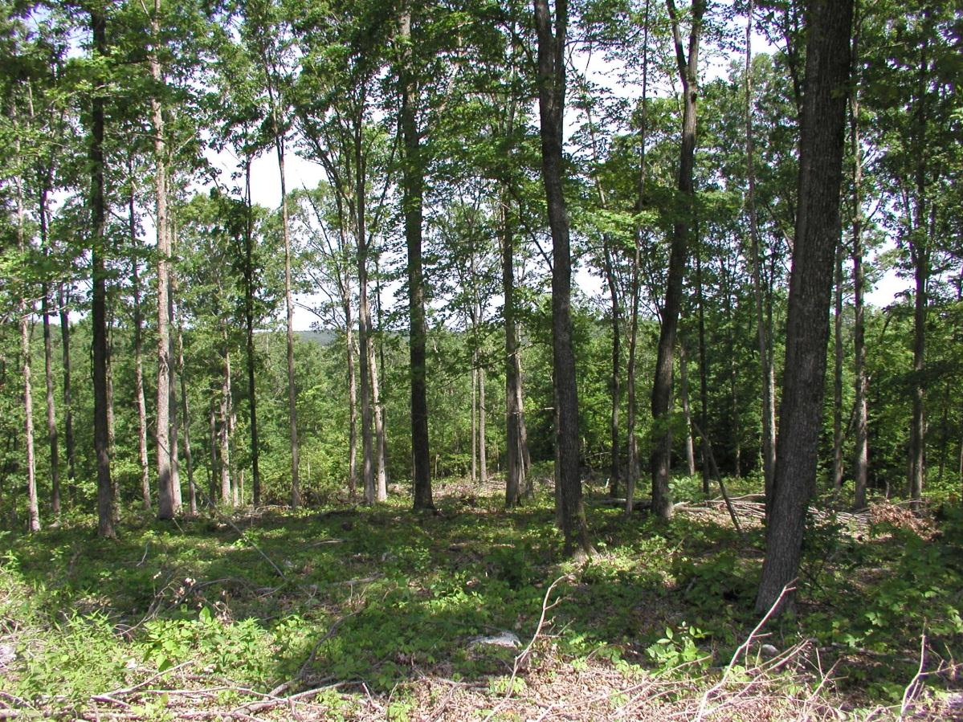
Wood Energy in the Green Economy
Forest Products
Food
Fiber, fodder
Energy
Timber
Ecosystem Services
Soil conservation
Carbon sequestration
Flooding control
Temperature control
Shelter
Watershed protection
Wildlife habitat, etc…
Wood Energy: Potential for local generation of carbon-neutral* energy while promoting better forest management
* If Sustainable Forest Management is respected

Slide 5
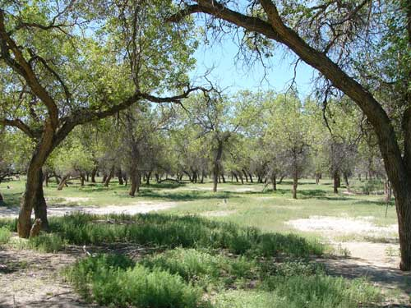

Wood Energy
Renewable energy generated from
  Co-products of forest management (deadwood, branches, tops)
  By-products from wood utilized for higher-value products
Not high-value logs!

Slide 6
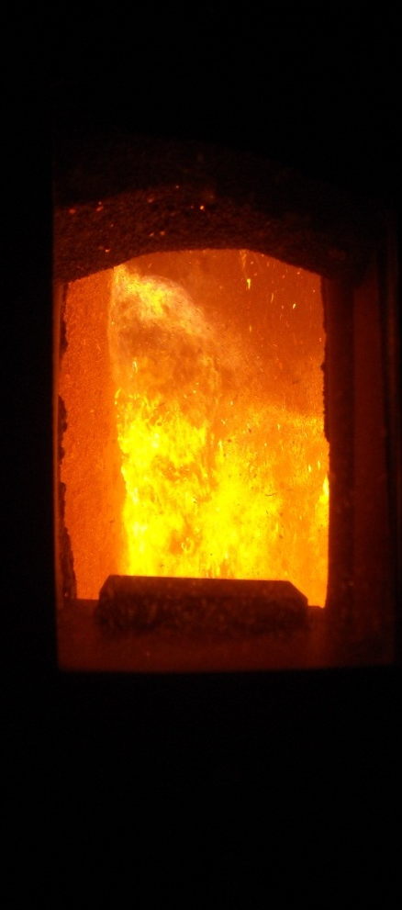
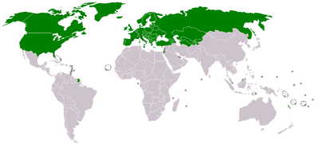
Wood Energy in the Green Economy
At national level, forests provide the largest share of renewable energy in the ECE region
Wood energy renewable only when sustainable forest management is maintained
Wood energy integral to sustainable livelihoods: rural families in particular
Source: UNECE/FAO Joint Wood Energy Enquiry
* among responding countries
Notes:
Important to mention that ECE/FAO estimates from the JWEE are considered to be conservative
JWEE results based on responding countries only.
Wood energy is the most important renewable energy source in developed countries like Sweden, Finland, the USA!

Slide 7
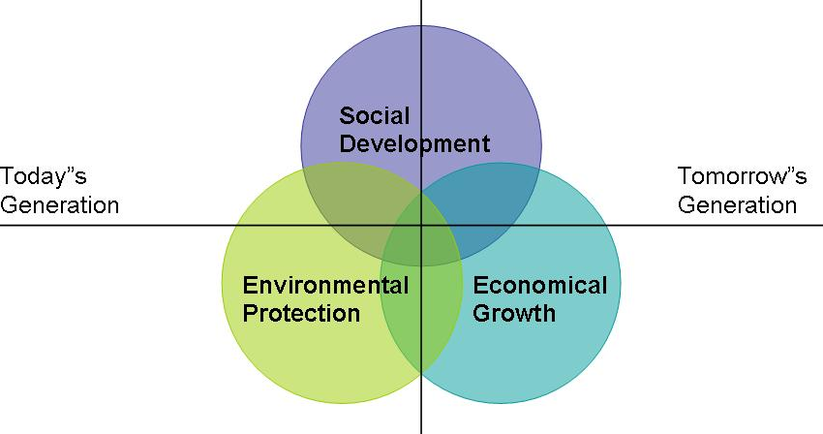
Wood Energy in a Green Economy:
Sustainable Resource Management
Socially acceptable: used to meet cooking and heating demand
Economically feasible: low-cost technology, with national economic development goals
Environmentally sound: Incorporated within sustainable forest management principles
Brundtland Commission (1987)
Notes:
http://www.unngocsd.org/CSD_Definitions%20SD.htm

Slide 8
Socially Acceptable:
Wood Energy for Food Security
Needed of cooking of foods, water boiling
Wood used to meet some 90% of energy needs of rural households
Wood energy provides for necessary cooking (and heating) needs at a low cost!

Slide 9
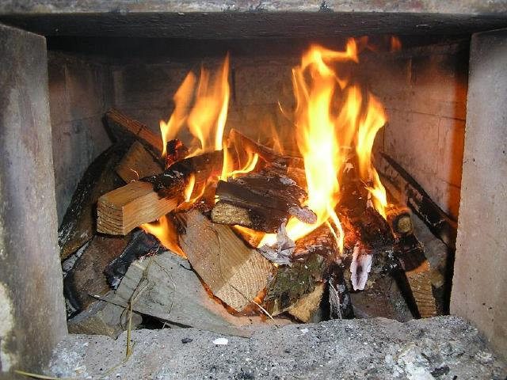
Economically Feasible
Use of low-cost, low-technology systems
No need for complex and expensive infrastructure (e.g. infrastructure to provide natural gas/propane).
Promote higher-value wood products; generate woody co-products for energy

Slide 10
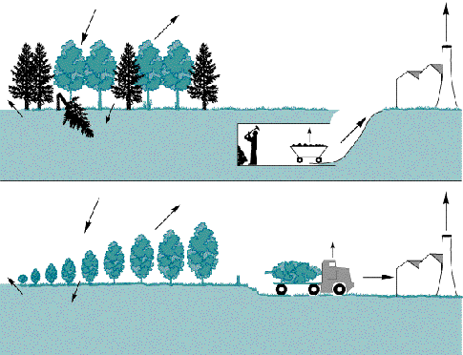
Environmentally Sound
Renewable, low-carbon/carbon neutral option
Reduces dependence on fossil fuels
Maximizes environmental value of products
Extractive: Mining fossil fuels (e.g. coal) release carbon that has been stored for thousands of years, with no recapture
versus
Sustainable forest management: Provide high-value timber products; carbon released during management and wood energy combustion is recycled back
Adapted from: http://web.ornl.gov/info/ornlreview/rev28_2/text/bio.htm
Notes:
http://continuingeducation.construction.com/article_print.php?L=221&C=823

Slide 11

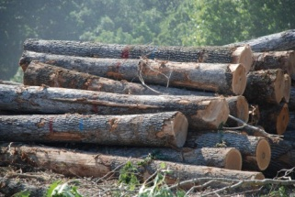
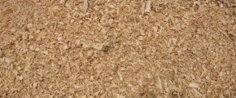
Maintaining Carbon in Growing Stocks and Products
Growth
Growth
Growth
Harvest
Harvest
Harvest
Carbon retained in solid wood products
CO₂
CO₂
By-products
CO₂
By-products
By-products

Slide 12
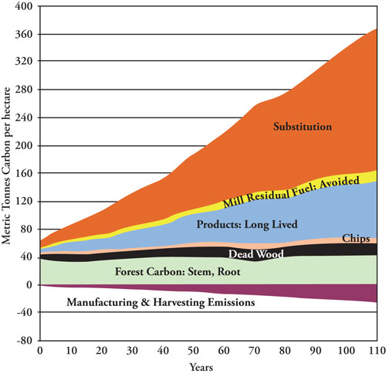
Source: McGraw Hill Construction
Notes:
Sustainable forest management by continuing growing trees, keeping carbon stored in “long lived” products can result in a net benefit in the reduction of emissions. Emissions from wood energy are captured back in biomass closing a loop.
http://continuingeducation.construction.com/article_print.php?L=221&C=823

Slide 13
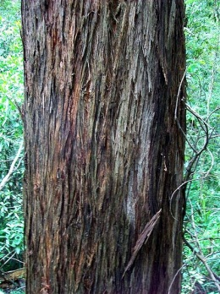
Use of firewood can have GHG emission reduction benefits
kg of CO₂ per kWh produced from different sources
Forest figures are from studies of
carbon capture through tree growth versus release due to
collecting and burning firewood in normal examples –
not perfect examples of sustainable forest management
Note that ‘renewable energy’ not carbon neutral!
(Source National Renewable Energy Laboratory)
Solar energy
Wind energy
Adapted from: Paul et al. (2003)
Notes:
Wood energy can provide significant improvements over the use of fossil fuels for energy generation. Compared to fossil fuels such as coal or heating oil the gains are major.
This case compares CO2 emissions per kWh for selected fossil fuels and woody biomass. Woody biomass sources include woodlands, (sparsely trees where woody biomass is harvested for energy), native forests and Eucalyptus plantations. This case illustrates the net benefits of wood energy uses.
Although a direct comparison is not possible due to differences in assumptions, data from the US National Renewable Energy Laboratory show that other renewables are not carbon neutral!

Slide 14
Public Policy Reform:
Wood Energy in a Green Economy in the CCA region

Slide 15
Public Policy Framework: Wood Energy
Forest Policy
Promote use of sustainable wood energy in a green economy
Strategy
Education, monetary incentives and regulatory approach for (a) land management (b) wood utilization, (c) energy conversion
Law:
Usufruct rights, community management, land leasing, establish market incentives for microloans, investments
Institutions
Forest, Energy, Economic Development Sector Agencies
Action Plan
Operational planning
The solid lines/arrows mean ‘to guide and implement policy’ (They are not hierarchical.)
The dotted lines/arrows mean a (cyclical) interaction or influence
[Adapted from: FAO (2010)]
Notes:
Forest policy: Integrated wood energy as part of a green economy agenda that fits sustainable development objectives.
Strategy: Promote professional forest management education for integrated resources (e.g. high-value timber products and energy), create tax incentives and reduce bureaucracy to promote better forest management. Motivate private sector involvement on land management. Reduce incentives for illegal deforestation, promote education on effective wood utilization and energy conversion.
Legal systems may need to be reformed. Tenure, and the ability to profit from land management are important to create incentives for sustainable management.
Institutions have to be strengthened in order to effectively deliver education programs, promote economic development, curtail corruption.

Slide 16
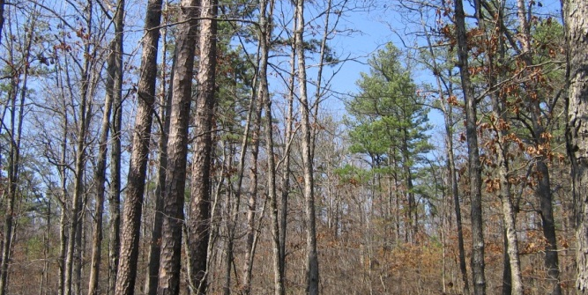
Public Policy for a Green Economy: Comprehensive Agenda
Support green economic development
Promote Sustainable Forest Management
Maximize carbon emissions reduction capacity
Minimize particle pollution from combustion
Strengthen energy security, diversification and low-cost heating/cooking systems

Slide 17
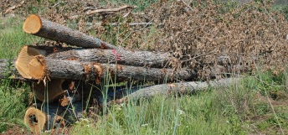
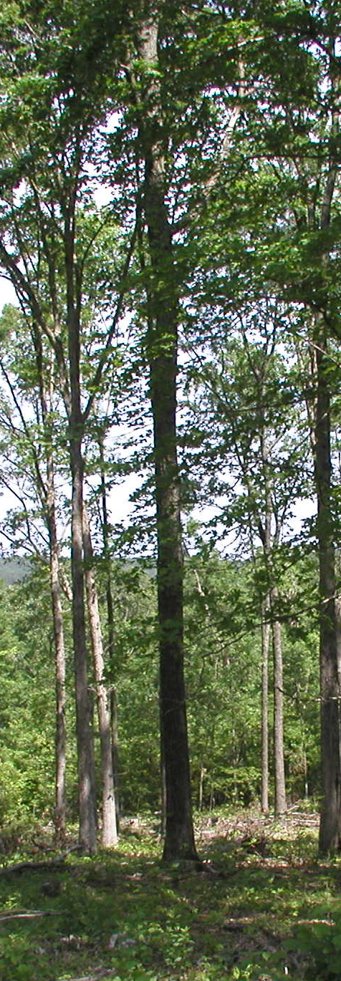
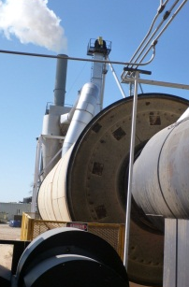
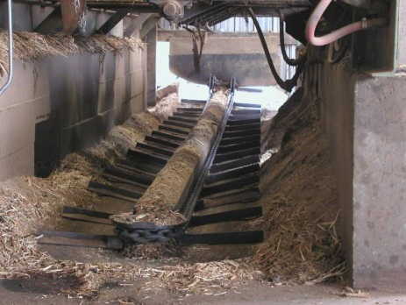
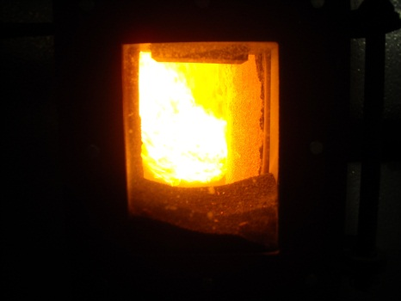
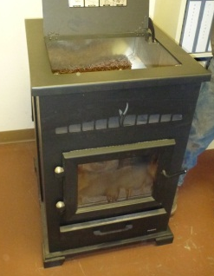
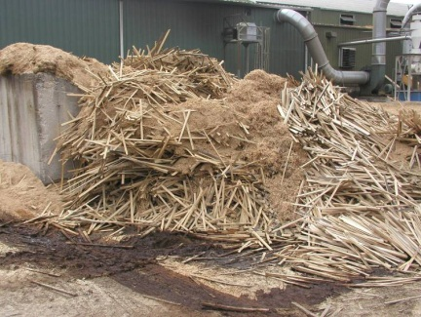
Public Policy: Wood Energy Web
Energy conversion& utilization
Supply chain
Forest management
Logging co-products (tops, branches, stumps)
Direct
Indirect
Wood product industry by-products (slabs, sawdust, chips)
Recovered
Opportunities for economic growth – need for reform
Notes:
Direct: Fuelwood from forestlands (branches and deadwood) and other sources such as hedgerows, gardens and orchards (pruning/shells)Logging co-products; Removal of excess biomass (fuel treatments, thinnings);
Indirect: Primary and secondary wood processing mill co-product and pulping liquors
Recovered: Urban wood residues
Dedicated: Short-rotation coppice plantations
Reform on forest management through education and reform of land uses (eg. Education of forestry professionals, adjustment of property rights such as leases and usufruct rights) is necessary. If the private sector is allowed to manage forest resources and promotes investment it can readily benefit the supply of high-value timber products and the generation of by-products for energy (e.g. slabs, sawdust, chips, branches and other residues).

Slide 18

Need for Policy Reform and Change
Households: Incentives for long-term management, maximize resource use, energy security
Land tenure: Legalize access & management for long-term planning and investment
Institutions: Need for shifts in paradigm, educate managers, evaluate existing disincentives such as define all forests as protected areas

Slide 19
Tools for reform: Land Management
Re-define land tenure, assign user rights to promote long-term land management
Define areas open and those off-limits for wood utilization (e.g. based on soil maps, strict conservation areas)
Pilot multi-purposed woody crops for increased productivity.
Strategies to maximize uses: combine wood structural (construction) and energy uses

Slide 20
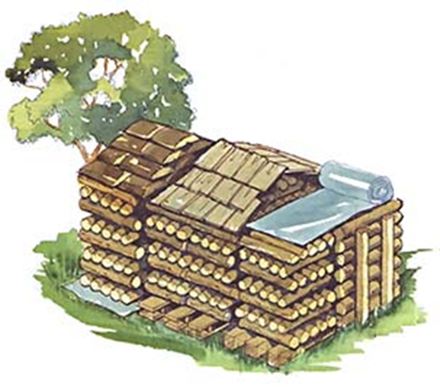
Example: Firewood
Firewood as a co-product of timber management
Processing to reduce moisture content:
  Remove bark
  Split wood into small pieces (35 cm in diameter)
Storage:
  Stack in a neat pile
  Cover the top to avoid moisture
  Store in a cool dry place
  20 percent moisture or less better for efficient combustion
Notes:
A few tips for firewood stacking:
- Stack the wood in separate rows in an open location where the sun shines and breeze can carry away the moisture.
- Do not let firewood on the ground for more than a couple of days before stacking. Mold and rot can set in quickly.
- Stack the wood up off the ground on concrete blocks poles, lumber rails or pallets.
- Loosely stack the wood no more than two layers deep.
- The top of the pile should be covered to keep off rain, but do not cover the sides to allow for ventilation.
- Keep a stack of firewood at a distance of at least 10 meters from the house.

Slide 21

Optimize Benefits of Firewood Use: Management
Sustainable yield. Net biomass (forest or plantation) growth should be positive (growth> removals). Land clearing is not!
Greater benefits when harvested with other products (e.g. timber, fodder)
Multi-purpose plantations are a favorable option

Slide 22
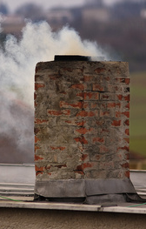
Optimize Benefits of Firewood Use: Clean Conversion
For each 100 micrograms of particulate pollution per cubic meter of air there is greater risk (%) of dying from:
  Emphysema (32%)
  Bronchitis and asthma (19%)
  Pneumonia (12%)
  Cardiovascular disease (9%)
Source: Washington State Department of Ecology
Notes:
https://fortress.wa.gov/ecy/publications/publications/92046.pdf

Slide 23
Tools for Reform: Legal & Socio-Economic
CCA laws define most forests as protected, creating a disincentive to motivate management by local villagers…
Yet wood energy is central to local livelihoods!
Opportunity provided by tradition of collection, cooking and heating with wood
In many villages, supply of electricity, coal, gas or fuel is often not provided

Slide 24
Example: Uzbekistan
When a boy is born, father plants 20 poplars along irrigation channel in his yard.
When son marries and needs a house, poplar trees are cut down and house is built.
Poplar trees grown in the yard, not outside of the private plot: (1) Security against theft; (2) Cutting trees outside the yard requires a permit and payment of a fee to the government.
What allows this 20-year planning?
Long-term land tenure, secure property rights!!!
Multiple use:
  Timber for construction, co-products for energy!!!
Notes:
http://siteresources.worldbank.org/EXTFORESTS/Resources/985784-1217874560960/Uzbekistan.pdf
Source: Savcor Indufor Oy (2005)
Changes to motivate tree planting. Currently it is rational behavior not to plant trees outside the plot. Must change the enabling environment to make it rational behaviour for tree planting and management in other places. 3 year tree tenure security for trees on government land in Uzbekistan for villagers and they are giving out improved cooking stoves and educating villagers on the importance of trees for the environment - as a way to help the forests. As the farmer said to me 'this is crazy'.

Slide 25
Example: China
Central government has promoted forestland property right reform since the 1980s.
First pilot in 4 provinces to make property rights clearer, alleviate owners’ tax burdens, allow flexible management and streamline tenure rights transfer established in 2004.
By 2010 accomplished main tasks in 18 provinces with over 68 million households as main beneficiaries Although focused on high-value timber products aim also generated large amounts of co-products for energy
Demonstrates importance of government commitment. Recommended to pilot reform before expanding to entire country.

Slide 26
Public Policy Recommendations
Promote sustainable wood use as an environmentally friendly renewable resource
Redefine land use rights, streamline bureaucratic procedures around wood use
Invest in capacity building to optimize forest productivity: integrate timber products and firewood
Evaluate forest classification and tenure reform to address underlining disincentives for local people not investing in forest management
Facilitate a network of forest sector stakeholders: villagers, businesses, government institutions, NGOs to partner on wood energy development
Adapted from: ECE/FAO, Green Economy Policy Brief: Wood Energy Opportunity or Risk?

Slide 27
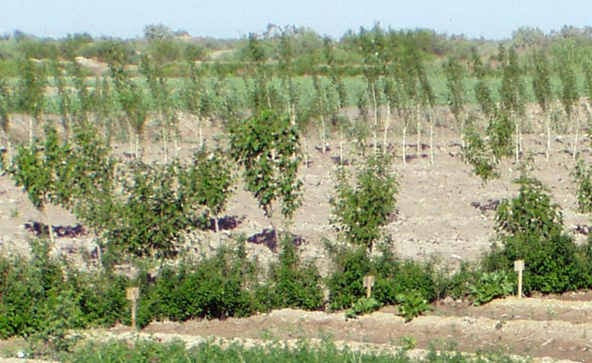
Final Remarks: Wood Energy
Compatible with sustainable forest management practices and green economy principles
Fundamental to food and energy security!
Integrate sustainable forest management with long-term economic development goals
Low-carbon localized energy systems at low infrastructure costs

Slide 28
Final Remarks: Public Policy
Tailored to country-specific conditions
  Amendment of public policy tools instruments: revisit land ownership and usufruct rights, liberalization of loan markets, education on coppice crops, tax incentives for land management
  Engage stakeholders in decision making process, a new approach from public forest institutions, partner with local villagers
  Pilot projects that integrate forest sustainability goals with clean firewood use

Slide 29
Thank You
Any questions on the presentation before we move on to the next presentation and exercise?
Contact:
Francisco X Aguilar
Department of Forestry
University of Missouri
aguilarf@missouri.edu

Slide 30
Training flow and structure – where are we?
Components of the training | Content-topics of the training
Intro to the training SFM and green economy principles
Review and analysis skills and methods. Spotlight on data gathering and analysis
Spotlight on wood energy Policy priority negotiation Policy drafting and review
Planning the process and methods for forestry plan/strategy for the green economy development. Training evaluation
Preliminaries and principles
Review and analysis
Policy development
Outcome: Improved understanding and skills

Slide 31
Policy priorities negotiation – why is it necessary? Why not jump from context analysis straight to policy formulation?
Relevance and balance: Improving the relevance and balance of the policy by examining all key issues from the perspectives of different stakeholders.
Ownership: Increasing ownership of the policy by stakeholders. Through engaging the negotiating policy priorities will increase chances of its acceptance and implementation
Accountability: Increasing accountability, interaction of key decision makers with other forest stakeholders helps them better understand and feel the consequences of policies on forest stakeholders.
Relationships: Constructively avoiding and managing policy conflicts, building new relationships and trust between forest stakeholders.
Notes:
31

Slide 32
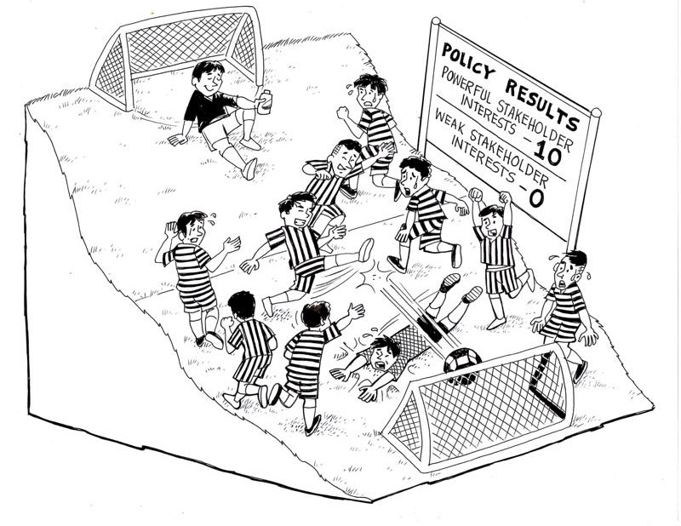
A key pre-requisite for an effective forest policy priority negotiation is trying to ensure a fair process - a more level playing field between key stakeholders
According to our rules we don’t change sides at half time!
Notes:
32

Slide 33
Role play on effective forest policy negotiation: Purpose and procedure
Purpose: To appreciate different perspectives among stakeholders on forest policy priorities( in this case on fuel wood) and in a ‘learning by doing’ way examine methods for multi-stakeholder policy priority negotiation.
You will be divided to play the roles of 3 stakeholder groups in a hypothetical situation.
First carefully read the roles that are given out.
Now in your separate stakeholder groups please get into your role and discuss and prepare a priority policy statement – from your stakeholders’ point of view on the topic of fuel wood( details are contained in the role hand-out)
Notes:
Role play handouts are provided – see Handouts folder Day 2 afternoon.

Slide 34
Role play on effective forest policy multi-stakeholder negotiation: Purpose and procedure
4. The statement must be in line with Green Economy principles and consider sustainable forest management, social, economic and environmental aspects – and must be feasible/realistic for the context explained in the role play
5. The statement must be concise – to be presented at the beginning of a multi-stakeholder negotiation. The methodology for this negotiation will be explained later.
Notes:
Role play handouts are provided.

Slide 35
Role play on effective forest policy negotiation
Please use the following format to prepare your fuel wood forest policy related statement
List key interests of your stakeholder group related to fuel wood production:
Justifications for the policy recommendation
One feasible and priority policy recommendation for fuel-wood:
Notes:
BIG SHEET: Prepare 3 of these. About the size of 1 large or 2 flip charts. Leave space below the headings to write. The blue band in the middle should be attached to the flip chart only using masking tape as this recommendation will be detached and removed. To put in the next exercise priority ranking.

Slide 36
Multi-stakeholder negotiation methodology
Procedure:
A representative from the first stakeholder group presents their statement and justifies it. 5 minutes.
Anyone else that wants to comment must come to the centre and sit down. First person that comes, is first to speak.
After commenting they must return to outside ring – time limit for comment is 1 minute.
Justifiers remain in centre and can respond at any time.
Once the facilitator ‘closes’ the fish bowl NO NEW people can come to the centre. Those in the middle can finish their comments.
The justifier may have final remarks at the end to try to convince people.
Fishbowl debate method
‘Fishbowl’ is the outside circle – the ‘fish’ are in middle.
This method is best explained by a demonstration which will now follow.
Notes:
36

Slide 37
Collectively ranking policy priorities
Criteria | Sustainable forest management | Economic/ livelihood | Social | Wood energy development | Feasibility | Total | Ranks
Policy recommendation
Policy recommendation
Policy recommendation
Procedure: You are no longer in your ‘roles’ – so do not be biased. Every individual should rank every policy recommendation according to the criteria – rank vertically. A score of ‘3’ means that that policy recommendation scores best for that criteria, ‘2’ for the next best and ‘1’ for the worst. Ranks of 3, 2 or 1 must be provided for every cell in the table, and for each recommendation no two ranks can be the same.
Notes:
BIG SHEET: Prepare this matrix out of about 3 flip charts side by side.

Slide 38
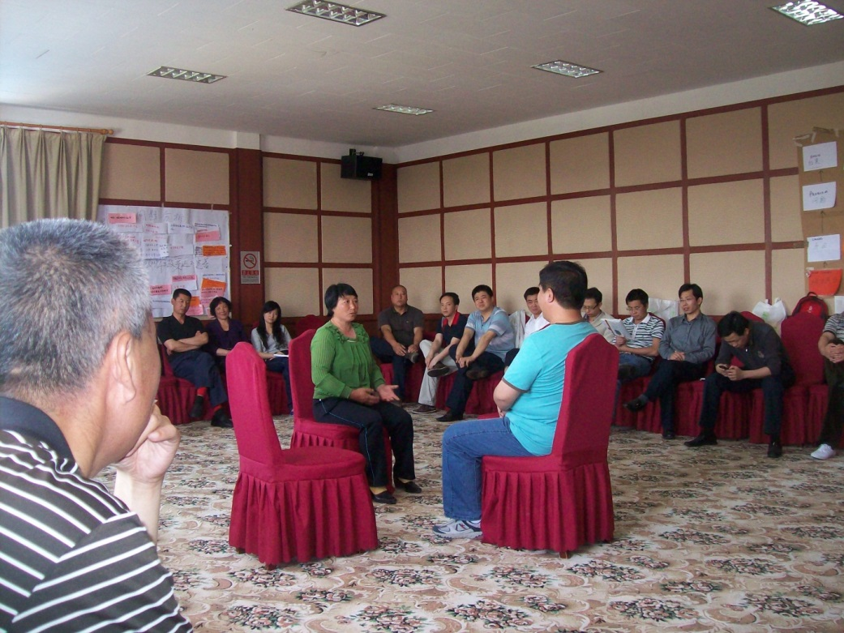
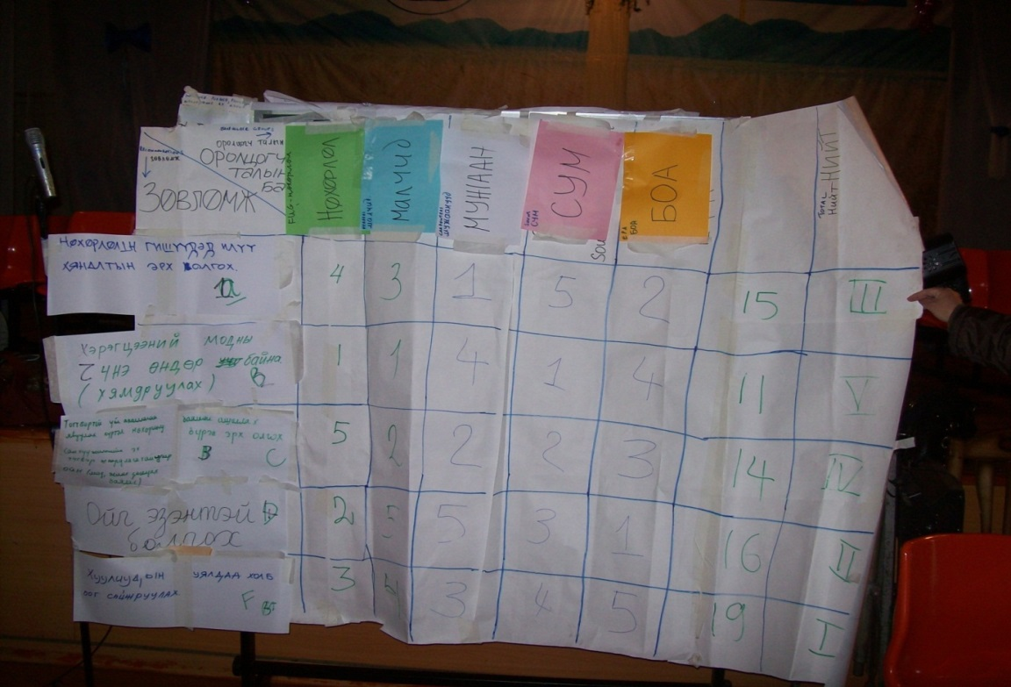
Policy priority negotiation – reflection on methods
Fish bowl debate method
Priority ranking
Strengths of method
Weakness/limitations of method
Recommendations for application/adaptation to your context.

Slide 39
Social methods tool box for engaging stakeholders and for negotiation of Sustainable Forest Management for a greener economy strategies.
Quick target assessment method
Poster with post-it method
Stakeholder mapping
Problem Analysis
Strengths, Weaknesses, Opportunities and Threats Analysis
Rights, Revenues and responsibilities analysis
Fishbowl debate
Priority ranking

Slide 40
Training delivery/approach reflection
Training delivery reflection team.
In your team discuss the following – write the answers on a flip chart.
What were the key lessons/insights that were generated today?
What training approaches/methods were used today? Which were the most effective for learning and why?
Any recommendations of how to improve the training delivery for today – adapt to your country context more?
Volunteer(s) should present the answers concisely 5 minutes, first thing tomorrow morning.
Notes:
BIG SHEET: Prepare flip chart with heading ‘Lessons of Relevance from today’

