Slide 1
“Driving India Into The Future”
Transmitted by the Government of India
Informal document WP.29-167-25 (167th WP.29, 10 - 13 November 2015, agenda item 6)
WP 29 – Nov 10th-13th, 2015
Geneva, Switzerland

Slide 2
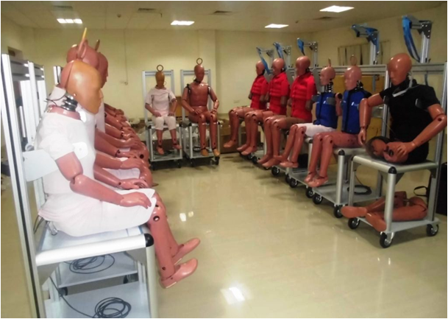
National Automotive Testing and R&D Infrastructure Project (NATRIP)
The most significant initiative in Automotive Sector by Govt. of India with an initial investment of Rs 1718 Cr. in 2005, revised to Rs. 2288 Cr in 2011.
A unique joining of hands among the Government of India, a number of State Governments and Indian Automotive Industry to create state-of-the-art Testing facilities.
Creating core competencies in automotive technology in India and to facilitate seamless integration of the Indian Automotive Industry with the world.

Slide 3
NATRIP – Vision & Mission
Vision - Create state-of-art research and testing infrastructure to drive India into the future of global automotive excellence. Mission - NATRiP aims at setting up of seven state-of-the-art automotive testing and R&D centres across the country and thereby:
Creating core global competencies.
Enhancing competitive skills for product development leading to deepening of manufacturing.
Synergizing India’s unique capabilities in Information Technology with the automotive sector.
Facilitating seamless integration of Indian automotive industry with the world to put India strongly on the global automotive map.

Slide 4
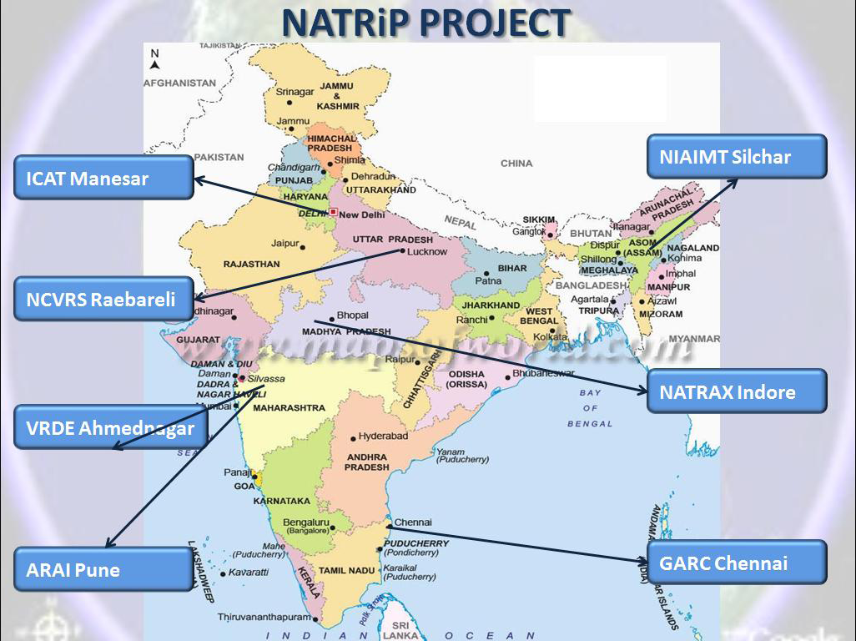
NATRIP Centres
A full-fledged testing and homologation centre within the Northern hub at ICAT-Manesar, Haryana and Southern hub at GARC-Oragadam, Chennai, Tamil Nadu.
Up-gradation of existing centres at ARAI- Pune and VRDE-Ahmednagar in western hub, in Maharashtra.
A world-class Proving Ground on 4,123 acres of land at NATRAX- Pithampur, near Indore, Madhya Pradesh.
Hill Area Driving Training Centre and In-Use Vehicle Inspection & Maintenance Centres in North East at NIAIMT-Silchar, in Assam.
A Centre for Testing of Tractors and Off-Road Vehicles with national facility for accident data analysis at NCVRS-Rae Bareli, Uttar Pradesh

Slide 5
Facilities at various centres under NATRIP
- Centre of Excellence
ICAT Manesar | GARC Chennai | NATRAX Indore | ARAI Pune | VRDE Ahmednagar | NIAIMT Silchar | NCVRS Raebareily
Powertrain Fatigue & Certification Passive Safety EMC NVH Test Tracks Component | Powertrain Fatigue & Certification Advance Passive Safety EMC Infotronics Component Test Tracks | Powertrain Vehicle Dynamics Test Tracks | Powertrain Fatigue Passive Safety | EMC ABS Track | I&M Driving Training Mechanics Training | Powertrain Fatigue Track & Field Accident Data

Slide 6
Powertrain
Completed facilities –
Mileage Accumulation Chassis Dynamometer (MACD) for 2W, 3W & 4W at ICAT & GARC
Engine Test Cell (ETC) for Heavy duty and Light duty engines at ARAI
Sealed Housing Evaporation Determination (SHED) facility for 2W, 3W and 4W at ICAT
Vehicle Test Cell (VTC) for 4W at ICAT & NATRAX
Upcoming facilities –
Vehicle Test Cell (VTC) for 2W, 3W & 4W at ARAI & GARC
Engine Test Cell (ETC) for Heavy duty & Light duty engines at ICAT & GARC
Climatic Vehicle Test Cell & Low Temperature Soak Room for 4W at ICAT, ARAI & GARC
SHED facility at ARAI & GARC

Slide 7
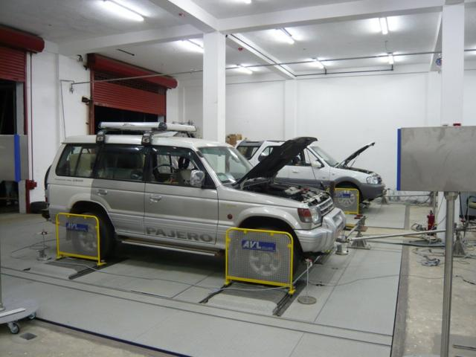
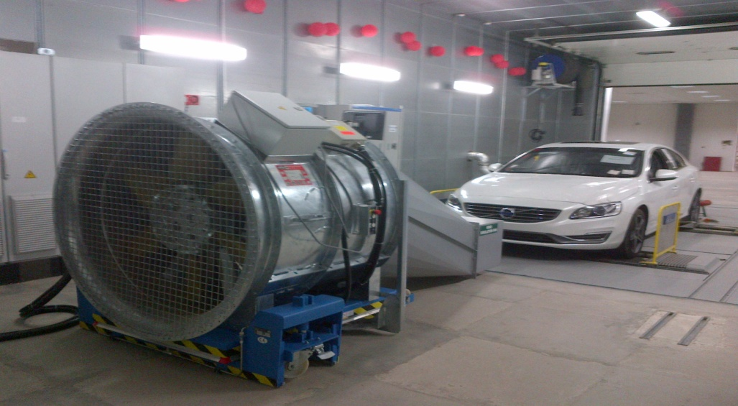
Powertrain Cont’d
MACD at ICAT & GARC
VTC at ICAT & NATRAX

Slide 8
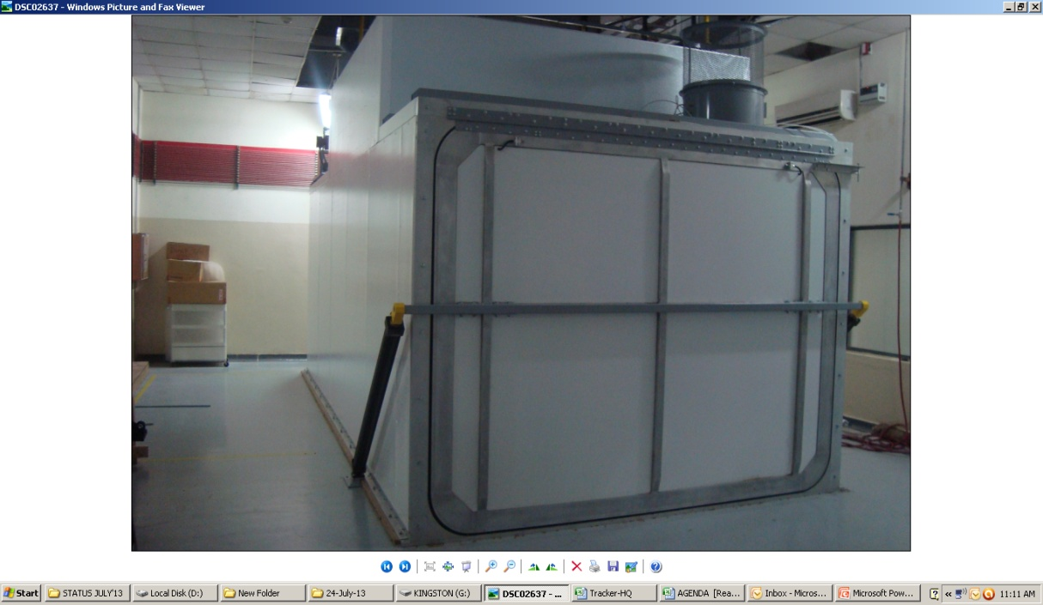
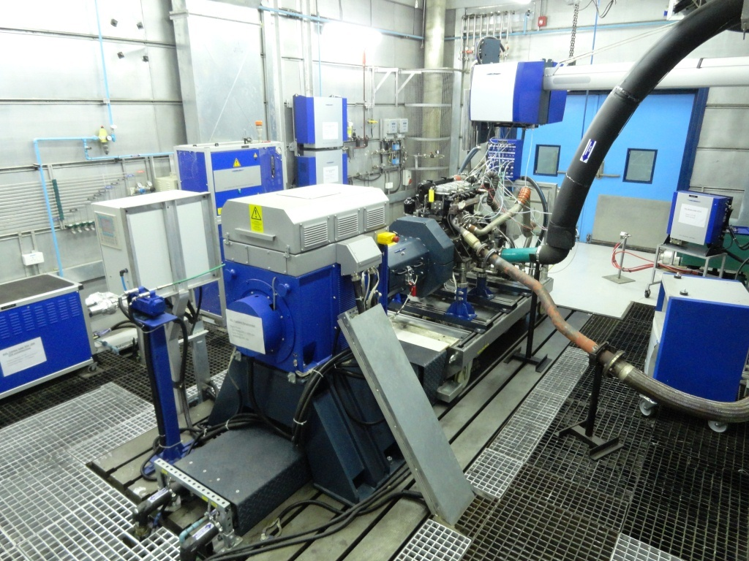
Powertrain Cont’d
SHED at ICAT
ETC at ARAI

Slide 9
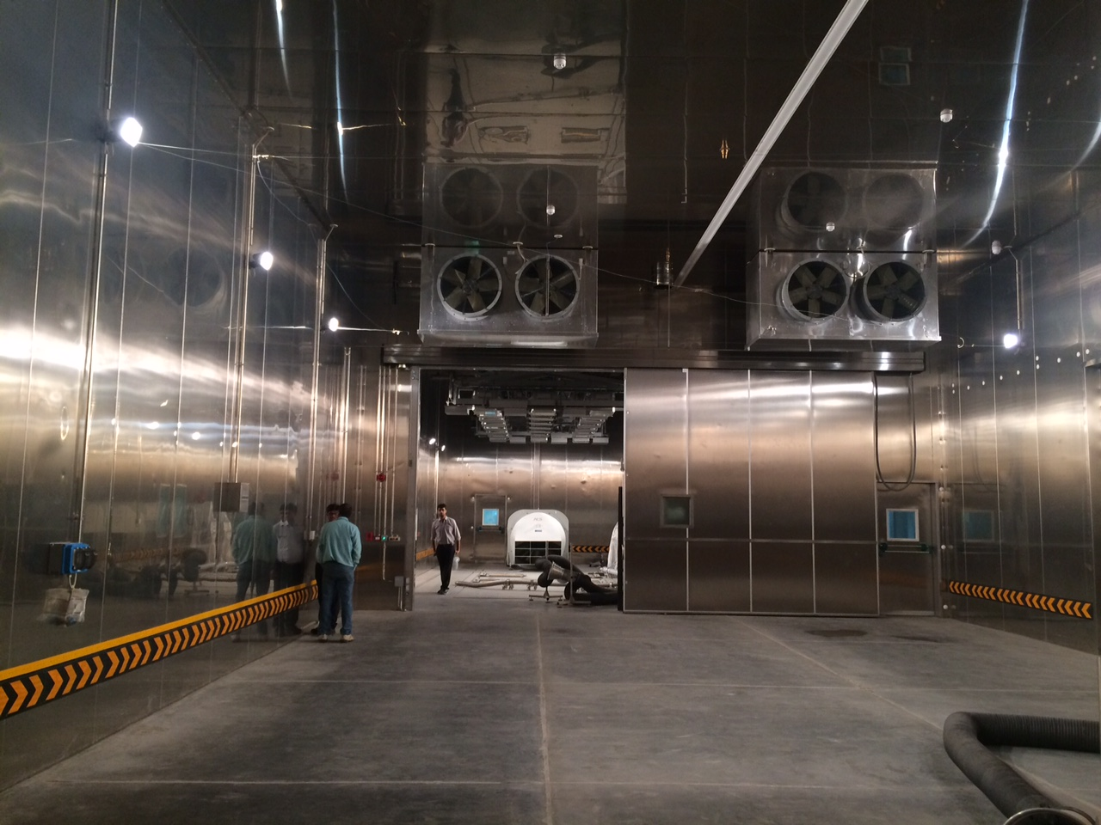
Powertrain Cont’d
CVTC & LTSR at ICAT
Soak Room at ICAT

Slide 10
Passive Safety
Completed facilities –
Pedestrian lab at ICAT & GARC
Airbag lab at GARC (only facility in India)
Upcoming facilities –
Static roll-over test, Dynamic roll-over test, De-celeration SLED test, Side impact test at ICAT, ARAI & GARC
Frontal impact test, Offset frontal impact test, Rear impact test, Pole impact test at ICAT, ARAI & GARC
Angular car to car crash test at GARC

Slide 11
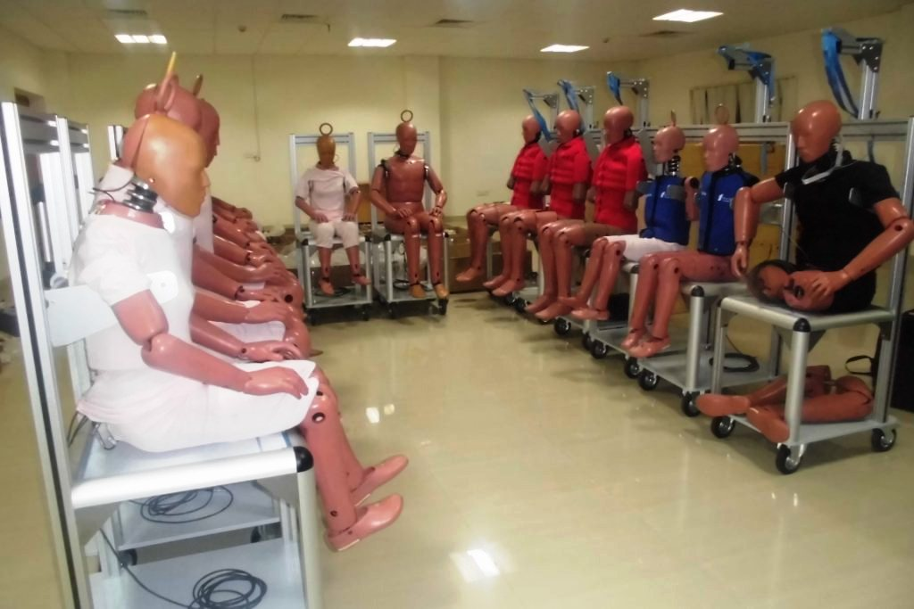
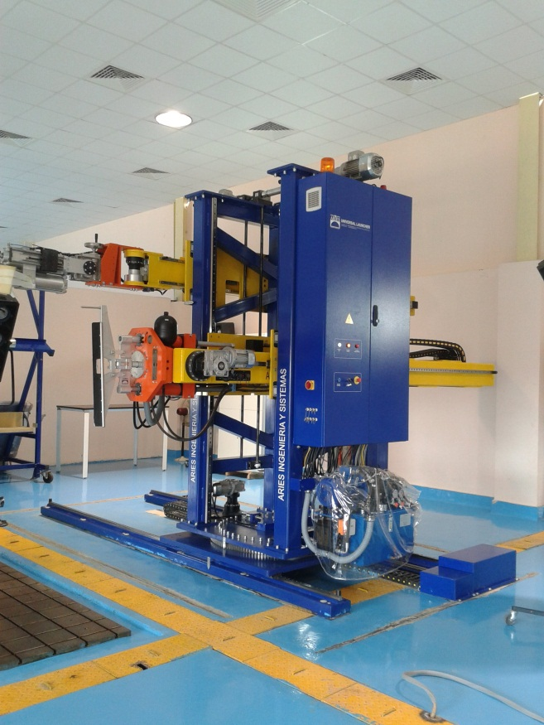
Passive Safety Cont’d
Pedestrain lab at GARC
Dummies at GARC
Pedestrian lab at ICAT

Slide 12
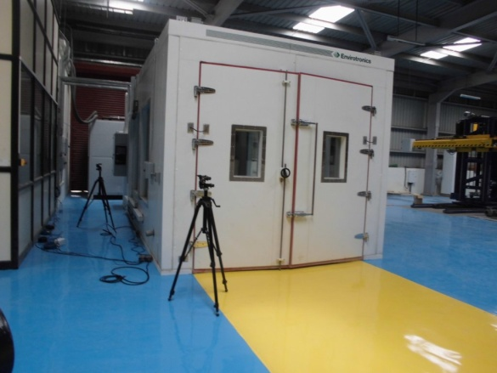
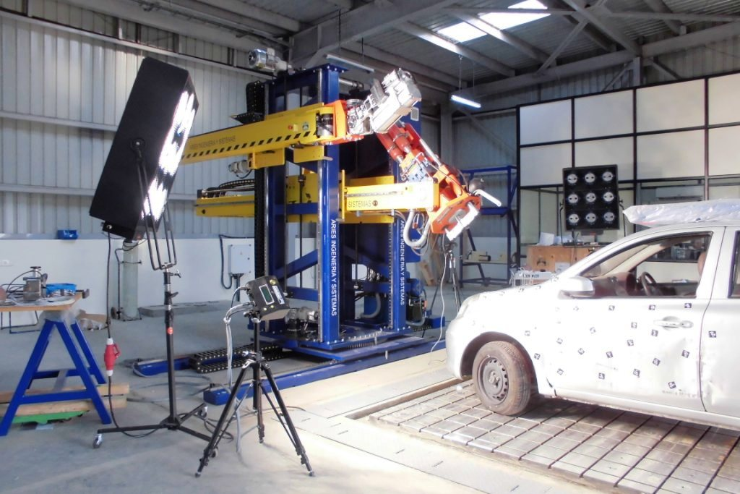
Passive Safety Cont’d
Airbag lab at GARC
Pedestrian lab at GARC

Slide 13
Fatigue & Certification
Completed facilities –
Electrodynamics vibration shakers integrated with climatic chamber, Interior fitting test rig, Head restraint test rig for seats, Bus window retention test rig, Bumper test rig at ICAT & GARC
Kinematic & Compliance (K&C) machine, Steering test rig, Elastomer test rig, and Damper test rig at NATRAX
MAST for component at ARAI
Upcoming facilities –
High frequency Multi Axis Simulation Table (MAST) with climatic chamber for component testing at ICAT
MAST with climatic chamber for component testing, Universal Test Bench for component, X-poster test rig for passenger cars at ARAI, ICAT & GARC
Heavy duty X-poster test rig at ICAT

Slide 14
Fatigue & Certification Cont’d
Upcoming facilities –
Drive-in four poster with climatic chamber for vehicles, X-Poster for 2&3 wheelers at ARAI
Tilt test platform, Universal Pneumatic actuators, Seat & seat belt anchorage, Resistance of seats for buses, Coupling devices, Cab pendulum, Bumper pendulum, Ballast plates, Upper & Lower head form, Traction devices, Shoulder belt traction devices and ISOFIX fixtures at ICAT & GARC
Cyclic actuators at GARC

Slide 15
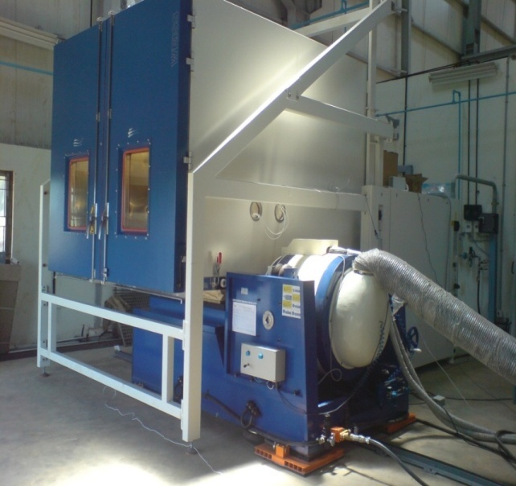
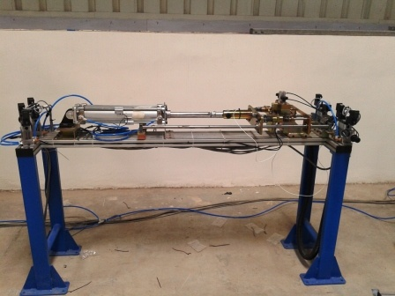
Fatigue & Certification Cont’d
ED-Shaker with Climatic Chamber at ICAT & GARC
Pneumatic Coupling Test Rig at ICAT & GARC

Slide 16
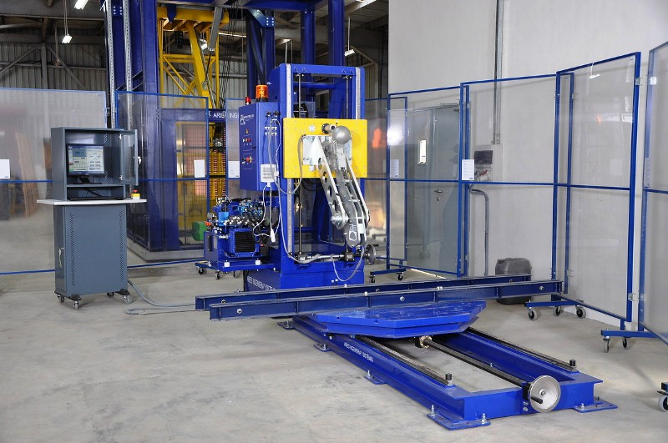
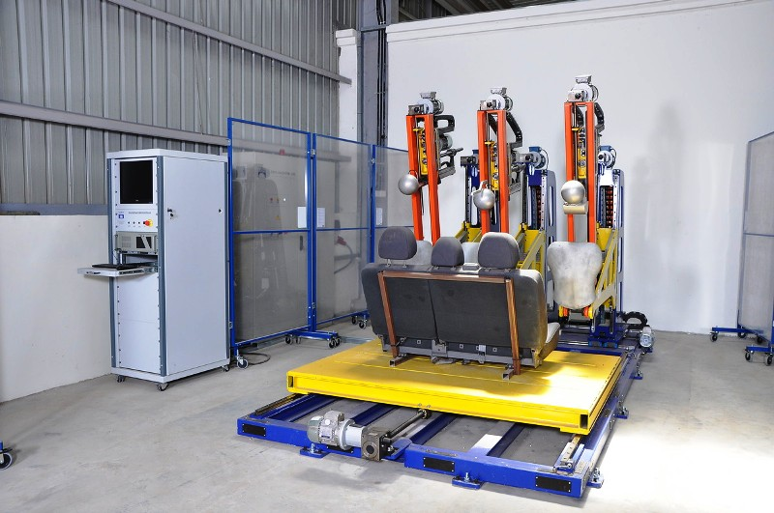
Fatigue & Certification Cont’d
Interior Fitting & Steering Impact Test system at ICAT & GARC
Head Restraint Test Rig at ICAT & GARC

Slide 17
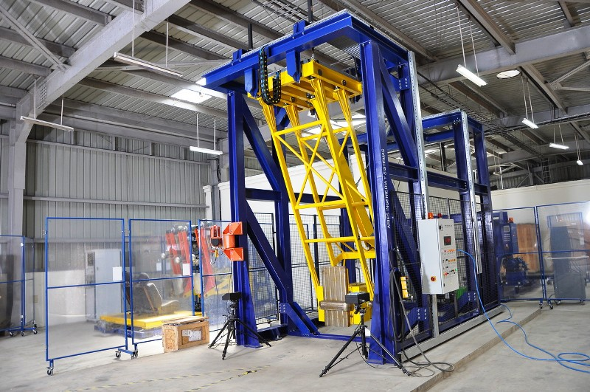
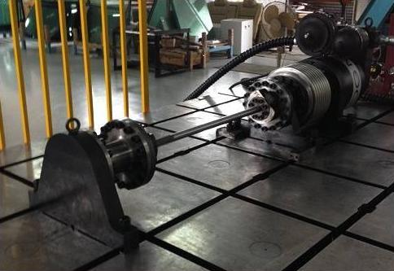
Fatigue & Certification Cont’d
Bumper Pendulum Test Rig at GARC
Rotary Actuator at ICAT

Slide 18
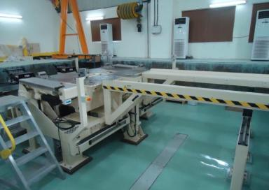
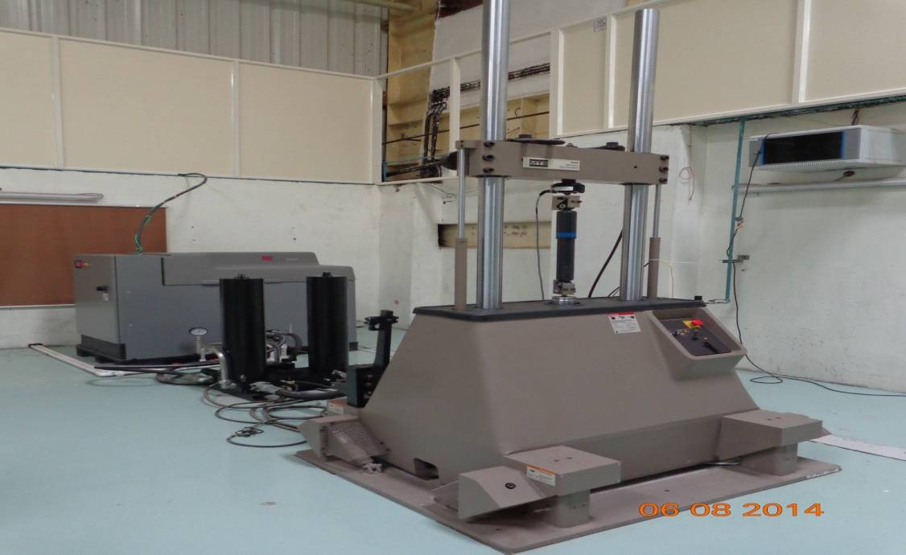
Fatigue & Certification Cont’d
K & C Machine at NATRAX
Damper Test Rig at NATRAX

Slide 19
Electromagnetic Compatibility (EMC)
Upcoming facilities –
Vehicle Semi Anechoic Chamber (VSAC) for electromagnetic compatibility up-to heavy commercial vehicle, Component Semi Anechoic Chamber (CSAC) at ICAT & GARC
Vehicle Semi Anechoic Chamber for small vehicles and components at GARC
Noise Vibration Harshness (NVH)
Upcoming facilities –
Transmission test bed, Vehicle Semi Anechoic Chamber (VSAC) for passenger car with 4X4 chassis dyno, Heavy Duty Semi Anechoic Chamber for trucks with 4X2 chassis dyno and Pass by Noise instrumentation at ICAT (only facility in India)

Slide 20
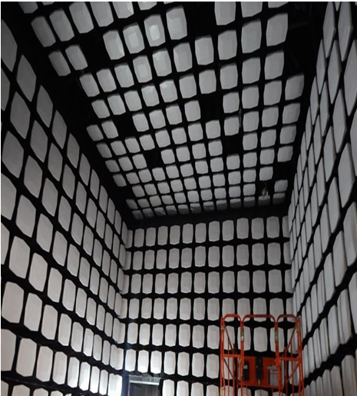
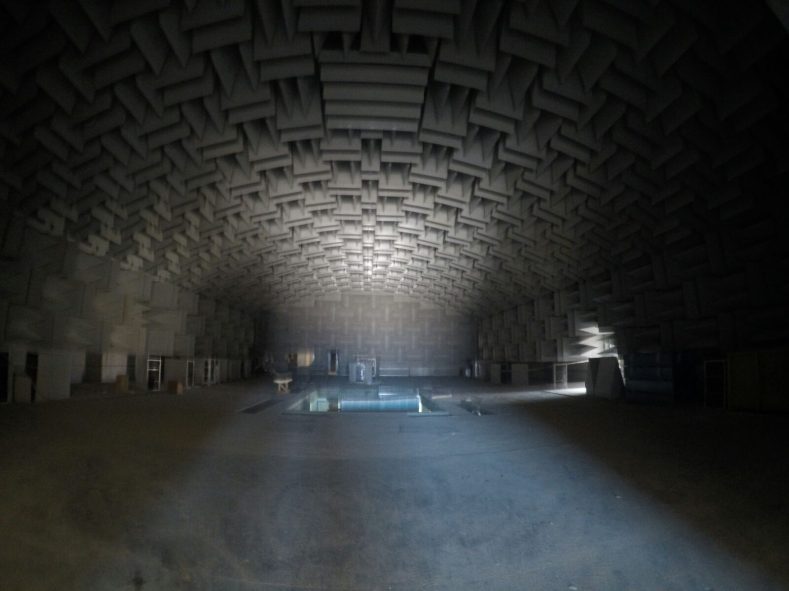
EMC & NVH
EMC lab at ICAT
NVH lab at ICAT

Slide 21
Test Tracks
Completed Test Tracks –
Steering pad track & External noise track (ENT) at GARC
Up-coming Test Tracks –
Steering pad track, Comfort track, Hill track, Oval track, Water flood track and Braking surface track at ICAT
Oval track (High Speed), Test hills track & Braking surfaces track at GARC
Dynamic platform, Straight braking track, Hill test track, Accelerated fatigue track, Gravel and Off-road track, Dry handling circuit, Comfort track, Handling track for 2&3 wheelers, Sustainability track, Wet skid pad and External noise track at NATRAX

Slide 22
Test Tracks Cont’d
EMC lab at ICAT
Steering pad at GARC
External Noise Tract at GARC

Slide 23
CAD-CAE lab
Completed facilities –
Simulia-Abaqus, Ansys, Altair-Hyperwork, Catia V6, Siemens NX 13100, MSC-Nastran, MSC-Fatigue, MSC-Adams at ICAT & GARC
Siemens and MSC-Adams Car at NATRAX
Automotive Infotronics lab
Upcoming facilities –
MATLAB, Measurement Calibration & Diagnostic Tools (MCDF), Hardware in Loop (HIL) system for Single ECU test bench for Powertrain & Chassis, Plant models (for Car & Engine) with Model in Loop (MIL), Rapid prototyping system for ECU development at ICAT & GARC

Slide 24
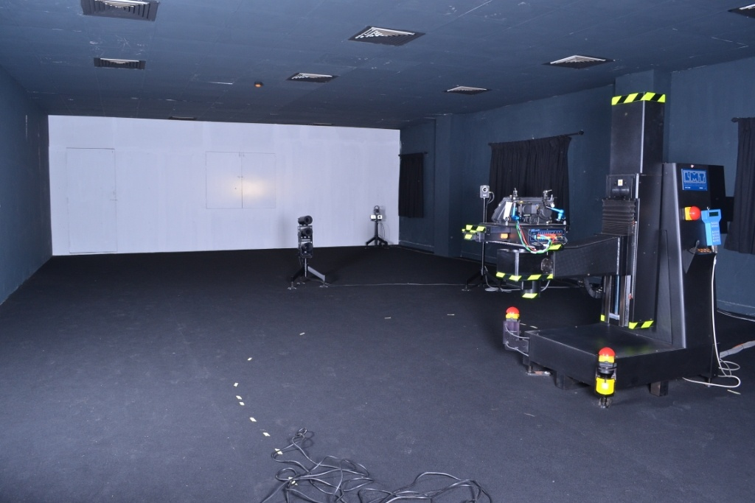
Other Facilities & Labs
Completed facilities –
Photometry lab
Inspection & Certification centre at NIAIMT:
- Fixed lane & Mobile lane for Inspection & Maintenance, Mechanical training along with Driving Simulators.
Photometry lab at GARC

Slide 25
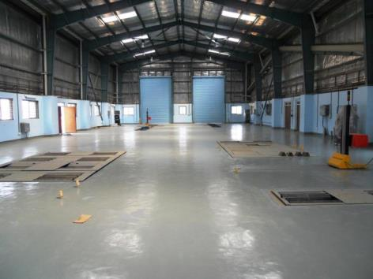
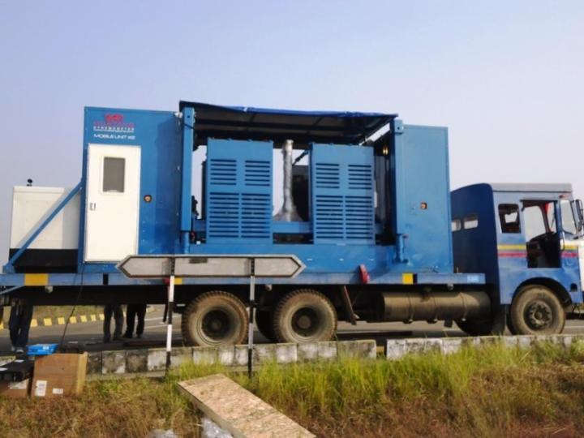
Inspection & Maintenance
Fixed lane at NIAIMT
Mobile lane at NIAIMT

Slide 26
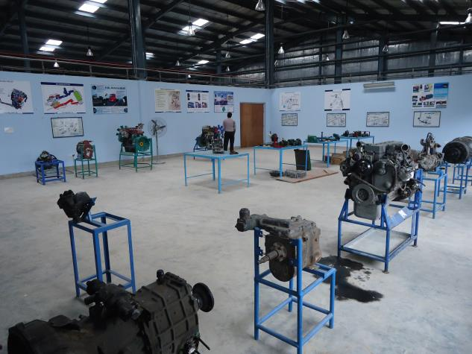
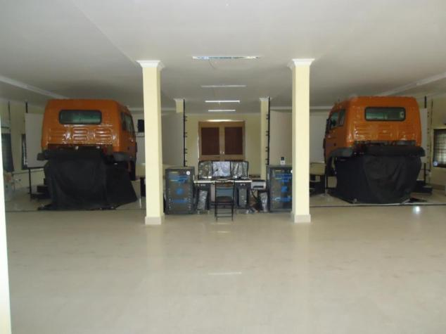
Inspection & Maintenance Cont’d
Mechanical Training Centre at NIAIMT
Driving Simulation lab at NIAIMT

Slide 27
“Driving India Into The Future”
Thank You
Sanjay Bandopadhyaya, IAS
Joint Secretary to the Government of India,
CEO & Project Direct, NATRIP
Email Address – ceo@natrip.in

