Slide 1
Research on Daytime Running Lamps of
4-wheeled Vehicles
Transmitted by the expert from Japan
Informal document GRE-74-20
(74th GRE, 20-23 October 2015,
agenda item 7(f))
Expert from JAPAN

Slide 2
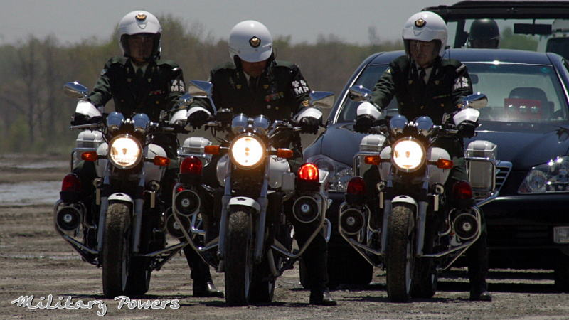
Background of DRLs in Japan
Permanent lighting of motorcycle headlamps mandatory
since 1996
Effective in reducing motorcycle accidents
* Concern for DRL glare to drivers
* Concern for reduced conspicuity of motorcycles in front of
4-wheeled vehicles
Currently, Japan does not allow DRLs for 4-wheeled vehicles.

Slide 3
Research Purpose
To verify the effects of DRLs on road traffic in Japan
The effects of a 4-wheeled vehicle with the DRL on were studied from the following perspectives:
(1) Right-turn behavior of the oncoming vehicle’s driver
(2) DRL glare given to the oncoming vehicle’s driver
(3) Conspicuity of a motorcycle in front of the 4-wheeled vehicle with the DRL on
(4) Pedestrians’ road-crossing behavior

Slide 4
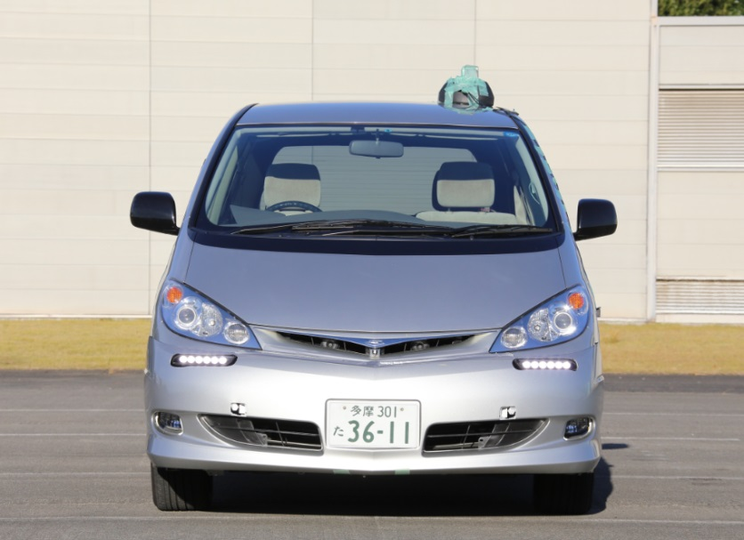
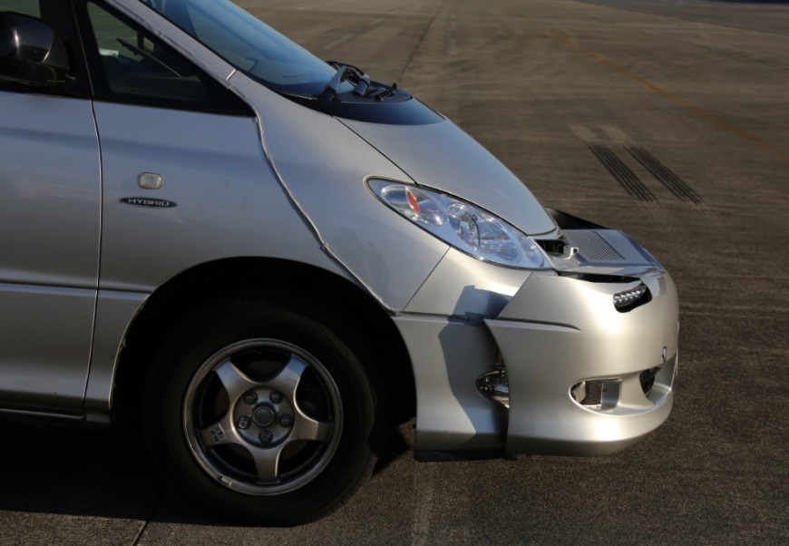
Test Conditions
Items |  | Conditions
Sky illuminance |  | Day (10,000 lx or above) Dusk (2,000 lx, 1,000 lx) Night (0 lx)
Lamp type (mounting height) | Test vehicle | Passing beam: HID, originally installed (775 mm) Daytime Running Lamp(DRL): LED (620 mm)
 | Motorcycle | Passing beam: HID, originally installed (895 mm)
Vehicle speed |  | 60 km/h
Test subjects |  | 20 persons (8 males, 12 females, aged 22 - 48, ordinary driver license holders)
Eye-point height of test subjects |  | 1,200 mm
Passing beam
DRL
DRL

Slide 5
Test Parameter: Sky illuminance
Sky illuminance: Day (10,000 lx)
DRL: 1,200 cd
Sky illuminance: Dusk (2,000 lx)
DRL: 1,200 cd
Sky illuminance: Dusk (1,000 lx)
DRL: 1,200 cd
Sky illuminance: Night (0 lx)
DRL: 1,200 cd

Slide 6
Test Parameter: DRL intensity
Tests conducted at dusk (1,000 lx)
w/o lighting
Passing beam
DRL: 300 cd
DRL: 1,200 cd
DRL: 2,000 cd

Slide 7
Test Setup
At 6 simulated intersections, measurements were taken simultaneously from 5 test subjects and 5 pedestrians.
Test subject & response switch
Test motorcycle
Pedestrians
Sidewalk 1.5 m
Traffic cone
Vehicle that each test subject drives
Pole
Test vehicle
Pedestrian
Test motorcycle
Panel
Dummy vehicle

Slide 8
Outline of Experiment (Drivers)
* The situation where the driver turns right was reproduced at a simulated intersection.
* The timing where each driver decides not to turn right if the motorcycle approaches any closer (1. right-turn limit timing) was measured.
* In addition, 2. DRL glare and 3. motorcycle conspicuity were also measured and evaluated.
Test subject
Motorcycle position at the right-turn limit timing
Time gap
Test vehicle with DRL on
3.5m
30m
7m

Slide 9
Outline of Experiment (Pedestrians)
* The situation where pedestrians are about to cross the road was reproduced in front of the crosswalk at a simulated intersection.
* The timing where each pedestrian decides not to cross the road if the motorcycle approaches any closer (4. road-crossing limit timing) was measured.
Motorcycle position at the road-crossing limit timing
Time gap
Test vehicle with DRL on
3.5m
30m
Test subjects
7m

Slide 10
(1) Results: Time gap toward two-wheeled vehicle
Day
Dusk
Dusk
Night
The difference from the “OFF" condition is significant according to the t-test result.
Time gap (s)
OFF
Passing
beam
DRL intensity (cd)
* Except for the "Day, 5,000 cd" condition, no particular effect of the DRL on the test subject's right-turn behavior was observed.

Slide 11
(2) Results: Evaluation of glare from DRL
Day: 10,000 [lx]
9: Imperceptible
8:
Percentages of
test subjects’ evaluation ratings
7: Satisfactory
6:
5: Tolerable (limit)
4:
3: Disturbing
2:
1: Intolerable
Passing beam
Under the "Day (10,000 lx or above)" condition, the evaluation rating 4 or below was rarely given even for the DRL intensity of 5,000 cd.

Slide 12
(2) Results: Evaluation of glare from DRL
Dusk (2,000 lx)
Dusk (1,000 lx)
9: Imperceptible
8:
7: Satisfactory
Percentages of
test subjects’ evaluation ratings
Percentages of
test subjects’ evaluation ratings
6:
5: Tolerable (limit)
4:
3: Disturbing
2:
1: Intolerable
Passing beam
Passing beam
Night (0 lx)
Under the "Dusk (1,000 lx)" condition, the evaluation rating 4 or below was given by 25% or more of the test subjects for the DRL intensity of 2,000 cd.
Percentages of
test subjects’ evaluation ratings
Under the “Night” condition, the DRL caused more glare than the headlamp.
Passing beam

Slide 13
(2) Results: Evaluation of glare from DRL
Weighted means for all test subjects
Day
Dusk (2,000 lx)
Dusk (1,000 lx)
Night
Imperceptible
Satisfactory
Ratings of discomfort glare
Tolerable (limit)
Disturbing
Intolerable
OFF
Passing beam
DRL intensity (cd)
* The evaluation rating tended to decline as the DRL intensity increased.
* Under the "Dusk (1,000 lx)" condition, the evaluation rating for the DRL intensity of 2,000 cd was around "5: Tolerable (limit)".

Slide 14
(3) Results: Conspicuity of two wheeled vehicle
Day (10,000 lx)
Very good
good
Slightly good
Normal
Slightly bad
Bad
Very bad
Percentages of
test subjects’ evaluation ratings
Passing beam
Under the "Day (10,000 lx)" condition, the DRL, regardless of its intensity, had almost no effect on the motorcycle conspicuity.

Slide 15
(3) Results: Conspicuity of two wheeled vehicle
Dusk (2,000 lx)
Dusk (1,000 lx)
Very good
good
Slightly good
Normal
Slightly bad
Bad
Very bad
Percentages of
test subjects’ evaluation ratings
Passing beam
Passing beam
Night (0 lx)
Under the "Dusk (1,000 lx)" condition, the evaluation "Somewhat difficult to see",
"Difficult to see" or "Very difficult to see" was given by about 30% of the test subjects for the DRL intensity of 1,200 cd.
Percentages of
test subjects’ evaluation ratings
Under the "Night (0 lx)" condition, the motorcycle conspicuity decreased with or without the DRL.
Passing beam

Slide 16
(3) Results: Conspicuity of two wheeled vehicle
Weighted means for all test subjects
Day Dusk Dusk Night
Very good
good
Slightly good
Normal
Slightly bad
Bad
Very bad
Motorcycle conspicuity
OFF
Passing beam
DRL intensity (cd)
* Under the "Day" condition, the evaluation rating tends to remain almost unchanged regardless of the DRL intensity.
* Under the "Dusk" and "Night" conditions, the evaluation rating tended to decline as the DRL intensity increased; under the "Dusk (1,000 lx)" condition, the mean rating from all test subjects for the DRL intensity of 2,000 cd was around "Normal“.

Slide 17
(4) Results: Time gap between pedestrian and two-wheeled vehicle
Day Dusk (2,000 lx) Dusk (1,000 lx) Night
No significant difference between "Day" and "Dusk" according to the t-test result
Time gap (s)
OFF
Passing beam
DRL intensity (cd)
* Overall, the time gap tended to decrease as the DRL intensity increased.
* On the other hand, the t-test result indicates that, under the "Day" and "Dusk" conditions, the trailing vehicle's DRL did not affect the road-crossing judgment involving the motorcycle.

Slide 18
Summary
(1) Time gap in the driver’s right-turn behavior
* Under the “Day (10,000 lx)” condition, there was a significant difference from the “headlamp OFF” condition when the DRL intensity was 5,000 cd.
* Under the other conditions, no effect of the DRL was found.
(2) Evaluation of DRL glare
* The evaluation rating tended to decline, i.e., more glare was generated, as the DRL intensity increased.
* Under the "Dusk (1,000 lx)" condition, the mean rating from all test subjects for the DRL intensity of 2,000 cd was around "5: Tolerable (limit)".
(3) Effect of the DRL on motorcycle conspicuity
* Under the "Day (10,000 lx)" condition, the DRL had almost no effect on the motorcycle conspicuity regardless of its intensity.
* Under the "Dusk" and "Night" conditions, the evaluation rating tended to decline as the DRL intensity increased; under the "Dusk (1,000 lx)" condition, the mean rating from all test subjects for the DRL intensity of 2,000 cd was around "Normal“.
(4) Time gap in pedestrians' road-crossing behavior
* Although, overall, the time gap tended to decrease as the DRL intensity increased, the t-test result indicates no effect of the DRL's lighting under the "Day" and "Dusk" conditions.

Slide 19
Thank you for your attention !

