Slide 1
Informal document GRB-65-02
(65th GRB, 15-17 February 2017,
agenda item 4(a), 9 & 16 )
Research on M3 sub-categories of R51-03
1
Notes:
1

Slide 2
Contents
M3 category in China with new energy
An example of M3 category EV
R51-03 on M3 categories
Problems for new technology
Existing problems
Suggestions
2

Slide 3
M3 category in China with new energy
Totally 491,709 buses and coaches sold in year 2016.
- Mainly contain M2 and M3 categories.
- Within which, nearly 123, 000 belong to new energy vehicles, which take nearly 25% percent.
- Within which, nearly 172, 000 belongs to M3 categories.
*Data from: <Automotive Information>, www.autoinfo.org.cn
Example: Tianjin City
- Planned to purchase 1000 buses and coaches from 2013 to 2016, within which more than 40% are EV, Hybrid, LNG & CNG, and totally have more than 10, 000 buses and coaches.
- More than 1846 EV buses and coaches are purchased from 2012 and is running now.
*Data from: www.tjbus.com, www.tj.xinhuanet.com
3

Slide 4
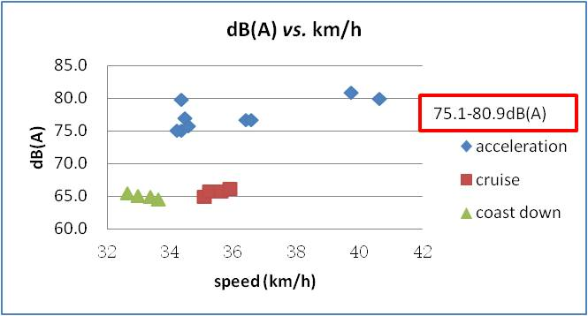
An example of M3 category EV
Kerb mass | 12445kg | Front axle | 4340kg | Rear axle | 8105kg | Test mass | 12550kg | Length | 12000mm
Gross vehicle mass | 19000kg | Front axle | 7000kg | Rear axle | 12000kg | Payload | 0 | Locked or non | Non-locked
4

Slide 5
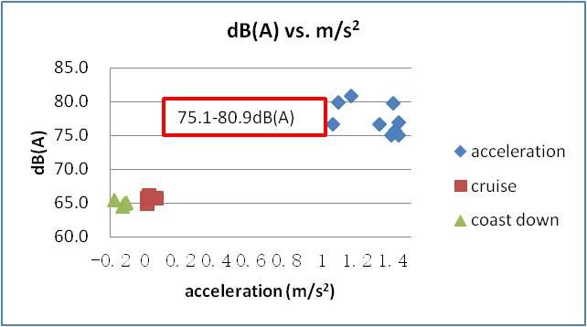
Problems for new technology
Rated power | 124 | Rated power (Motor) | 110 | Peak power (Motor) | 220 | Torque | 3000 N.m | S | 1250rpm
This bus belongs to the sub-category with P_{n} no more than 150kW, so:
76dB(A) from 2016;
74 dB(A) from 2020;
73 dB(A) from 2020.
1. The rated engine power of EV and hybrid buses are always half of diesel engine.
2. The acceleration of EV is always higher than the diesel engine during the test, even the rated engine power of diesel engine is higher.
5

Slide 6
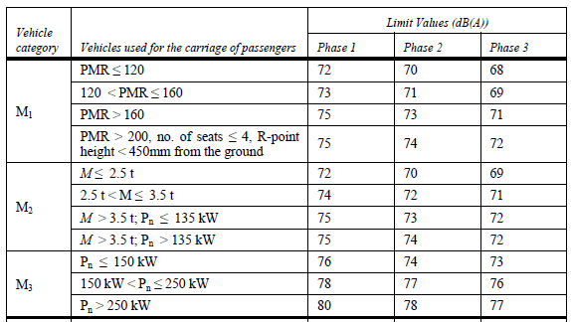
Existing problems (diesel engine)
Length | P_{n} | GVM
6-7m | 85-105kW | 5200-7800kg
7-8m | 88-147kW | 5500-11500kg
8-9m | 118-191kW | 11000-14000kg
9-10m | 147-191kW | 12500-14000kg
Products parameters of China M3
There will still be problems with the sub-categories level of rated engine power, even we only consider the traditional buses and coaches.
* See details: GRB-64-24 - (China) Implementation of the 03 series of amendments to Regulation No. 51 in China
6

Slide 7
R51-03 for M3 categories
M3 vehicle
Diesel
LNG/CNG
Gasoline
Hybrid
EV
Main target
Similar to diesel engine
Partly solved
Not considered
We are making limit value for M3 buses and coaches, but not for diesel engine with certain exhaust level only.
The test engine speed percentage and sub-categories based on the rated power of diesel engines will always meet problems for other engine types.
7

Slide 8
Suggestions
Add some new vehicle sub-categories.
- Set different rated engine power sub-categories for gasoline, EV, Hybrid, LNG & CNG.
Use some new definition for engine power
- Do not use the rated engine power for EV, but use the peak power.
Not only use the engine power but also use complete vehicle parameters for sub-categories
- If the engine power can not cover all situation of M3 categories, some other stable parameters of complete vehicle can also be considered together.
Build up new regulation for new technology
- Build up new regulation systems for EV separately, with considering pass-by noise, high frequency noise, QRTV, ASEP……
8

Slide 9
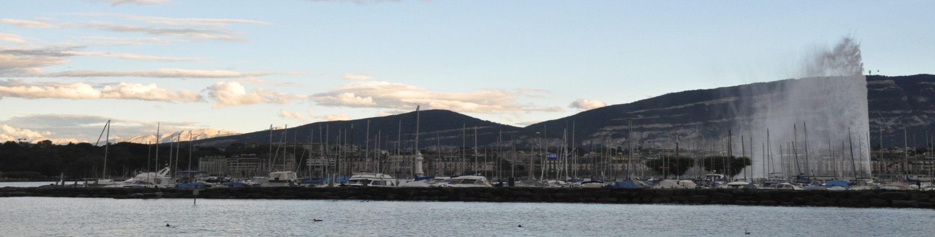
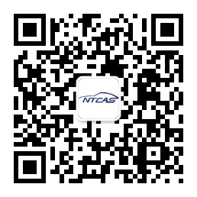
National Automotive Standardization Technical Committee
Thanks for your attention
Web site：www.catarc.org.cn
9

