Slide 1
IWG for ASEP Report to GRB 67th from the 5th and 6th IWG for ASEP sessions
Transmitted by the experts of IWG ASEP
Informal document GRB-67-15-Rev.1
(67th GRB, 24-26 January 2018,
agenda item 4 (b))

Slide 2
Meetings
1rst Meeting : 2016, November – Tianjiin
2d Meeting : 2017, February – Geneva
3rd Meeting : 2017, May – Brussels
4th Meeting : 2017, July – Washington
5th Meeting : Japan, 2017, November, 7th am to 9th pm
6th Meeting : Geneva (in junction with GRB), 2018, January, 22th pm to 24th am
7th Meeting : 2018, March 20th am – 22nd am, China, Changchun
8th Meeting : Europe (Brussels EC to be confirmed), 2018, July, 10th am -12th am
9th Meeting : Geneva (in junction with GRB), 2018, September, 10th pm to 12th am
10th Meeting : Japan, 2018, November, 06th am – 08th am

Slide 3
Participants to 5th and 6th Sessions
Contracting parties : France, China, Japan, Germany, EC, Russian Federation
NGOs : OICA, IMMA, CLEPA, ISO

Slide 4
Related documents
GRB 64th :
GRB-64-23-(Rev.1) - (Chair) (Revised) draft Terms of Reference of IWG ASEP
GRB-64-16 - (France) Information on ASEP
GRB-64-04 - (ISO) Proposals to clarify the provisions of Regulation No. 51, Revision 3, Annex 7
GRB 65th :
ECE/TRANS/WP.29/GRB/2017/2 - (IWG on ASEP) Proposal for Supplement 2 to the 03 series of amendments to Regulation No. 51
GRB-65-26 (IWG ASEP) - Modifications proposed to ECE/TRANS/WP.29/GRB/2017/2
GRB-65-25 (IWG ASEP) - Presentation of ECE/TRANS/WP.29/GRB/2017/2
GRB-65-24 (IWG ASEP) - Progress report
GRB 66th :
ECE/TRANS/WP.29/GRB/2017/5 - (IWG on ASEP) Proposal for Supplement 3 to the 03 series of amendments to Regulation No. 51
GRB-66-14 (IWG ASEP) Status report
GRB 67th :
GRB-67-14 Transitional provisions for R51-03.3
GRB-67-15 Rev.1 (IWG ASEP) Status report
And all documents in UNECE IWG ASEP website

Slide 5
Report of discussions and conclusions Consideration of some technical elements for current procedures
Following comments from GRB members on ECE/TRANS/WP.29/GRB/2017/5, the IWG for ASEP concluded that :
geometry, surface and obstacles outside ISO 10844 has a negligible impact for backfire assessment,
transitional provisions are needed for Sound Enhancement, “Backfire” (SPL from AA to BB+20m) and “anchor point” (L wot i+1 instead of L wot i). IWG proposes GRB-67-14.
IWG for ASEP proposes to precise following paragraph to avoid interpretation
6.2.3. Additional sound emission provisions
[…]
The sound emission of the vehicle under typical on-road driving conditions, which are different from those under which the type-approval test set out in Annex 3 and Annex 7 was carried out, shall not deviate from the test result in a significant manner.

Slide 6
Report of discussions and conclusions General consideration of ASEP revision and application
Some concerns where expressed :
What kind of problems, products we want to check and solve with ASEP?
What kind of vehicles, what speeds we should focus?
Strict test for vehicles subjects to doubts and simple test for ”normal” vehicles
Need to prohibition or prevention of illegal modification/defeat device
Some questions are still in discussions
Difficulties to define normal or subject to doubts vehicles.
Identification of possibilities of illegal manipulations even if impossible to be exhaustive – to be able to find solutions to avoid these situations

Slide 7
Report of discussions and conclusions General consideration of ASEP revision and application
Following proposal from ISO about indoor alternative method for UN51.03, IWG for ASEP requests ISO support to develop alternative indoor method(s) for ASEP.
IWG ASEP requests to L-categories people :
to consider model,
to provide information on technologies and manipulations,
to provide data to help the group to understand application of the model on the largest range of vehicles

Slide 8
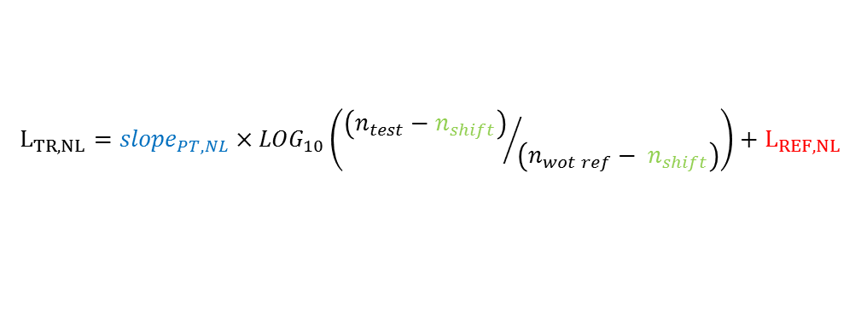
Report of discussions and conclusions Model concept and test program
The model was presented and discussed :
Model :
With :
L tyre, No Load :
L propulsion, No load :
L propulsion, Dynamic:
Anchor points are defined from L_{wot} and L_{crs} (from the lower or single gear, the acceleration, the vehicle speed v_{BB}, the engine speed n_{BB}).
$L_{exp}=10×{LOG}_{10}\left({10}^{0,1×L_{Tyre}}+{10}^{0,1×L_{PT, NL}}+{10}^{0,1×L_{DYN}}\right)$+Margin
$$L_{TR, NL}={slope}_{TR}×{LOG}_{10}\left({V_{test}}/{50}\right)+L_{REF, TR}$$
$$L_{TR, NL}={slope}_{PT,NL}×{LOG}_{10}\left({\left(n_{test}−n_{shift}\right)}/{\left(n_{wot ref}− n_{shift}\right)}\right)+L_{REF, NL}$$
$$L_{DYN}={slope}_{DYN,FL}×{LOG}_{10}\left({\left(n_{test}−n_{shift}\right)}/{\left(n_{wot ref}− n_{shift}\right)}\right)+L_{REF, DYN,NL}+∆L_{DYN}$$

Slide 9
Report of discussions and conclusions Model concept and test program
Test program and excel files for datas were reviewed following preliminary tests :
ASEP-05-13 (OICA) 2017-11-09 IWG DATA ENTRY SHEET - WITH EXAMPLE.xlsx
ASEP-05-17 (OICA) 2017-11-06 IWG DATABASE TYRE ROLLING SOUND_PUBLIC.xlsx
ASEP-05-16 (OICA) 2017-11-06 IWG DATABASE STATIONARY_PUBLIC.xlsx
Prediction model and data were presented and discussed :
ASEP-06-02 (OICA) OICA presentation - ASEP Development - Physical Expectation Model - OFFICIAL.pdf
ASEP-06-03 (OICA) DATABASE ALL VEHICLES - PUBLIC.xlsx
Data collection was running :
to create a data pool which can be used to investigate the impact of the ASEP revision on current vehicle technology,
to deliver data to support the validation of design parameters for the ASEP assessment model.

Slide 10
To be done for the 7th meeting
The group strongly requests GRB members to participate and to deliver data in respect to the model and/or the sound emissions:
Delivery van, micro-van, budget car, BEV, HEV, any new technologies, sport cars, manipulated vehicles, …
The group requests to IWG members to work on:
Model parameters such as x% evaluation, slopes, …
Partial throttle : Vehicle sound model and test method : How to specify ?, which input for the model (%load, acceleration, pedal course, …).
Low and high speed alternative approaches if tests are difficult due to facilities, methods, …
§.6.2.3 (last sentence) of the main body of the UN Regulation 51-03

Slide 11
To be done at the 7th meeting
The group proposes to work on :
Test program and data collection
Prediction model for DYN,
Application to all technologies,
Formulas and table of symbols, first draft of new annex 7
§.6.2.3. (last sentence) of the main body of the UN Regulation 51-03
Partial load (especially GRB/2018/2 Part 3 of the Table 1)

