Slide 1
OVC-HEV Certification according to R83/R101 Mode Selection for condition A and B
Submitted by the expert from OICA | Informal document GRPE-76-22 76th GRPE, 9-12 January 2018 Agenda item 3(a)

Slide 2
OVC-HEV Certification according to UN-ECE R83/R101 Background
Current legislative text could lead to the interpretation that a mode for condition B shall be selected which is not only reflecting the energy (fuel and electric energy) used for vehicle propulsion but also the energy used for energy conversion (recharging the battery – fuel energy to electric energy).
If energy is used for energy conversion, this converted/recharged energy is reflected on the one hand side in a higher fuel consumption but on the other hand side also in a lower electric consumption.
WLTP is taking of this fact and is correcting the Sustaining Test (which is the corresponding test to condition B) towards a neutral charging balance.
R83/R101:
For NOVC-HEVs, a correction of the fuel consumption towards a neutral charging balance is described.
For OVC-HEVs, this correction is not described for condition B.
WLTP:
For NOVC-HEVs, a correction of the fuel consumption towards a neutral charging balance is described.
For OVC-HEVs, this correction is described for the Charge-Sustaining-Test (corresponding to condition B).

Slide 3
OVC-HEV Certification according to UN-ECE R83/R101 Question on the purpose of the test results
Question: Should the test results reflect
energy used for vehicle proposal and energy conversion?
energy used for vehicle propulsion only?
OICA position:
Test results should reflect the energy used for vehicle propulsion only.
Therefore, as the legislative text is not reflecting this, action is necessary to reflect this in the text (Uploaded informal documents)
Proposed text is a copy from WLTP (with some adaptions), WLTP text already approved
Although NEDC is facing out in Europe, there are still countries/regions accepting approvals according to R83/R101 and that’s why it is necessary to take action and reflect the intention of the legislation into the text of the legislation.

Slide 4
OVC-HEV Certification according to UN-ECE R83/R101 Measurement of energy after testing in Condition A and Condition B
Reminder: e₁, e₂ and e₃ have to measured after testing in condition A and condition B
Energy measured after test
Recharged energy after complete depletion
For condition A: according to R101, § 4.2.1., the EV-mode has to be selected if your able to drive more than one mode in pure electric operation
Remaining open question: Which mode to select for condition B? (next slide only focus on condition B)

Slide 5
OVC-HEV Certification according to UN-ECE R83/R101 Mode selection for condition B – effect of different uses cases
Use case 1: Charge-Mode under Condition B
$e_{2,charge}≪e_{3}$ ➔ $E_{4,charge}$ is significantly negative
Use case 2: Charging balance neutral mode under condition B
Slight discharge: $e_{2}>e_{3}$ ➔ $E_{4,neutral+}$ is slightly positive Slight charge: $e_{2}<e_{3}$ ➔ $E_{4.neutral−}$ is slightly negative
Comparison of use case 1 and use case 2 (green: identical, red: difference):
$E_{1}$
$E_{4,charge}$ is significantly negative, $E_{4,neutral+}$ is slightly positive, $E_{4,neutral−}$ is slightly negative
$C_{condition A}$
$C_{condition B,charge} ≫C_{condition A,neutral}$
$D_{e}$ and $D_{av}$
Neutral: Intention of R83/101 legislation (also intention of WLTP)
Effect on weighted electric consumption and weighted fuel consumption:
Electric consumption | $$E_{charge}=\frac{\left(D_{e}∗E_{1}\right)+(D_{av}∗E_{4,charge})}{D_{e}+D_{av}}$$ | $$≪$$ | $$E_{neutral}=\frac{\left(D_{e}∗E_{1}\right)+(D_{av}∗E_{4,neutral+/−})}{D_{e}+D_{av}}$$
Fuel Consumption | $$C_{charge}=\frac{\left(D_{e}∗C_{conditon A}\right)+(D_{av}∗C_{condition B,charge})}{D_{e}+D_{av}}$$ | $$≫$$ | $$C_{neutral}=\frac{\left(D_{e}∗C_{conditon A}\right)+(D_{av}∗C_{condition B,neutral})}{D_{e}+D_{av}}$$

Slide 6
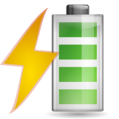
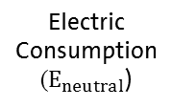
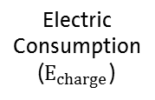
OVC-HEV Certification according to UN-ECE R83/R101 Different use cases for mode selection under condition B
Use Case 1: Charge-Mode
Use Case 2: Neutral Hybrid-Mode
Electric Consumption
($E_{charge}$)
Fuel Consumption
($C_{neutral}$)
Electric Consumption
($E_{neutral}$)
Fuel Consumption
($C_{charge}$)
Vehicle Propulsion
Battery Charging
Recharged Electric Energy can be used for upcoming electric driving
Vehicle Propulsion
Vehicle Propulsion
Vehicle Propulsion
Lower Fuel Consumption
Higher Electric Consumption
9
Energy used for Vehicle Propulsion in the test
3
12
Energy used for Vehicle Propulsion in the test
Energy used for Battery Charging in the test (for electric propulsion at later stage)

Slide 7
BACK UP

Slide 8
OVC-HEV Certification according to UN-ECE R83/R101 Example on mode selection “legislative text” – table
Imagine a vehicle with the following mode set up:
1 pure electric mode
Several hybrid modes
Intelligent hybrid mode
Charging-Balance-Neutral hybrid mode
Sport-Mode
Hybrid mode which is charging the REESS
None of the columns in 4.1.3. is perfectly fitting
There are arguments for column 4, as – looking at the surface – is not containing the wording “pure electric”, but one could assume that it is covered by the wording “hybrid mode” as the whole line is called “hybrid modes”.
But: Going into column 4 would lead in the case of this vehicle to a mode selection which is reflecting not only the energy used for vehicle propulsion but also the energy used for energy conversion (conversion from fuel into stored electric energy in the REESS)
The next slides will explain the effect on the test results fuel consumption and electric consumption.

Slide 9
OVC-HEV Certification according to UN-ECE R83/R101 Reminder: homologation test procedure
Test procedure for OVC-HEV testing is set up as follows:
Charging
Range Determination
End of Test
SoC, speed trace
Hybrid Window
Charging
Condition A
Charging Discharging
Condition B
SoC, speed trace
Hybrid Window

Slide 10
OVC-HEV Certification according to UN-ECE R83/R101 Mode selection for D_{e}-Range determination
Test procedure for Range Determination
Charging
Range Determination (D_{e}-Range)
End of Test
SoC, speed trace
Hybrid Window
Mode selection for Range Determination (for D_{e}-Range):
According to UN-ECE R101, Annex 9, Paragraph 4.2.2.1.1.

Slide 11
OVC-HEV Certification according to UN-ECE R83/R101 Mode selection for Condition A and Condition B testing
Test procedure for Condition A and Condition B testing
Charging
Condition A
Charging Discharging
Condition B
SoC, speed trace
Hybrid Window
Mode selection for Condition A and Condition B:
According to UN-ECE R101, Paragraph 4.1.3. and 4.2.1.

Slide 12
OVC-HEV Certification according to UN-ECE R83/R101 Mode selection “legislative text”
Mode selection for Condition A and Condition B:
According to UN-ECE R101, Paragraph 4.1.3. and 4.2.1.
Mode selection for Range Determination (for D_{e}-Range):
According to UN-ECE R101, Annex 9, Paragraph 4.2.2.1.1.

Slide 13
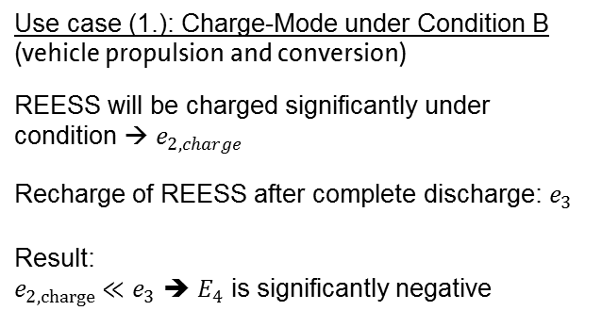
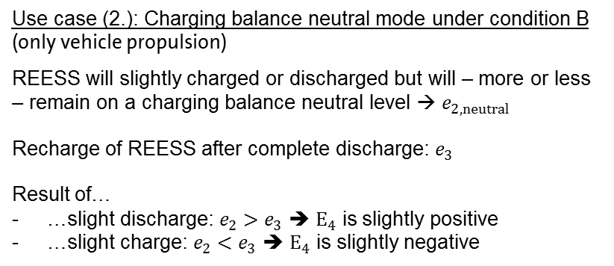
OVC-HEV Certification according to UN-ECE R83/R101 Mode selection for condition B – effect of different uses cases on measured energies
$$e_{4}=e_{2}−e_{3}$$
Use case (1.): Charge-Mode under Condition B (vehicle propulsion and conversion)
REESS will be charged significantly under condition → $e_{2,charge}$
Recharge of REESS after complete discharge: $e_{3}$
Result: $e_{2,charge}≪e_{3}$ ➔ $E_{4}$ is significantly negative
Use case (2.): Charging balance neutral mode under condition B (only vehicle propulsion)
REESS will slightly charged or discharged but will – more or less – remain on a charging balance neutral level → $e_{2,neutral}$
Recharge of REESS after complete discharge: $e_{3}$
Result of… …slight discharge: $e_{2}>e_{3}$ ➔ $E_{4}$ is slightly positive …slight charge: $e_{2}<e_{3}$ ➔ $E_{4}$ is slightly negative

Slide 14
OVC-HEV Certification according to UN-ECE R83/R101 Mode selection for condition B – effect of different uses cases
Use case 1: Charge-Mode under Condition B
$e_{2,charge}≪e_{3}$ ➔ $E_{4}$ is significantly negative
Use case 2: Charging balance neutral mode under condition B
Slight discharge: $e_{2}>e_{3}$ ➔ $E_{4}$ is slightly positive Slight charge: $e_{2}<e_{3}$ ➔ $E_{4}$ is slightly negative
$E_{1}=\frac{e_{1}}{D_{Condition A}}$
is electric consumption under Condition A
$E_{1}=\frac{e_{1}}{D_{Condition A}}$
is electric consumption under Condition A
$E_{4,charge}=\frac{e_{2,charge}− e_{3}}{D_{Condition B}}$
is electric consumption under Condition B (in use case 1)
$E_{4,neutral}=\frac{e_{2,neutral}− e_{3}}{D_{Condition B}}$
is electric consumption under Condition B (in use case 2)
$C_{condition A}$
is fuel consumption under Condition A
$C_{condition A}$
is fuel consumption under Condition A
$$C_{condition B, charge}$$
is fuel consumption under Condition B (in use case 1)
$$C_{condition B, neutral}$$
is fuel consumption under Condition B (in use case 2)
$D_{e}$ is range driven under pure electric mode
$D_{e}$ is range driven under pure electric mode
$D_{av}$ is 25km (assumed distance between two battery recharges
$D_{av}$ is 25km (assumed distance between two battery recharges

Slide 15
OVC-HEV Certification according to UN-ECE R83/R101 Mode selection for condition B – effect of different uses cases
Use case 1: Charge-Mode under Condition B
$e_{2,charge}≪e_{3}$ ➔ $E_{4,charge}$ is significantly negative
Use case 2: Charging balance neutral mode under condition B
Slight discharge: $e_{2}>e_{3}$ ➔ $E_{4,neutral+}$ is slightly positive Slight charge: $e_{2}<e_{3}$ ➔ $E_{4.neutral−}$ is slightly negative
Comparison of use case 1 and use case 2 (green: identical, red: difference):
$E_{1}$
$E_{4,charge}$ is significantly negative, $E_{4,neutral+}$ is slightly positive, $E_{4,neutral−}$ is slightly negative
$C_{condition A}$
$C_{condition B,charge} ≫C_{condition A,neutral}$
$D_{e}$ and $D_{av}$
Effect on weighted electric consumption and weighted fuel consumption:
$$E_{charge}=\frac{\left(D_{e}∗E_{1}\right)+(D_{av}∗E_{4,charge})}{D_{e}+D_{av}}$$ | $$≪$$ | $$E_{neutral}=\frac{\left(D_{e}∗E_{1}\right)+(D_{av}∗E_{4,neutral+/−})}{D_{e}+D_{av}}$$
$$C_{charge}=\frac{\left(D_{e}∗C_{conditon A}\right)+(D_{av}∗C_{condition B,charge})}{D_{e}+D_{av}}$$ | $$≫$$ | $$C_{neutral}=\frac{\left(D_{e}∗C_{conditon A}\right)+(D_{av}∗C_{condition B,neutral})}{D_{e}+D_{av}}$$

