Slide 1
Informal document GRPE-76-25
76th GRPE, 11-12 Jan. 2018, agenda item 3(b)
Status report
of the
WLTP Informal Working Group
Prepared by WLTP IWG

Slide 2
0. Content
WLTP Overall Progress
Overview of „Request for GRPE Approval“
Amendment 4 of GTR#15 + request to adopt
Procedure of future amendments
Amendment 1 of GTR#19 + request to adopt
Revised working schedule + request to endorse
Progress in the Task Forces
Outlook for GRPE-77
Seperate presentation:
9. Transposition into UN R (GRPE-76-24e/24a1e)

Slide 3
1. WLTP Overall Progress
2 Informal Working Group Meetings:
20th IWG, 26-28 September, Seoul
Amendment 4 of GTR#15 (WLTP)
Amendment 1 of GTR#19 (EVAP)
21rd IWG, 9 January, Geneva
Informal to amend Amd 4 of GTR#15
Informal to amend Amd 1 of GTR#19
Revised working schedule
Request to GRPE-76:
Adopt amendments to GTRs #15 and #19
Endorse revised working schedule

Slide 4
2. Request for GRPE Approval
Working Items | Documentations | Next Actions
GTR #15 Amendment 4 | ECE/TRANS/WP.29/GRPE/2018/2 (technical report : ECE/TRANS/WP.29/GRPE/2018/8) GRPE-76-xx : amending Amendment #4 | Contents of GRPE-76-xx will be incorporated into Working Document and Submit Working Document to 175th WP.29 session (June 2018)
GTR #19 Amendment1 | ECE/TRANS/WP.29/GRPE/2018/4 (technical report : GRPE-76-06e) GRPE-76-05e : editorial amendment | Contents of GRPE-76-05e will be incorporated into Working Document and Submit Working Document to 175th WP.29 session (June 2018)
PROLONGATION of Phase 2b activities |  | Provide letter to 174th WP.29 session (March 2018) Get job done based on new schedule

Slide 5
3-1. Amendment 4 of GTR#15
(Vehicle Exhaust Emissions and CO2 measurement)
Working Document : ECE/TRANS/WP.29/GRPE/2018/2
To improve the gear shifting procedures (nrated, nmin_drive_up/down)
To introduce bi-fuel and bi-fuel gas vehicles keeping in line with Regulation No. 83.
To introduce the appropriate positioning of payload mass during road load determination.
To exclude all Rechargeable Electric Energy Storage Systems (REESSs) that do not contribute to vehicle propulsion from monitoring.
To improve the definitions, terminology and editorial correction.
To define more specifically the difference in mass of CO2 during charge sustaining between the test with the highest and lowest positive and negative electric energy charge.
< complete list can be seen in WLTP-21-03e_Appendix >

Slide 6
3-2. Informal to amend GTR#15 Amd 4
Items | RESULTS | notes
Gear shift methodology | IN | WLTP-21-05_appendix1-Rev1
Dual axis dyno | OUT | will be IN after developed provisions of restrain system
Interpolation range Minimum delta’s as guidance Other elements on minimum delta Interpolation range 20% + 5g Introduction mid-vehicle | IN OUT IN OUT | Point (a) of Annex 4, 4.2.1.1.2. (Points (b), (c) and (d)) Annex 6, 2.3.2.2. (Annex 6, 2.3.2.4-5)
Permissible wind speed RL determination | IN | Annex 4, 4.1.1.1.1-2
Ki factor | IN | Annex 6, appendix 1
Drive trace index | IN | Annex 7, 7.2-3, CP option
Rolling resistance | TBD | GRPE: Keep original text or accept improvements
EV - run in - warm up | IN OUT | Annex 8, 2 On agenda SG-EV

Slide 7
4-1. Procedure of future amendments
< Up till GRPE-76 >
Amendment 4 adopted at WLTP-20
Informal GRPE-76-xx to amend Amd 4 to GRPE
Sent to GRPE-76: …/GRPE/2018/2
Request to GRPE-76: endorse …/GRPE/2018/2 + GRPE-76-xx
Discussed to amend Amd 4 at WLTP-21
Requests to GRPE-76:
Send Amd 4 to WP.29 in June 2018
will be used by EC to prepare 2nd Act EU-implementation – due in 2018

Slide 8
4-2. Procedure of future amendments
< After GRPE-76 – in case of positive decision GRPE >
Amendment 5 will be prepared at WLTP-22, -23, -24, [-25]
Aim amendment to GTR#15 once a year, starting from June 2018 session WP.29
Amd 5: Jan 2019 GRPE
[Amd 6: Jan 2020 GRPE]
[Amd 7: Jan 2021 GRPE]
Note: flexibility if required or appropriate
Draft new working document …/GRPE/2019/x to Jan 2019 GRPE
[and if necessary informal …]
Request January 2019 GRPE-78 to send Amd 5 to June 2019 WP.29

Slide 9
5. Amendment 1 of GTR#19
(Vehicle Evaporative Emission measurement)
Working Document : ECE/TRANS/WP.29/GRPE/2018/4
Major Amendments:
To include sealed-tank system test procedure
To improve the procedure of tyres baking (vehicle preparation)
To clarify witness by type approval authority
To clarify BWC(Butane Working Capacity) measurement
Informal Document : GRPE-76-05e
Editorial amendments will be incorporated into ECE/TRANS/WP.29/GRPE/2018/4

Slide 10
6-1. Revised working schedule
We are HERE
2008
2013
~2015
~2016
Phase1a
World-wide harmonized test cycles
Test procedure of pollutants and CO2/FC/EC/Range under 23degC condition
Phase1b
handle
remaining
items from
Phase1a
Phase2a
focus on
evaporative
test
procedure
Phase2b
Low temp.
Auxiliary devices
Durability
OBD
ISC, COP
E-lab. UNR
~2018
PROLONGATION
~2020

Slide 11
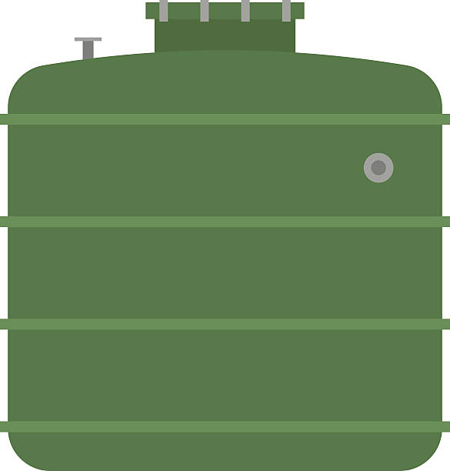
6-2. Justification of Phase2b prolongation
2018
New Issues (revealed during homologation process in EU and Japan ) need to be solved in urgent
Development of "UNR_WLTP" need more resources than expected
WLTP IWG member accepted 2 years extension taking into account of their demands
UNR
Dura.
Cycle
Original :
ECE/TRANS/WP.29/2016/29
OBD
Low T
COP
Evapo.
EXTEND by TWO YEARS
2018
2019
2020
New Issues
UNR
New Issues
UNR
New Issues
UNR
PROPOSAL
Dura.
MAC
Idle
Evapo.
Cycle
Idle
Cycle
Evapo.
OBD
COP
ISC
Low T
Low T
OBD
Dura.
Low T
Dura.
MAC
Cycle
ISC

Slide 12
7. Status of each TF
Please refer WLTP-21-07e for each TF progress
https://wiki.unece.org/download/attachments/51972955/WLTP-21-07e_Current%20Status_rev1.pdf?api=v2
8. Outlook for GRPE-77
Working Categories | Expected Actions
Transposition to UNR | progress report and may ask guidance for improvement
New Issues | provide Informal document for GTR#15_amd#5
Other TFs | report latest status
GTR Amendment | no document is expected
IWG Meeting | request more than 1 day session

