Slide 1
Global Technical Regulation No. 16 (Tyres) IWG Tyre GTR Proposal for Amendment No. 2 (phase 2A)
Informal document GRRF-86-28
86th GRRF, 12-16 February 2018
Agenda item 7(a)

Slide 2
Amendment Categories
Alignment of the provisions with the most recent developments in UN Regulations
Alignment to scope and clarifications
New Harmonized Provisions
Reference Inflation pressure
Measuring Rim (TYREGTR-17-09)
Administrative
Editorial

Slide 3
1. Alignment of the provisions with the most recent developments in UN Regulations
Definitions, specifications, markings
ECE/TRANS/WP.29/2016/51 (R30) Removal of the repetitions of the word ‘Pneumatic’
ECE/TRANS/WP.29/2016/52 (R54) Modified Definition of “Brand name/trademark”, “Manufacturer”, “Trade description/commercial name”
ECE/TRANS/WP.29/2016/60 (R117)
ECE/TRANS/WP.29/2016/52 (R54) The inscription "M+S", "M.S.", "M&S", "M-S", or "M/S", in characters not less than 4 mm high, if the tyre is a snow tyre or if the tyre is a special use tyre; Drum Speed in kmph ipo rpm for R54 Endurance test program High Flotation table update
ECE/TRANS/WP.29/2017/105 (R30) The inscription M+S or M.S or M&S if the tyre is classified in the category of use "snow tyre" or if the tyre is classified in the category of use "special use tyre"
ECE/TRANS/WP.29/2016/51 (R30) Section Width, Outer Diameter Calculation and Specification
Nominal Rim Diameter code table update

Slide 4
2. Alignment to scope and clarifications
Examples
Removal from the scope of:
- Special Tyres (ST) for trailers in highway service;
- LT or C tyres with tread-depth of greater than or equal to 14.3 mm (18/32 inch)
Rationale: “ST” for trailers and LT/C with tread depth .ge. 14.3mm are regulated under FMVSS §571.119 which covers “New pneumatic tires for motor vehicles with a GVWR of more than 4,536kilograms(10,000pounds) and motorcycles.” Therefore out of the GTR scope as defined in 1.1
General Clarifications
Procedure to assess the flat tyre running mode of passenger car run flat tyres

Slide 5
3. New Harmonized Provisions
Tyre Dimensions
Addition of new harmonized provisions for physical dimensions of LT/C tyres
(new Section 3.20; old Sections 3.20 & 3.21 to be deleted)
Subdivision in 3 categories:
Physical dimension for metric sizes (excluding all sizes listed in Annex 6) Most stringent requirements from FMVSS 139/R54 retained
Physical dimension for high flotation sizes (excluding all sizes listed in Annex 6)
Requirements as per WP.29/GRRF/2018/5 amended by GRRF-86-26,
subject to approval by GRRF and adoption by WP.29
Physical dimension for sizes listed in annex 6 (Legacy)

Slide 6
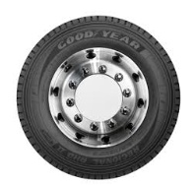
Regulation ECE R54 and FMVSS Pressure : Test/Stamping/relationship to Load Carrying Capacity
4. Reference Inflation Pressure
FMVSS-119 |  | ECE-R54
Defined in reference to the Load Range, based on the Inflation Pressure corresponding to the maximum load rating marked on the tire; | Regulatory test pressure | Manufacturer’s declaration;
Inflation Pressure associated with the maximum load rating | Sidewall Pressure Marking | Test pressure
Maximum Load Rating to be not less than the lowest of the published standards | Link with Industry standards | THEORETICALLY: No linkage required; IN PRACTICE: Usually equals the inflation pressure prescribed by a standards organization
FMVSS -139
Industry Standards
Test Conditions
FMVSS 139
Test Condition
UN- ECE 54
US CFR
Title 49
Transportation
Tire Stamping
Defined by the regulation
Loose relationship/Manufacturer’s decision
Tyre Manufacturer is defines and declares the ECE54 test pressure

Slide 7
Industry proposal, ECE R54 Test inflation pressure
4. Reference Inflation Pressure
Create a strong link between the test inflation and the tyre load carrying capacity
Industry Standards
Test Conditions
Tire Stamping
Defined by the regulation
Manufacturer’s decision
Proposal:
2.56 Reference Test Inflation Pressure applicable for LT/C tyres is the minimum cold inflation pressure for the maximum load carrying capacity of the tyre. [for single application]

Slide 8
4. Reference Inflation Pressure
Remaining issue: Tire Marking
Option 1: keep in the Technical Prescription the two markings and CP’s to decide which one(s) they want to implement
3.0 Requirements
3.3. Other Sidewall markings
3.3.5. In the case of LT or C type tyres, the maximum load rating and corresponding inflation
pressure of the tyre, shown as follows: "Max load single ___kg (___lb) at ___kPa (___psi) cold"; "Max load dual ___kg (___lb) at ___kPa (___psi) cold". For LT and C type tyres rated for single fitment only, mark as follows: "Max load ___kg (___lb) at ___kPa (___psi) cold".
3.3.11. In the case of LT or C type tyres, an indication, by the "PSI" index, of the
inflation pressure to be adopted for the load/speed endurance tests. A table showing
the relationship among "PSI" and "kPa" units is listed in Annex 4.
Option 2: Harmonize the markings

Slide 9
5. Measuring Rim
Definition and Specification
2.41. "Measuring rim" means an actual rim of specified width as defined by one of the standards organizations as specified in Annex 7, on which the tyre is fitted for measuring the physical dimensions;
3.5.3. The theoretical section width shall be calculated by the following formula:
S = S1 + K(A-A1), …
A is the width (expressed in mm) of the measuring rim, as declared by the manufacturer;
3.11. High speed performance test for passenger car tyres
3.11.4.1. Mount a new tyre on the test rim specified by the manufacturer as the "measuring rim and test rim".
3.22. Tyre rolling resistance test
3.22.3.2. Measuring rim (see Annex 9)
The tyre shall be mounted on a steel or light alloy measuring rim, as follows:
(a) For Class C1 tyres, the width of the rim shall be as defined in ISO 4000-1:2010;
(b) For Class C2 and C3 tyres, the width of the rim shall be as defined in ISO 4209 1:2001.
In cases where the width is not defined in the above mentioned ISO Standards, the rim width as defined by one of the standards organizations as specified in Annex 7 may be used."
A unique Rim width
Any Rim width
Any Rim Width
A unique Rim width
Inconsistent usage of the term ‘Measuring rim’

Slide 10
5. Measuring Rim
Reference
Rim widths are defined in the GTR No. 16 in reference to:
Standards organizations eg 2.41. "Measuring rim" means an actual rim of specified width as defined by one of the standards organizations as specified in Annex 7, on which the tyre is fitted for measuring the physical dimensions;
ISO eg 3.22.3.2. The tyre shall be mounted on a steel or light alloy measuring rim, as follows: (a) For Class C1 tyres, the width of the rim shall be as defined in ISO 4000-1:2010; (b) For Class C2 and C3 tyres, the width of the rim shall be as defined in ISO 4209 1:2001.
Annex 9 of Tyre GTR Measuring rim width:
Class C1 tyres
The measuring rim width Rm is equal to the product of the nominal section width SN and the coefficient K2:
Rm = K2 • SN

Slide 11
5. Measuring Rim
Remove the concept of 'measuring rim' in the sense of rims on which a test is to be performed from GTR and replace it by 'test rim' in line with the ISO definition.
New definition of test rim: "test rim: rim on which a tyre is fitted for testing“ in line with ISO: 4223-1 2002 para 8.8
New definition of “measuring rim width: specified rim width as defined in Annex 9 on which the tyre is fitted for measuring the physical dimensions”
Introduce for each test of the GTR a paragraph defining the test rim to be used.
Remove the references to ISO 4000-1and 4209-1 from the main text of R117 annex 6, 2.2 and GTR 3.21.3.2, since the measuring rim width is given in an annex in the annex (9).
Update the Annex 9 of the Tyre GTR with the relevant content of ISO 4000-1 and 4209-1 defining the approved rims and the measuring rim widths.
IWG Proposal
Proposal brings clarity and coherence to the Tyre GTR text without changing the technical provisions intent

Slide 12
6. Administrative
7. Editorial
Examples (administrative)
3.3.1.2.3.3.1 . In the case of LT and C type tyres, the words "Load Range" or "LR" followed by the letter designating the tyre load range "B, C, D, or E". This marking is at the discretion of the Contracting Parties implementing the GTR 16.
Reason: Relevance to the 98 agreements.
Removal of type approval related references
Example (Editorial)
3.15.3.2. Increase the load until the bead unseats or the applicable value specified in paragraph 3.15.1. is reached.
3.15.3.3. Repeat the test at least four places equally spaced around the tyre circumference.
3.15.3.4. Increase the load until the bead unseats or the applicable value specified in paragraph 3.15.1. is reached.
3.15.3.5. Repeat the test at least four places equally spaced around the tyre circumference.

Slide 13
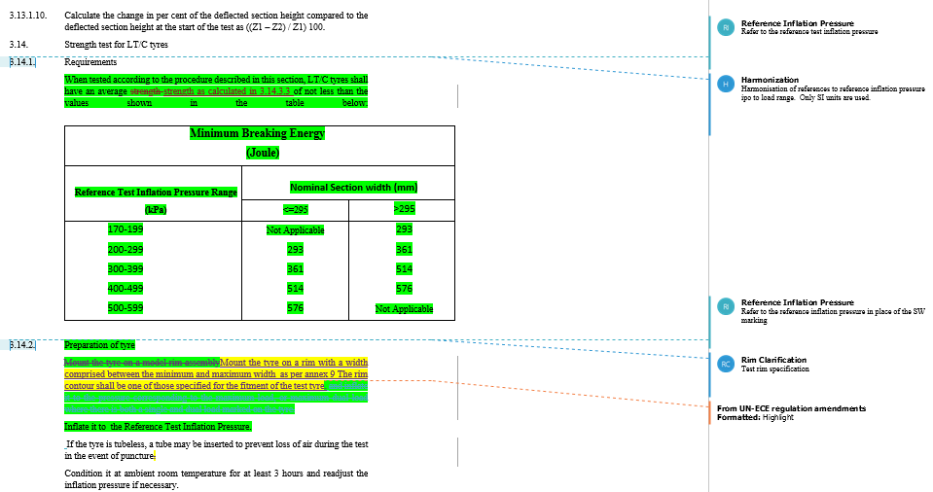
IWG working Document on Technical Prescriptions
Colour code:
Green : IWG proposal
Yellow: IWG work in progress
Markups by categories
Scope alignment and clarifications
Harmonization
From UN-ECE regulations amendments
Reference Inflation Pressure
Rim Clarification
Administrative
Editorial

Slide 14
Thank you for your attention

