Slide 1
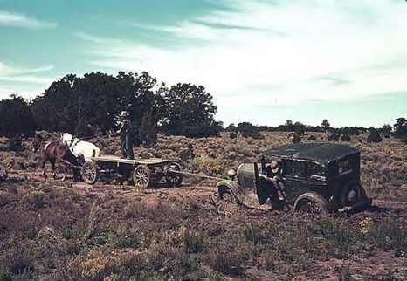
GRBP 70th session
Document GRBP-70-19
Agenda items 6 and 14
NEW TRACTION DEFINITION

Slide 2
CURRENT TRACTION DEFINITION (reminder)
[...]
2.12. “Traction tyre” means a tyre in class C2 or C3 bearing the inscription TRACTION and intended to be fitted primarily to the drive axle(s) of a vehicle to maximize force transmission in various circumstances.
6.5.1. The tyre shall have a tread pattern with minimum two circumferential ribs,
each containing a minimum of 30 block-like elements, separated by grooves and/or sipe elements, the depth of which has to be minimum of one half of the tread depth.
The use of an alternative option of a physical test will only apply at a later stage following a further amendment to the Regulation including a reference to an appropriate test methods and limit values.
(CURRENT) DEFINITION OF TRACTION IS BASED ON 1 GEOMETRICAL PATTERN PARAMETER
→ 2012 : ETRTO TRACTION TASK FORCE WAS FIRSTLY LOOKING FOR A TEST METHOD(S) AS ALTERNATIVE OPTION

Slide 3
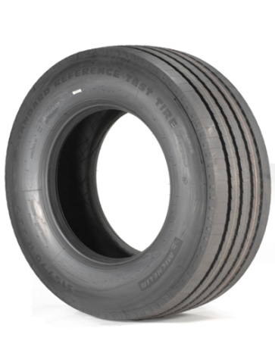
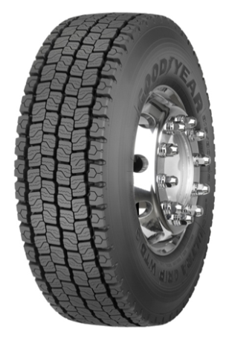
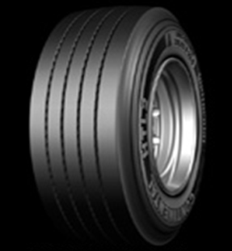
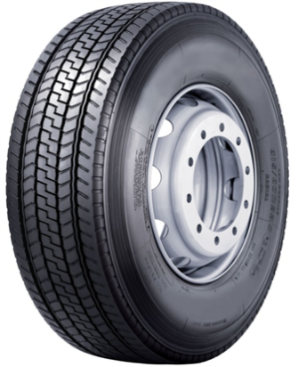
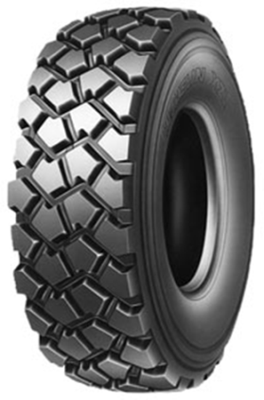
3 full Round Robin Tests
8 types of patterns, 12 tyre candidates
34 soil types tested by Companies during 2 years
summer and winter campaigns
21 EU tracks + 13 JPN tracks
Sand, Clay, Loose soil, Gravel, Concrete, Metallic plates,...
Wet and Dry tracks, Snow,...
TEST TRIALS (2013-2015)
TEST REPRODUCTIBILITY IS VERY LOW ESPECIALLY FOR SOFT SOILS.
AN ALTERNATIVE FOR NEW DEFINITION USING A UNIQUE OR A COMBINATION OF TEST(S) WAS NOT POSSIBLE

Slide 4
ETRTO GUIDELINES for NEW APPROACH (2016)
Have a more objective correlation with performance
Use objective but simple measurements
Interest of a transversal void/fill ratio introduction
More precise definition of pattern traction elements
Take into account non rib patterns
Take into account future possible technologies and designs
→ 2016 : ETRTO TRACTION TASK FORCE WAS THEN LOOKING FOR A NEW APPROACH
→ CHANGE FROM CURRENT PURE GEOMETRICAL APPROACH TO A MORE MECHANICAL APPROACH

Slide 5
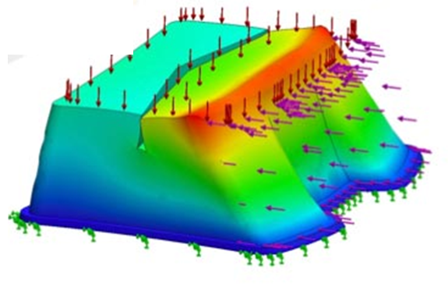
INTRODUCTION OF PATTERN “DEFORMATION POTENTIAL” CONCEPT
CURRENT DEFINITION
(only 1 factor)
NEW DEFINITION PROPOSAL
(3 factors)
Image source :
Google image
Total amount of elements (TE)
Limit : 60 = minimum 2 x 30 elements
Total amount of elements (TE)
Introduction
of new concept of Deformation Potential
(deeper block and more voids lead to more deformation)
Deformation Potential (DP) =
void/fill ratio x tread depth ³
3 PARAMETERS : TOTAL AMOUNT of ELEMENTS & VOID/FILL RATIO & TREAD DEPTH.
NEW APPROACH IS MORE MECHANICAL ORIENTED ...

Slide 6
MORE FLEXIBILITY BUT MORE SEVERE CONDITION FOR BLOCK SEPARATION FEATURES
CURRENT DEFINITION
NEW DEFINITION
Elements separated
by grooves/sipes having
their depth in average
min 70% of tread depth AND everywhere min 10% of tread depth
Elements separated
by grooves/sipes having
their depth
min 50% of tread depth
min 10% TD
Stronger requirements concerning the separating grooves/sipes
from 50% to 70% and never below 10%
NEW APPROACH IS MORE MECHANICAL ORIENTED ... and MORE SEVERE (for longer Traction sustainability)
BUT STILL CLEAR, RELIABLE and without need of specific testing.

Slide 7
NEW LIMIT PROPOSALS
TE
400
200
100
60
TE
400
200
100
60
TE
400
200
100
60
C2 tyres
HERE ABOVE
MAY BE
TRACTION
Small C3 tyres with RD < 20
HERE ABOVE
MAY BE
TRACTION
Big C3 tyres with RD ≥ 20
HERE ABOVE
MAY BE
TRACTION
BELOW
MAY NOT
BELOW
MAY NOT
BELOW
MAY NOT
0 500 1250 1400 2000 DP
0 500 1250 1400 2000 DP
0 500 1250 1400 2000 DP
TE : Total amount of Elements in tread pattern
DP : Pattern Deformation Potential = VR * TD ³ RD : Nominal Rim Diameter code
NEW TRACTION LIMITS
C2 - SMALL C3 - BIG C3

Slide 8
SYNTHESIS : IMPACT on the MARKET DISTRIBUTIONS
C2 TYRES
C3 TYRES
CURRENT
Definition
60% might be
Traction marked -
40% may not be
NEW
Definition
Proposal
40% may be -
60% may
no more be
CURRENT
Definition
75% might be
Traction marked -
25% may not be
NEW
Definition
Proposal
40% may be -
60% may
no more be
With new TRACTION definition
Segregation will better correspond to market reality AND TO REGULATION INTENTION
Sales information :
2016 Europool data

Slide 9
CONCLUSION
ETRTO considers that current TRACTION definition is not well segregating real Traction tyres from non-Traction ones.
It has not been possible to define a unique test method and a unique threshold to propose a physical test method.
ETRTO proposes a more mechanical approach for the new Traction definition.
This new Traction definition proposal provides a more accurate segregation, better corresponding to market reality.
Sufficient transitional provisions will be precised in a Working Document for next GRBP session if this proposal is accepted.

Slide 10
Thank you ! !

