Slide 1
Informal document GRPE-78-12-Rev1
78th GRPE, 8-11 January 2019
Agenda item 7

Slide 2
49th PMP session in conjunction with 78th UNECE GRPE session
PMP IWG Progress Report
Informal document GRPE-78-12-Rev1
78th GRPE, 8-11 January 2019
Agenda item 7
Geneva, 8th -11th January 2019
UNITED NATIONS
A more comprehensive version of this presentation is available on the PMP website as document PMP-49-02

Slide 3
PMP meetings in 2018
2018-01-10: PMP 46th (GRPE Geneva summary)
2017-05-16/17: PMP 47th
2018-11-7/8 PMP 48th
NEXT F-2-F MEETING: PMP 50th Session 3rd – 4th April 2019 (Location: JRC Ispra - tbc)

Slide 4
EXHAUST PARTICLE EMISSIONS

Slide 5
Main open points
Round Robin Sub-23nm
Raw exhaust sampling
Round Robin PNC (Particle Number Counter)
Horizon 2020 projects
Particle emissions from gas engines
WLTP low temperature PN testing
Effect of fuel on PN

Slide 6
Sub23 nm Round Robin
Development of a sub23nm (cut-off size:∼ 10 nm) particle number measurement procedure based on the existing PMP methodology conveniently adapted.
Main purpose: Monitoring particle emissions of new engine/after-treatment technologies.
Assessment of the repeatability/reproducibility of the proposed particle counting methodology by means of a “round robin”.
Two systems with CS and 10nm CPC to circulate
Each lab PMP system plus a 10nm CPC (to circulate)
One golden vehicle (Opel Astra GDI – no GPF)
  The PMP group would have preferred 6d technology for the golden vehicle, this was not available in the program timing and will need investigation later
7 EU labs completed. Extension to China / Japan / USA under investigation

Slide 7
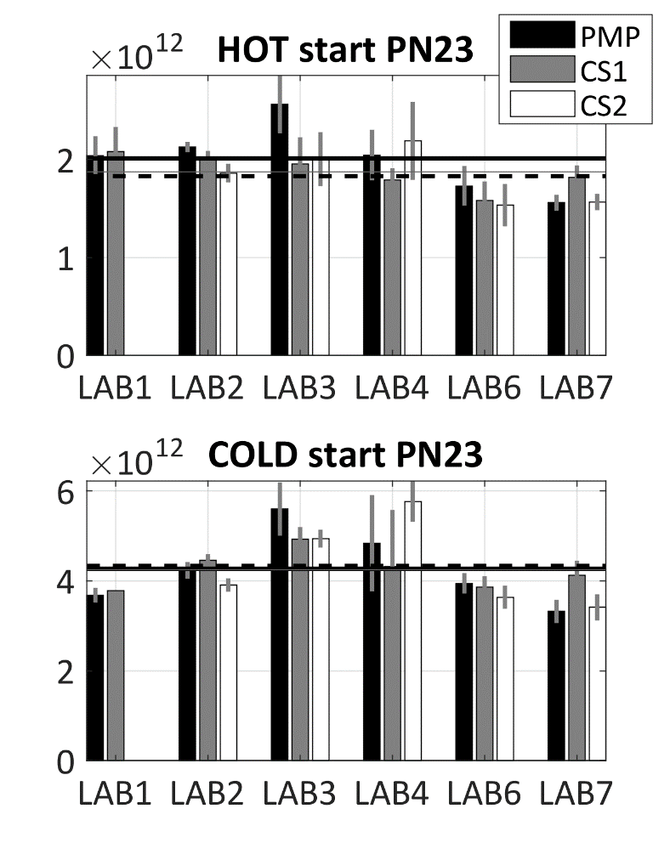
PMP PN23 results
The average PN23s in laboratories
  The PN23 for different instruments within 10%
Repeatability/Reproducibility Better for CS1 than for PMP or CS2
10¹²/km | HOT | COLD
PMP | 2.0 ± 0.3 | 4.3 ± 0.8
CS1 | 1.9 ± 0.2 | 4.2 ± 0.4
CS2 | 1.8 ± 0.3 | 4.3 ± 1.0
Average
lines
 | HOT/COLD
PN23 | Repeatability | Reproducibility
PMP | 0.17 /0.19 | 0.20 /0.23
CS1 | 0.10 /0.10 | 0.14 /0.16
CS2 | 0.15 /0.23 | 0.20 /0.24
Normalized
to mean

Slide 8
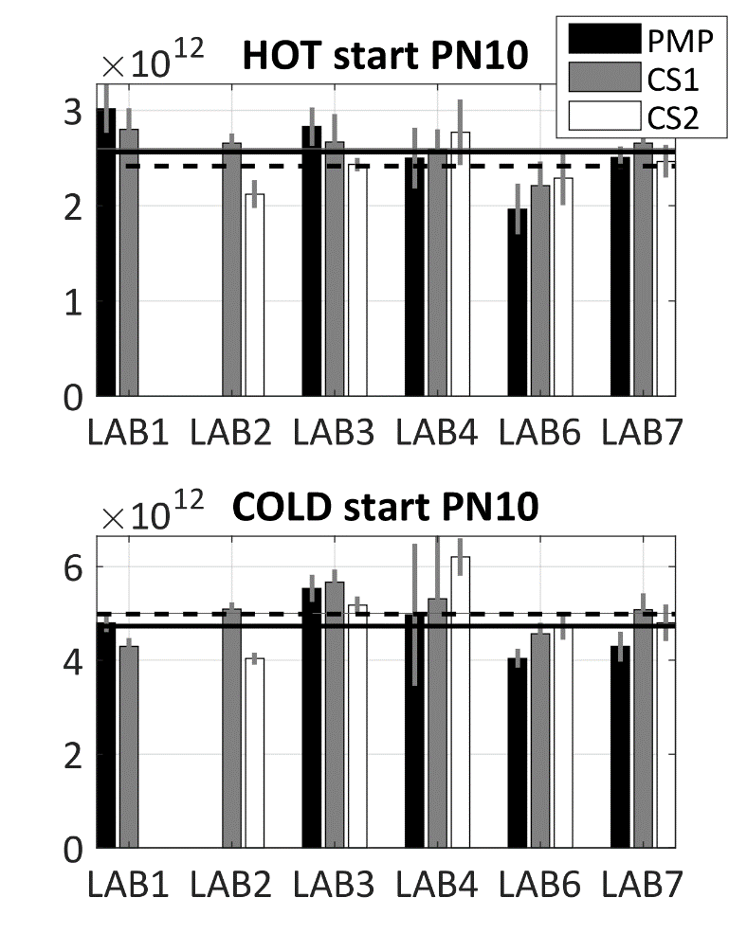
PMP PN23 and PN10 results
The average PN23s in laboratories
  The PN23 for different instruments within 10%
  Repeatability/Reproducibility Better for CS1 than for PMP or CS2
The average PN10 in laboratories
  The PN10 for different instruments within 15%
  Repeatability/Reproducibility Better for CS1 than for PMP or CS2
  Catalytic Stripper is better for PN10 than PN23
Recalibration/-design needed
  Current methodology →
    High variation of Sub23nm between laboratories
    LOSSES at Sub23nm-fraction

Slide 9
PN Counting from Raw Exhaust via Fixed Dilution
Interest in this approach confirmed by some engine manufacturers and some instrument manufacturers
01 Series of amendments to Reg. 132 already includes such possibility but the procedure is not defined
First analysis of potential benefits/issues presented during the last meetings
Correlation with other methods (CVS and partial flow system) and advantages/disadvantages to be checked – Additional data required

Slide 10
Raw exhaust (tailpipe) sampling
Preliminary results generated by the JRC show 20% differences
Input from others is necessary
Theoretical investigation of uncertainty
Data presented by the industry during the 43rd meeting confirming good correlation
A well designed experimental programme has been agreed between JRC and ACEA
Objectives:
Assess raw exhaust sampling for type approval
  Uncertainty TP vs CVS or PFDS
  Robustness of TP systems
  Technical specifications
Sub-23 nm
  Support PMP

Slide 11
Scope / Timeline
The exercise should cover:
  CNG, DPF regenerations, high bio-fuels
  Crankcase (open system) emissions connected to tailpipe
  Instruments will be calibrated (especially 10 nm CPCs)
European timeline from week 41 2018 to week 19+ 2019 covering 6 OEMS
Extension to China (VECC and CAAM) under consideration
Preliminary results at OEM1 show good results:
  Excellent comparability partial flow – raw exhaust for both 23 and 10 nm CPCs
  No artifacts from crankcase emissions

Slide 12
PNC Calibration Round Robin
Final report finished – Available on the PMP website
Several reccomendations for calibration procedure improvement
Agreement within PMP group that at this moment in time changes to the calibration procedure make sense only in combination with the development of a sub-23 nm procedure

Slide 13
Short literature review about effects of gasoline characteristics on solid PN-Emissions, GDI
Aromatics are suggested to increase PN emissions
  Hard to decompose, High ΔHv
  Low volatility,
  Decompostion directly to soot precursors
Volatility of the fuel is suggested to imply lower PN emissions
  Low volatility of fuel can affect mixture formation  wall wetting  PN
  (Too) high volatility fuel  possible flash evaporation  enhanced PN
  "Moderate" volatility increase  PN decrease
Oxygenates are suggested to decrease PN emissions
  Oxidative reduction of soot precursors, Enhanced oxidation of soot, enhanced combustion in first place
  At high Oxygenate levels, possibility to increase PN

Slide 14
NON-EXHAUST PARTICLE EMISSIONS

Slide 15
NON-EXHAUST PARTICLE EMISSIONS
BRAKE WEAR EMISSIONS
TASK
DEVELOPMENT OF A COMMON METHOD FOR
SAMPLING AND MEASURING BRAKE WEAR PARTICLES

Slide 16
DEVELOPMENT OF A COMMON METHOD FOR
SAMPLING AND MEASURING BRAKE WEAR PARTICLES
STEP 1
DEVELOPMENT OF A NEW REAL-WORLD BRAKING CYCLE

Slide 17
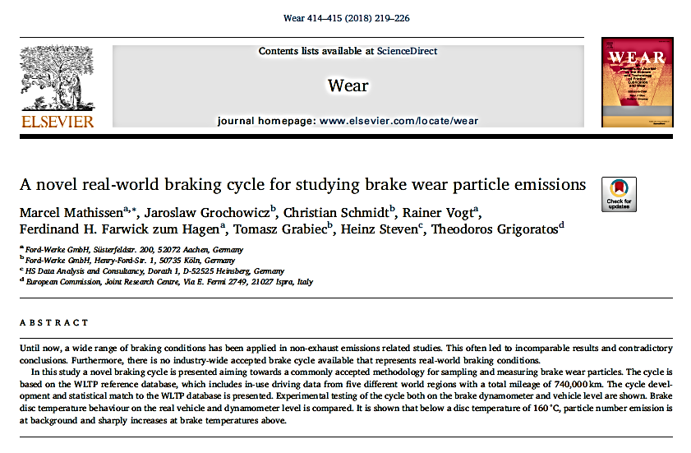
Development of a NEW REAL-WORLD BRAKING CYCLE
NOVEL CYCLE
The novel cycle has been developed and is freely available to the public in Mendeley (WLTP-based Real-World Brake Wear Cycle) https://data.mendeley.com/ datasets/dkp376g3m8/1
Technical details regarding the cycle are described thoroughly in a peer-reviewed publication and have been presented to conferences (SAE Brake Colloquium, EuroBrake) as well as to PMP meetings

Slide 18
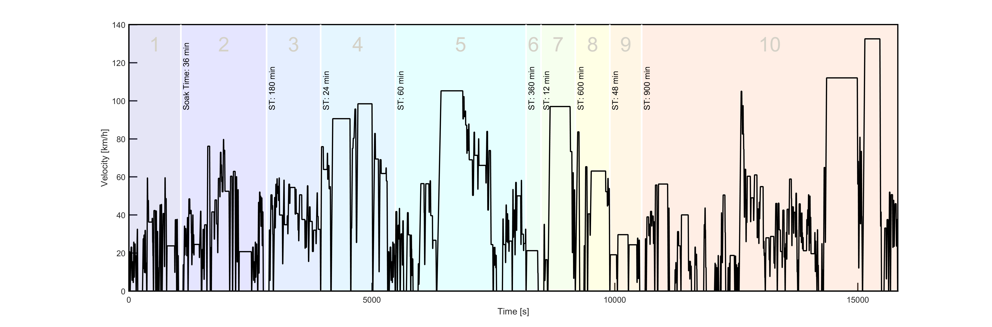
Development of a NEW REAL-WORLD BRAKING CYCLE
NOVEL CYCLE
THE CYCLE AT A GLANCE
10 trips with 303 stops in 4½ h and 192 km cycle
Average vehicle speed of 44 km/h with maximum speed of 133 km/h
Deceleration rates of 0.5–2.2 m/s² are applied (mean value of 1.0 m/s²)
The cycle has already been tested at several labs and some preliminary results have been presented to the 48th PMP Meeting. More results are expected to be published in 2019

Slide 19
Development of a NEW REAL-WORLD BRAKING CYCLE
OPEN ISSUES FOR TF1 CONSIDERATION
Q1. Low/high cooling air flow during dyno testing will lead to higher/lower average and maximum temperatures than observed in the field. How can we reproduce correct temperature levels? PMP has a recommended protocol for this during the RR validation phase.
Q2. Not all brake dyno setups are similar to each other. What would be the temperature level and cooling influence on other test setups particularly for emission testing. Still under investigation at PMP
Q3. What temperature will be achieved for other brake systems (vehicle classes) and how to adapt cycle to other vehicle classes? Further discussions needed at PMP during 2019
Q4. The development of the new cycle was based upon the WLTP European data for specific reasons. A further analysis of the WLTP data from other Regions (i.e. Japan) will be carried out to analyze if the cycle is also representative

Slide 20
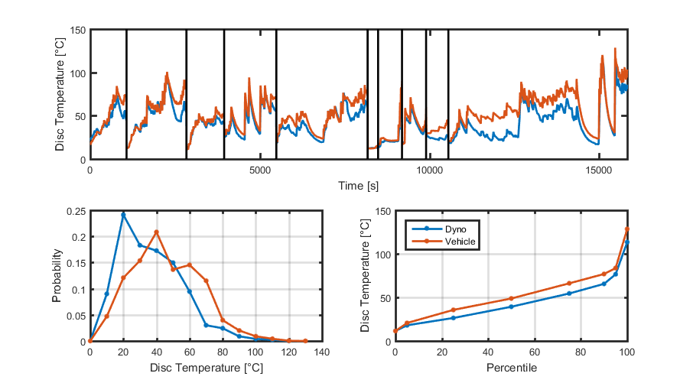
VALIDATION of THE NOVEL REAL-WORLD BRAKING CYCLE
ROUND-ROBIN EXERCISE
RR: The overall objective is to demonstrate that the novel cycle is repeatable at brake dyno level and reproducible at different labs/dynos. For that reason the brake temperature profile recorded at the vehicle during the development phase should be reproduced at the dyno level
RR is conducted in standard brake dyno test setup and NOT emissions setup
Preliminary results from 3 labs demonstrate a difference between vehicle and dyno temperature lower than 10°C
FORD EXAMPLE
Mathissen et al. 2018

Slide 21
DEVELOPMENT OF A COMMON METHOD FOR
SAMPLING AND MEASURING BRAKE WEAR PARTICLES
STEP 2
DEFINITION OF A SET OF MINIMUM REQUIREMENTS
FOR THE EMISSIONS MEASUREMENT SETUP

Slide 22
SELECTION/DEFINITION OF TESTING PARAMETERS
DEFINITION OF THE SCOPE BASED ON THE MANDATE
There is a common agreement that both PM₁₀ and PM_{2.5} as well as PN emissions should be investigated
Challenge: Optimal layout and sampling conditions might be different for mass and PN measurement! A compromise could be needed to achieve all measurements simultaneously
Challenge: There is no agreement yet on whether the PN concentration measurement shall focus on solid particles like in case of exhaust emissions or on total particles

Slide 23
SELECTION/DEFINITION OF TESTING PARAMETERS
STRUCTURE THE WORK IN DIFFERENT THEMATIC TOPICS
The work has been structured in 9 Chapters based on the needs identified at the discussion for the definition of the scope
1. Introduction, rationale, scope and list of topics not addressed
2. Nomenclature, definitions, and terminology, including ISO and EN standards
3. Brake dynamometer capabilities
4. Sampling system
5. Brake emissions mass measurement system
6. Brake emissions number measurement system
7. System calibration, validation, and sign-off
8. Appendixes

Slide 24
SELECTION/DEFINITION OF TESTING PARAMETERS
CURRENT STATUS
The minimum testing requirements/specifications for the data collection have been agreed. Agreement on the following parameters/topics has been reached:
1. Defined Cycle (WLTP-novel)
2. Background/blank concentration check
3. Defined range of cooling air temperature and RH
4. Common brake system for the first round of experiments
5. Definition of a common bedding-in procedure
6. Common method for measuring the brake temperature
7. Measurement of PM concentration based on the gravimetric method described in Chapter 5
8. Calculation of residence time in the enclosure and in the duct
9. List of parameters to be registered

Slide 25
BRAKE DUST SAMPLING AND MEASUREMENT
CURRENT STATUS
Collection of experimental data within the TF2 (on-going)
Data already exist from previous projects (already presented in 37th – 48th PMP Meetings)
TF2 members are involved in many on-going projects and more data will come from there in the near future
Based on this data the TF2 will define all necessary testing parameters and will come up with a minimum set of requirements for the sampling set-up and the necessary instrumentation

Slide 26
FUTURE TECHNOLOGIES - CHALLENGES
The test rig approach clearly focuses only on the brake system
Other technologies (e.g. regenerative braking, smart braking, ADAS) have the potential to reduce brake wear emissions
How to assess these technologies?
  The topic has been discussed in the last 2 PMP meetings – Presentation from VDA and TU Ilmenau showing a potential of between 60-90% decrease in PN emissions
  Different options have been identified (modified cycle, modified brake dynos, eco-innovation like approach, modelling…)
  Further analysis will follow once the common methodology development is concluded

Slide 27
TYRE WEAR PARTICLES
In the 48th PMP meeting 3 sessions were dedicated to the subject
JASIC (Japan) presented their methodology for Tire dust emission measurement for a passenger vehicle.
TU Ilmenau presented the results of laboratory measurements of tire wear emissions from their common project with AUDI (Presentation will become available in May)
ETRMA provided an overall perspective of the tyre industry not only for tyre wear particle emissions but also for Microplastic emissions

Slide 28
PMP NEXT STEPS

Slide 29
PMP Mandate
Current mandate expires in June 2019
The PMP group had submitted to GRPE in June 2016 an updated draft version of the ToR and requested a new mandate with two main new concrete objectives:
  Sub 23 nm exhaust particles:
    Demonstrate the feasibility to measure sub23nm particles with the existing PMP methodology with appropriate modifications and assess measurement differences/uncertainties by means of a round robin (RR)
      Development of a suggested common test procedure for sampling and assessing brake wear particles both in terms of mass and number

Slide 30
PMP Mandate
The informal group on Particle Measurement Programme should complete the tasks described in the revised TOR by June 2019. A prolongation and extension of the mandate of the group, in relation to the above tasks should be considered in by GRPE in the 79th session.
The new mandate request will take into consideration the post-Euro 6/VI standard discussion just started in Europe

Slide 31
Post-Euro VI/6
A number of new measures will be assessed in the next months in view of a possible introduction in the post-Euro 6/VI standards.These include:
  Reduction of the cut-off size below 23 nm (at least 10 nm) of the particle number measurement methodology
Other measures under consideration not linked to post Euro 6/VI
  Assessment of the possibility to introduce a standard on brake emissions
  Methodology for the measurement of tyre abrasion rate

Slide 32
Sub-23 nm exhaust particles
EC requested the methodology to be ready, from a technical point of view, by June 2020
This means a number of decision to be taken in the short term to leave enough time to assess different engine technologies and provide inputs for the definition of the limits
It has been proposed to:
  Organize soon a webconference to start the discussion within PMP group and to prepare the next f-2-f meeting
  Prepare a detailed roadmap in the next f-2-f meeting to meet the target date
  Drafting coordinator needed

Slide 33
Potential timeline /Milestones (to be revised)

Slide 34
BRAKE WEAR EMISSIONS
DEVELOPMENT OF A COMMON METHOD FOR
SAMPLING AND MEASURING BRAKE WEAR PARTICLES
STEP 1 - Development of a new real-world braking cycle
WLTP Database Analysis (Concluded)
Comparison of WLTP data with Existing Industrial Cycles (Concluded)
Development of a first version of the novel (WLTP based) braking schedule (Concluded)
Validation of the novel cycle - Round robin (Deadline: January 2019)
STEP 2 - Definition of a set of minimum requirements for the emissions measurement setup
Selection of the testing methodology (Concluded)
Comparison of existing systems/test rig configurations (Concluded)
Selection/definition of testing parameters (Deadline: Still on-going)
Validation of the selected configuration(s) & measurement methods (Deadline: December 2019)

Slide 35
WHAT NEXT FOR REGULATORY PURPOSE?
Building on the methodology developed within PMP seems to be a sensible approach
Once the suggested methodology has been “completed” from a technical point of view, a monitoring phase to assess typical emission levels of brake systems as well as repeatability and reproducibility should follow
Considering that PMP is based on voluntary participation/contribution, this requires a strong commitment from OEM and OEM suppliers

Slide 36
Potential timeline /Milestones

Slide 37
TYRE WEAR EMISSIONS
EU Third Mobility Package included the decision to develop a standard methodology to measure tyre abrasion rate
Very likely this methodology will be developed by an ad-hoc group set up by the EU Commission with strong involvement of main stakeholders, especially tyre manufacturers
The focus will be on the amount of material released into the environment by tyres (microplastics issue)
PMP could be involved again afterwards to investigate any possible correlation between abrasion rate and contribution to airborne PM10-2.5

Slide 38
Any questions?
You can find the PMP leadership team at
Chair : Giorgio Martini - giorgio.martini@ec.europa.eu
Technical Secretary : Rainer Vogt - rvogt@ford.com

