Slide 1
Transmitted by the Chair and Secretary of VIAQ
Informal document GRPE-81-08
81th GRPE, 9 -11 June 2020
Agenda item 12
Status Report of the
VIAQ (Vehicle Interior Air Quality)
Informal Working Group
Geneva, June 9-11th 2020
Chair: Andrey KOZLOV, Russian Federation
Co-Chair: Jongsoon LIM, The Republic of Korea
Secretary: Andreas WEHRMEIER, BMW

Slide 2
Background
Regarding to Terms of reference for the 2nd stage of VIAQ IWG activity it was developed provisions and test procedures in a recommendation by including Part 3 in the Mutual Resolution No. 3.
Final text of Mutual Resolution M.R.3 was published at UNECE site on 1 of November 2018 as the document ECE/TRANS/WP.29/1143
Notes:
2

Slide 3
ToR for the Second Stage
Timeline
2018 2019 2020
1 2 3 4 5 6 7 8 9 10 11 12 1 2 3 4 5 6 7 8 9 10 11 12 1 2 3 4 5 6 7 8 9 10 11 12
WP.29
GRPE
VIAQ
180
181
182
VIAQ Madate
76
77
78
79
80
81
Informal
document
formal
document
11
12
13
14
15
16
17
18
19
20
Half of working items almost closed
Make a drafting grup
Develop provisions and harmonized test procedures.
VIAQ recommendation (a new part of M.R.3)
January 2020: Draft document was submitted to 80th GRPE session
June 2020: Adoption of the draft document by 81st GRPE session
November 2020: Adoption of the draft document by WP.29
Notes:
3

Slide 4
VIAQ IWG Meetings since the 80th GRPE sessions
19th VIAQ IWG Meeting
  Paris, France, 9-10th March 2020
  Two days
Notes:
4

Slide 5
Amendment to Mutual Resolution (M.R.3) on VIAQ
During last two years by Informal Working Group was developed amendment to Mutual Resolution 3 concerning Vehicle Interior Air Quality. The main updates are
Updated the part I for technical rationale and justification taking into account emissions from tested vehicle entering to the cabin with exhaust gases
Updated the description of existing regulations and standards in part I
Added the part III describing the test procedure for emissions entering to the vehicle cabin with exhaust gases
Added 2 annexes describing Idle test setup and the form of the test report
NO changes in part II describing test procedure for emissions from interior materials are made.
Proposal for an amendment to Mutual Resolution (M.R.3) is the working document
ECE/TRANS/WP.29/GRPE/2020/16
Notes:
5

Slide 6
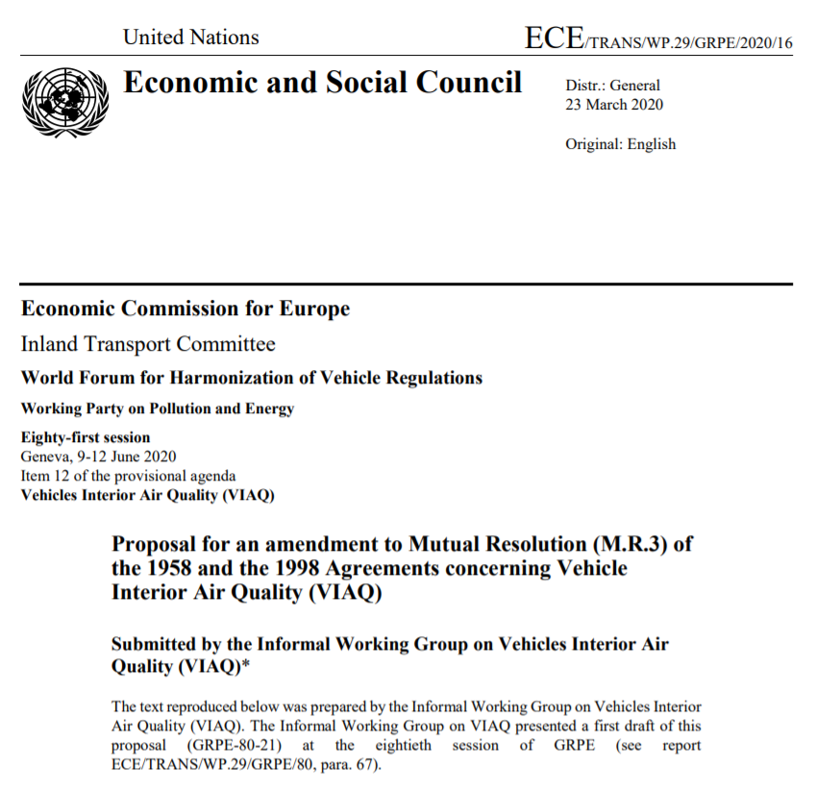
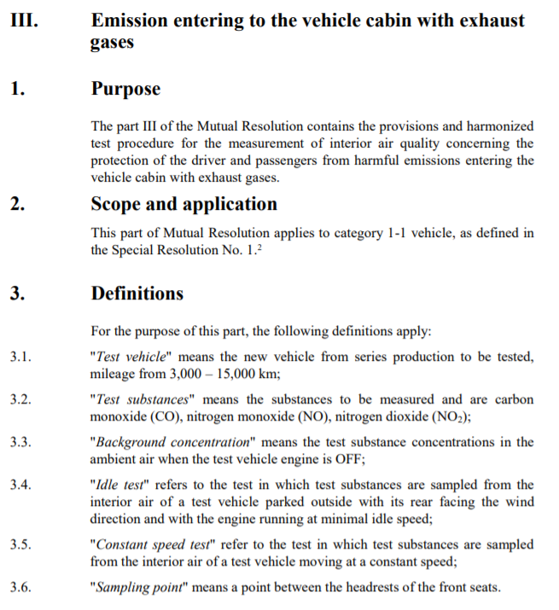
New Part III of M.R.3 on VIAQ
Notes:
6

Slide 7
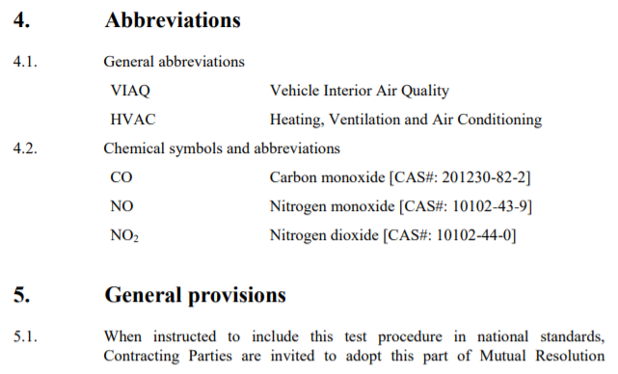
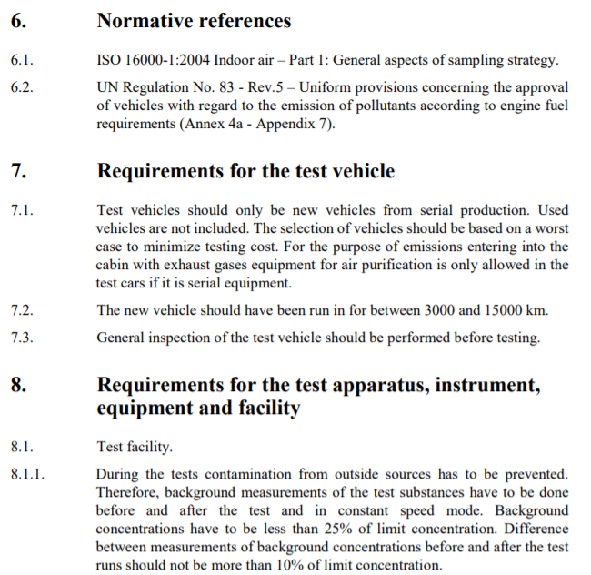
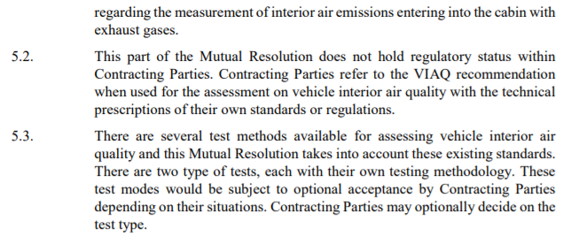
New Part III of M.R.3 on VIAQ
Notes:
7

Slide 8
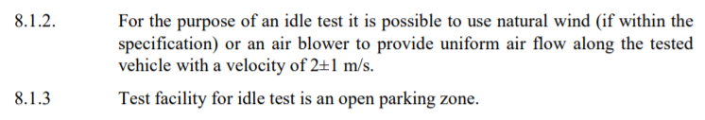
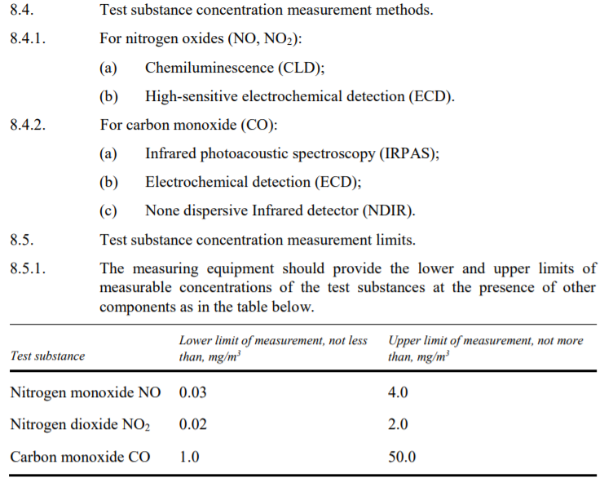
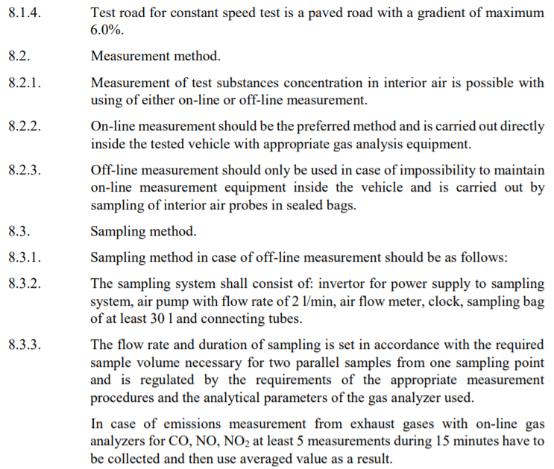
New Part III of M.R.3 on VIAQ
Notes:
8

Slide 9
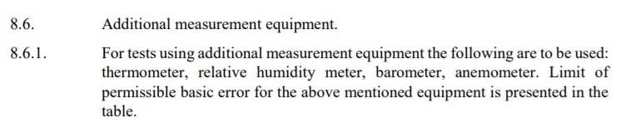
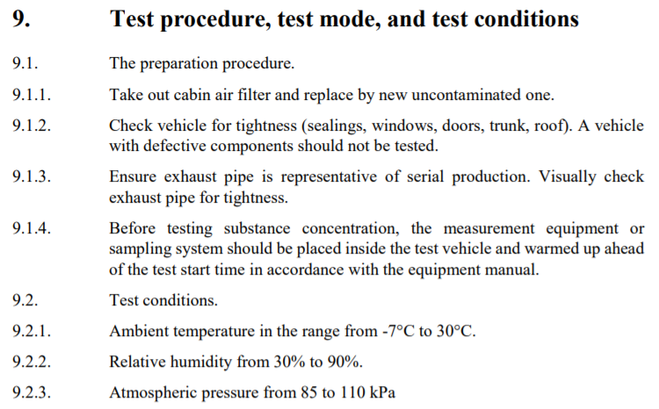
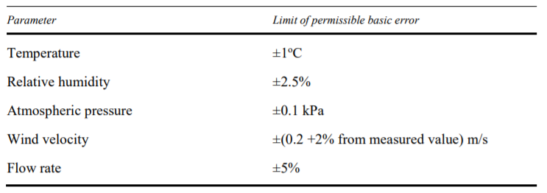
New Part III of M.R.3 on VIAQ
Notes:
9

Slide 10
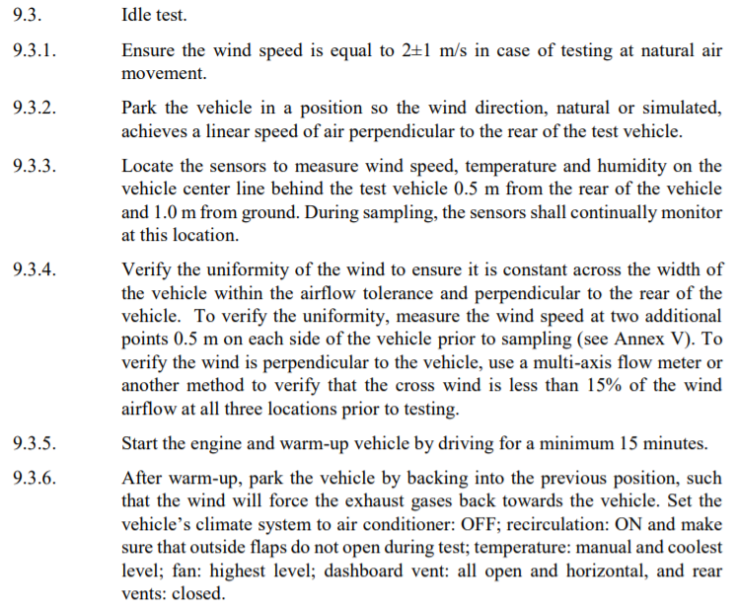
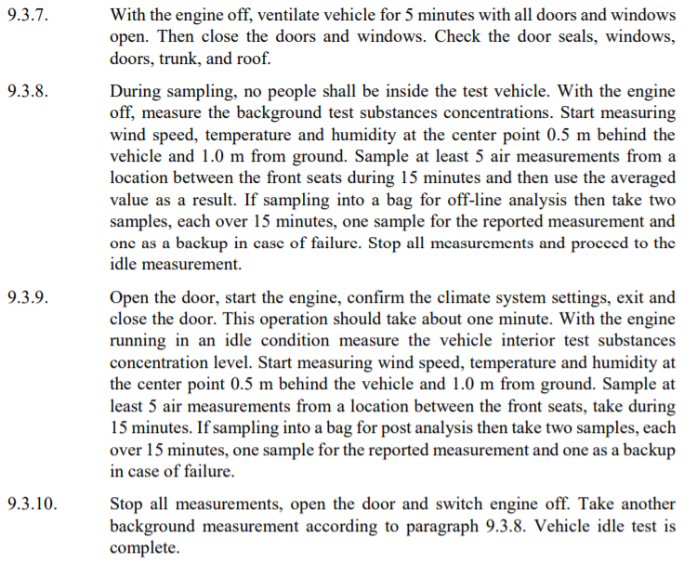
New Part III of M.R.3 on VIAQ
Notes:
10

Slide 11
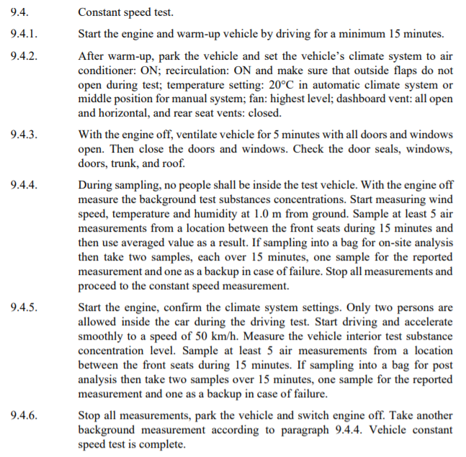
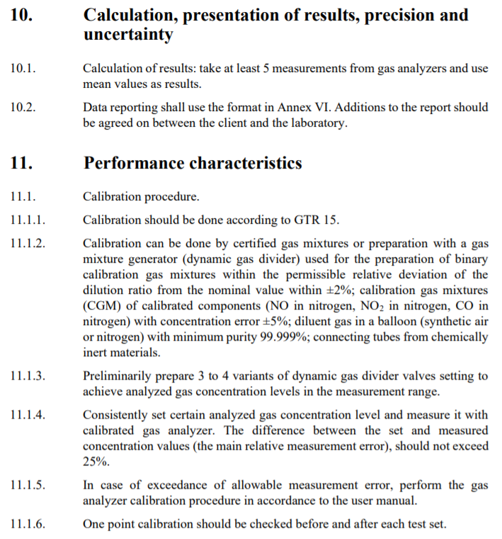
New Part III of M.R.3 on VIAQ
Notes:
11

Slide 12
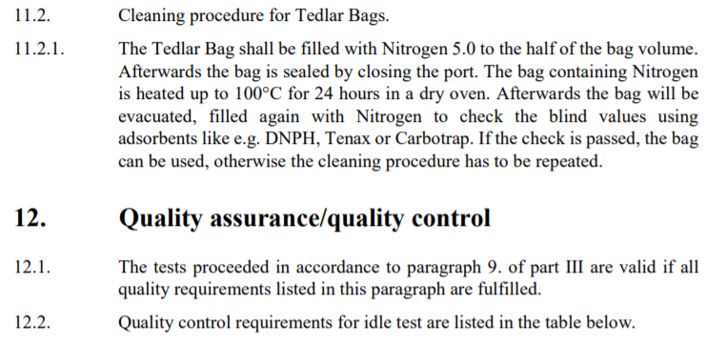
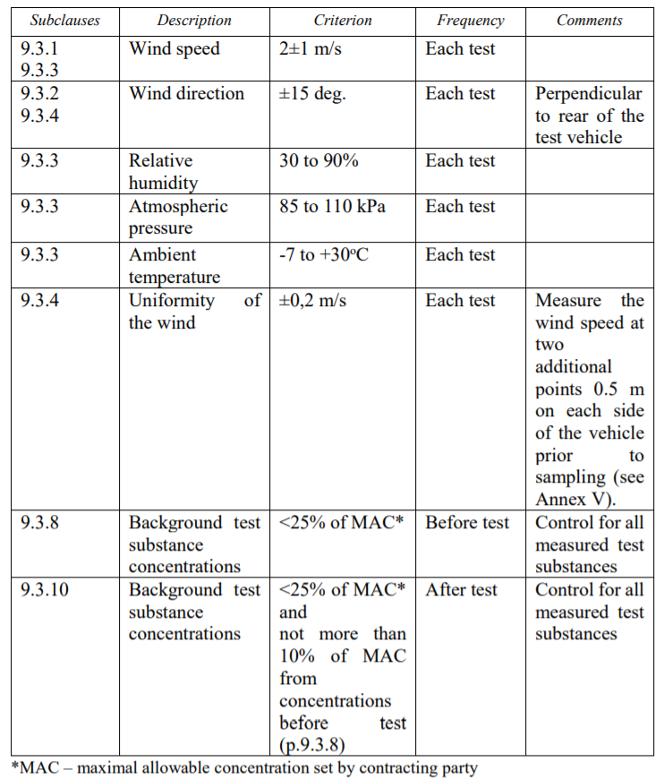
New Part III of M.R.3 on VIAQ
Notes:
12

Slide 13
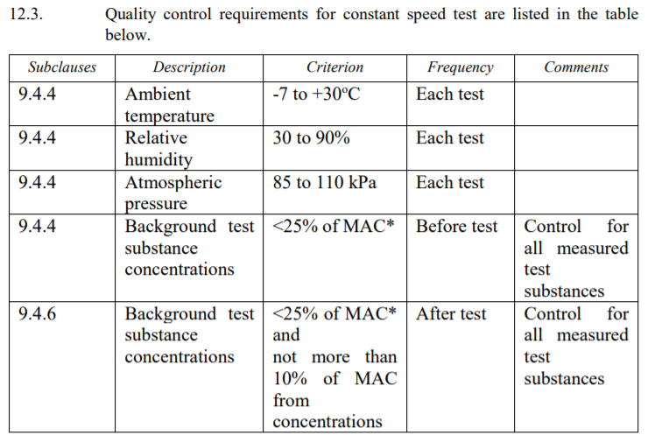
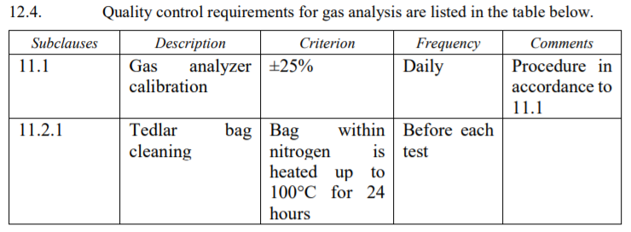

New Part III of M.R.3 on VIAQ
Notes:
13

Slide 14
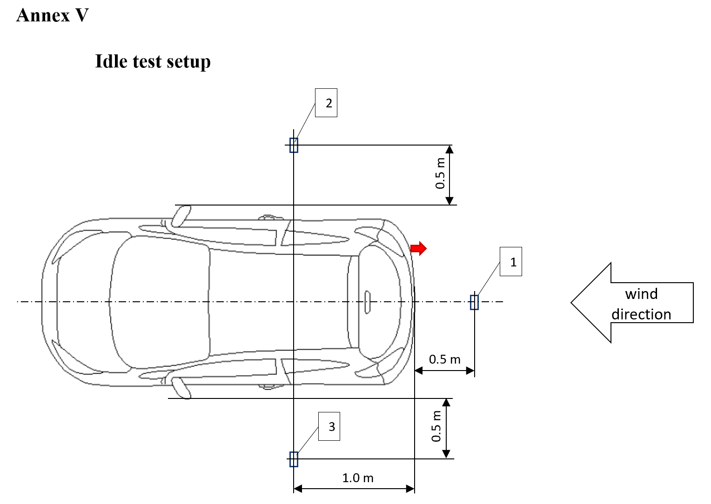

New Part III of M.R.3 on VIAQ
Notes:
14

Slide 15
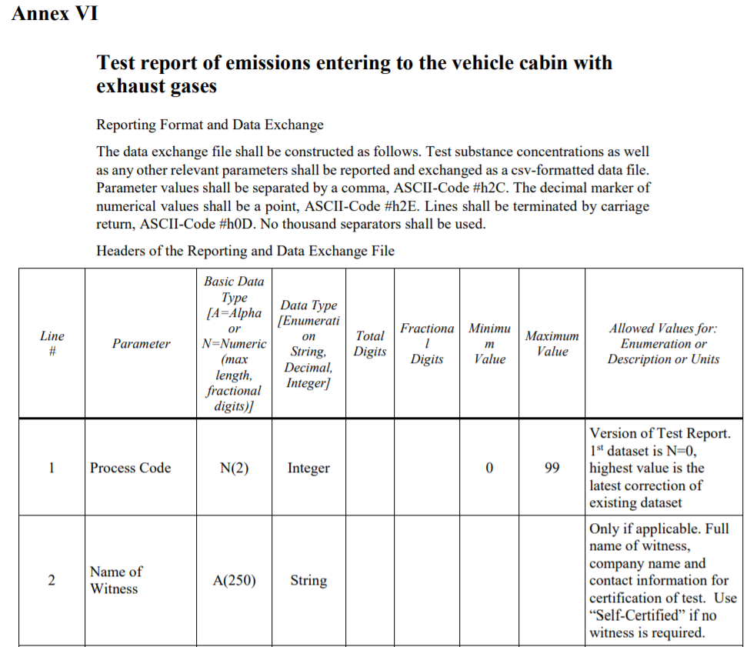
New Part III of M.R.3 on VIAQ
Notes:
15

Slide 16
Amendment to Mutual Resolution (M.R.3) on VIAQ
Conclusions on the second stage of VIAQ IWG activity
During two years was formulated, discussed and agreed all working items concerning emissions entering to the vehicle cabin with exhaust gases
Amendment to Mutual Resolution (M.R.3) on VIAQ was developed and presented to GRPE
Informal working group discussed future of vehicle interior air quality improvement and concluded to start with a broad scope of different outside pollutants including biological active particle like virus and to focus on the most relevant pollutants during the activities of the 3rd stage
Notes:
16

Slide 17
Third Stage
The mandate of VIAQ IWG will expire November 2020.
The IWG concluded to continue work on stage 3
The Terms of reference and rules of procedure was agreed on 19th VIAQ meeting
The main objective of the 3rd stage is the issues of the vehicle interior air quality, addressing outside air pollutants entering into the vehicle cabin and the interior air cleaning efficiency
The IWG asks GRPE for the new mandate till November 2025
Notes:
17

Slide 18
Third Stage
Terms of reference and rules of procedure for the Informal Working Group on Vehicle Interior Air Quality (VIAQ)
Notes:
18

Slide 19
1. Background
1.1 VIAQ informal working group developed a new Mutual Resolution No.3 on Vehicle Interior Air Quality taking into account emissions of chemical substances from the interior materials. This issue is linked to evaporative emissions from chemical compounds used in some of the vehicles’ interior elements, such as the dashboard, seat etc. The mutual resolution contains provisions and harmonized test procedures for the measurement of interior air emissions from interior materials.
1.2 On the second stage, exhaust gas entry from the tailpipe of the vehicle is taken into account. The amendment of Mutual Resolution No.3 contains provisions and harmonized test procedures for the measurement of interior air pollution from exhaust gases of a tested vehicle. The list of test substances includes CO, NO, and NO₂.
1.3 Another, probably most important, source of interior air pollution is ambient air, which could contain many harmful substances emitted by other vehicles, power plants, industry etc. The group considered the inclusion in the scope of interior air pollutants from outside sources as a possible extension of the mandate at third stage. As an extension of the existing Mutual Resolution on VIAQ, this will take into account not only interior air emissions generated from interior materials and exhaust gases from the vehicle entering into the cabin but also outside air pollution sources. The list of outside air pollutions could include CO, NO, NO₂, SO₂, O₃ volatile organic compounds (VOC), aldehydes, aromatic and aliphatic hydrocarbons, particulate number (PN) and mass (PM) and microbiological substances, e.g. allergens, fungi, bacteria and viruses. As an extension of the existing Mutual Resolution on VIAQ, this will take into account not only interior air quality but also the air cleaning efficiency of the vehicle air handling & treatment system.
Notes:
19

Slide 20
2. Procedural Background
2.1 At the 173rd WP.29 session Proposal for a new Mutual Resolution (M.R.3) for of the 1958 and the 1998 Agreements concerning Vehicle Interior Air Quality (VIAQ) was adopted (ECE/TRANS/WP.29/2017/136). Final text of Mutual Resolution M.R.3 was published at UNECE site on 1 of November 2018 as the document ECE/TRANS/WP.29/1143
2.2 At the 172nd WP.29 session, WP.29 endorsed the extension of the mandate of the IWG on VIAQ until November 2020 to extend the work to consider not only emissions generated by interior materials, but also exhaust gases from the tailpipe that enter into the vehicle cabin. (ECE/TRANS/WP.29/1131, para44)
2.3 At the 80th GRPE session, the Chair of the IWG on Vehicles Interior Air Quality presented the draft amendment of Mutual Resolution No. 3 (GRPE-80-21) and requested an extension of the mandate of the IWG on VIAQ until November 2025 to expand the work to consider interior air pollution from outside sources. (ECE/TRANS/WP.29/GRPE/80, para 67)
Notes:
20

Slide 21
3. Objective
3.1 The VIAQ informal working group will have an open structure, which will enable the exchange of information and experiences on relevant regulations, policy measures and harmonization efforts.
3.2 This proposal expands on the issues of the vehicle interior air quality, addressing outside air pollutants entering into the vehicle cabin and the interior air cleaning efficiency, to develop a test procedure in a recommendation by including Part 4 in the Mutual Resolution No. 3.
Notes:
21

Slide 22
4. Terms of reference
4.1 The following terms of reference describe the main tasks of the IWG.
  Identify and collect the information and research data on outside and interior air quality and its relevance for vehicles, taking into account the activities being carried out by various governments, and non-governmental organizations.
  Identify and understand the current regulatory requirements with respect to vehicle interior air quality and incoming air cleaning efficiency in different markets.
  Identify, review and assess existing test procedures suitable for the measurement of harmful substances while entering into the vehicle cabin and the interior air cleaning efficiency (including test modes, sample collection methods and analysis methods, etc.)
  (d) Develop provisions and test procedures in a recommendation by including Part 4 in the Mutual Resolution No. 3.
Notes:
22

Slide 23
5. Timeline
5.1 The work of the group on Vehicle Interior Air Quality should be completed by November 2025. An extension of the mandate of the group should be considered in due time by GRPE, if necessary.
(a) January 2021: Discussion for the directions and working items.
Data collection and analysis
(b) January 2022: Analysis of existing test procedures
(c) June 2022: Report to GRPE Concept of test procedure
(d) January 2023: Tests by VIAQ IWG members
(e) January 2024: Start working with draft document and verify test procedure
(f) January 2025: Submit the draft document to GRPE
(g) June 2025: Adoption of the draft document by GRPE
(h) November 2025: Adoption of the draft document by WP.29
Notes:
23

Slide 24
6. Scope and work items
6.1 Interior air emissions emitted from interior materials
(a) Continue to work, review, and assess the harmonized test procedures
      Update the interior emissions section 2 for the Mutual Resolution
6.2 Substances from exhaust gases entering to the vehicle cabin
    (a) Continue to work, review, and assess the harmonized test procedures
    Update section 3 for the Mutual Resolution
6.3 Outside air pollutants entering into the vehicle cabin and their cleaning efficiencies
    (a) Collect the information and research data on relevant air pollutants and similar issues, and understand the current regulatory requirements with respect to vehicle interior air quality in different markets.
    (b) Review, assess and develop new test procedures suitable for the measurement methods of air pollutants entering into the vehicle cabin and their cleaning efficiencies (including test modes, sample collection methods and analysis methods, etc.)
    (c) Discuss the potential of air pollutants in the vehicle interior air with toxicologists.
    (d) Develop a draft for test procedures in a recommendation.
Notes:
24

Slide 25
7. Rules of procedure
7.1 The following rules of procedure describe the functioning principles of the informal working group.
    (a) The IWG is open to all participants from any country or organization of WP.29 and its subsidiary bodies. A limitation of the number of participants for the IWG is not foreseen.
    (b) A Chair (Russian Federation), a vice chair (Republic of Korea) and a secretary (OICA) will manage the IWG.
    (c) The official language of the IWG will be English.
    (d) All documents and/or proposals shall be submitted to the secretary of the group in a suitable electronic format, preferably in line with the UNECE guidelines in advance of the meetings. The group may refuse to discuss any item or proposal, which has not been circulated 5 working days in advance of the scheduled meetings.
    (e) The informal group shall meet regularly in conjunction with the GRPE sessions, presuming the availability of meeting rooms. Additional meetings will be organized upon demand.
    (f) An agenda and related documents will be circulated to all members of the informal working group in advance of all scheduled meetings.
    (g) The work process will be developed by consensus. When consensus cannot be reached, the Chair of the informal group shall present the different points of view to GRPE. The Chair may seek guidance from GRPE as appropriate.
    (h) The progress of the informal group will be routinely reported to GRPE orally or as an informal document by the Chair or the secretary.
    (i) All working documents shall be distributed in digital format. The specific VIAQ section on the UNECE website shall continue to be utilised.
Notes:
25

Slide 26
Timeline
WP.29
197
GRPE
81
82
83
84
85
86
87
88
89
90
91
VIAQ
20
21
22
23
24
25
26
27
28
29
30
31
32
33
34
35
36
37
38
39
2020 | 2021 | 2022 | 2023 | 2024 | 2025
Concept Test Procedure
PM Draft +Gas Draft Final Draft
Data collection
Analysis of existing test procedures
Tests by VIAQ IWG members
Developing of harmonized test procedure
Stage 3. Phase 1
Stage 3. Phase 2
Notes:
26

Slide 27
Next VIAQ IWG Meetings
20th VIAQ IWG Meeting (TBD)
  • Brussels, Belgium, 9 - 10th November, 2020
  Two days
Notes:
27

