Slide 1
FIA Consumer Views on Automated and Connected Vehicles
Gerd Preuss, FIA Representative UNECE 179th WP 29 session UNECE Geneva 12-14 November 2019
Informal document WP.29-179-18
179th WP.29, 12-14 November 2019, Agenda item 2.3

Slide 2
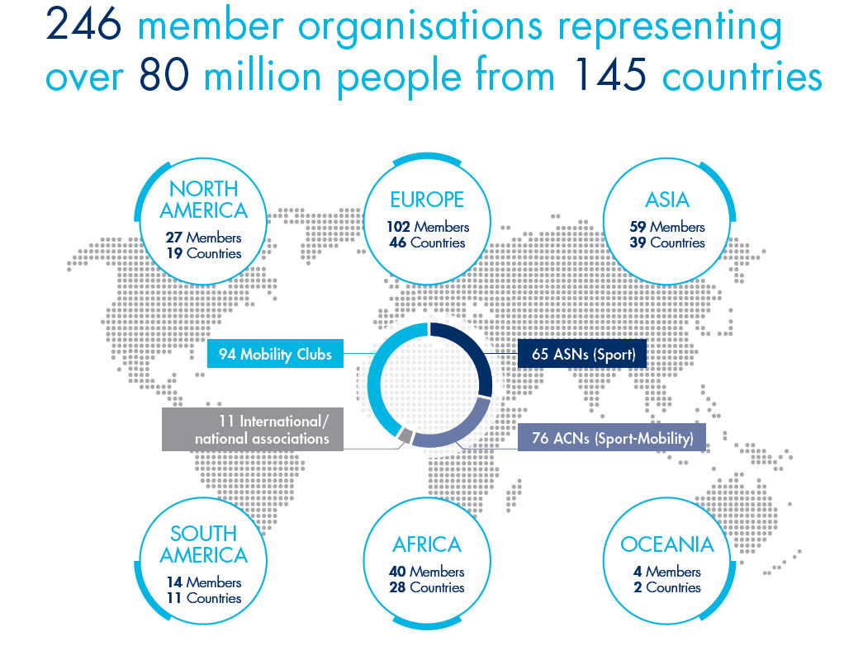
THE FIA: a worldwide presence
Founded in 1904, with headquarters in Paris, the Fédération Internationale de l'Automobile (FIA) is
a non-profit making association.
It brings together 246 national motoring and sporting organisations from 145 countries on five continents.
Its member clubs represent 80 millions of motorists

Slide 3
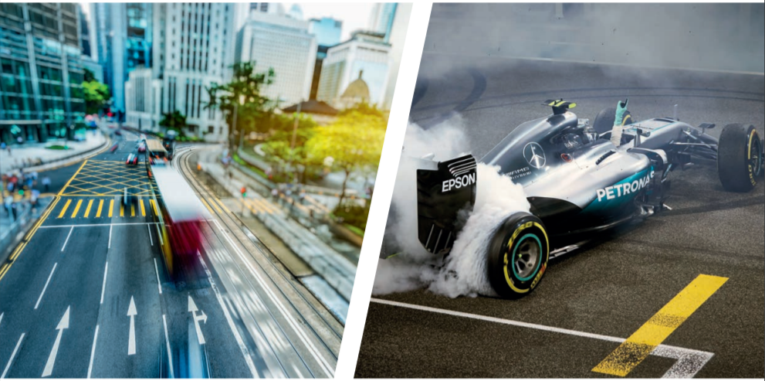
THE FIA: two pillars
SPORT
MOBILITY
Mission: ensures that fair, capably regulated and above all safe events are conducted in all corners of the globe.
Mission: ensure that safe, affordable and clean systems of transport are available to all.

Slide 4
FIA Consumer Views on Automated and Connected Vehicles
Automated and Connected Vehicles may improve Road Safety and offer new smart Mobility Services for the benefit of road users. The FIA welcomes the UNECE initiative to regulate IT Security, Data Privacy and Over The Air Updates
The FIA sees potential for improvement in the current drafts of GRVA, such as: 1. Next to software, also hardware shall be updated 2. A harmonized communication channel shall ensure highest security as well as authorised remote access to in-vehicle-data
3. IT security shall be ensured over the lifetime of the vehicle

Slide 5
FIA Consumer Views on Automated and Connected Vehicles
IT security over the lifetime of the vehicle; is this a topic for UNECE WP 29? Existing examples of UN Regulations (1958) that cover the lifetime of the vehicle are:
No. 59 (Replacement (retrofit) silencing systems
No. 83 (including durability requirements and "in use" requirements)
No. 90 (Replacement braking parts)
No. 133 (Recyclability of motor vehicles)
National Legislation?
Current legislations on national or regional level do not cover IT security issues, like updates of soft- or hardware. IT security is a new area in automotive regulation and requires technical adequate specifications, like updated software with better performance
FIA sees UNECE as the right place to regulate IT security over the lifetime of the vehicle

Slide 6
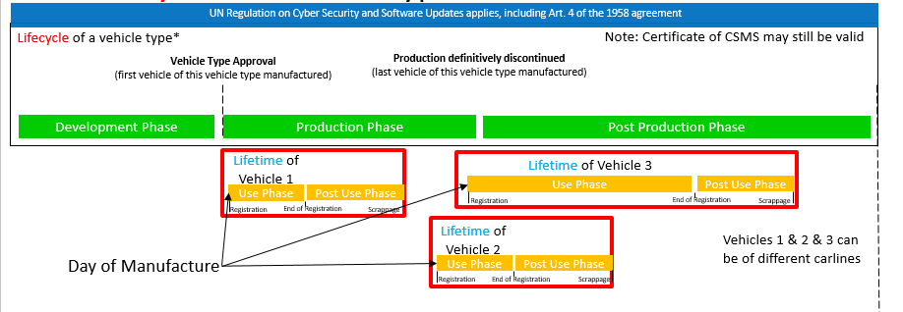
FIA Consumer Views on Automated and Connected Vehicles
Lifetime vs Lifecycle
The Lifetime of a vehicle starts with first registration of the vehicle and ends with the scrappage of the vehicle. It does not end with its decommissioning!
Lifecycle is related to the CSMS of a vehicle manufacturer, consumers need certainty for their vehicles, so Lifetime is the relevant term to look at

Slide 7
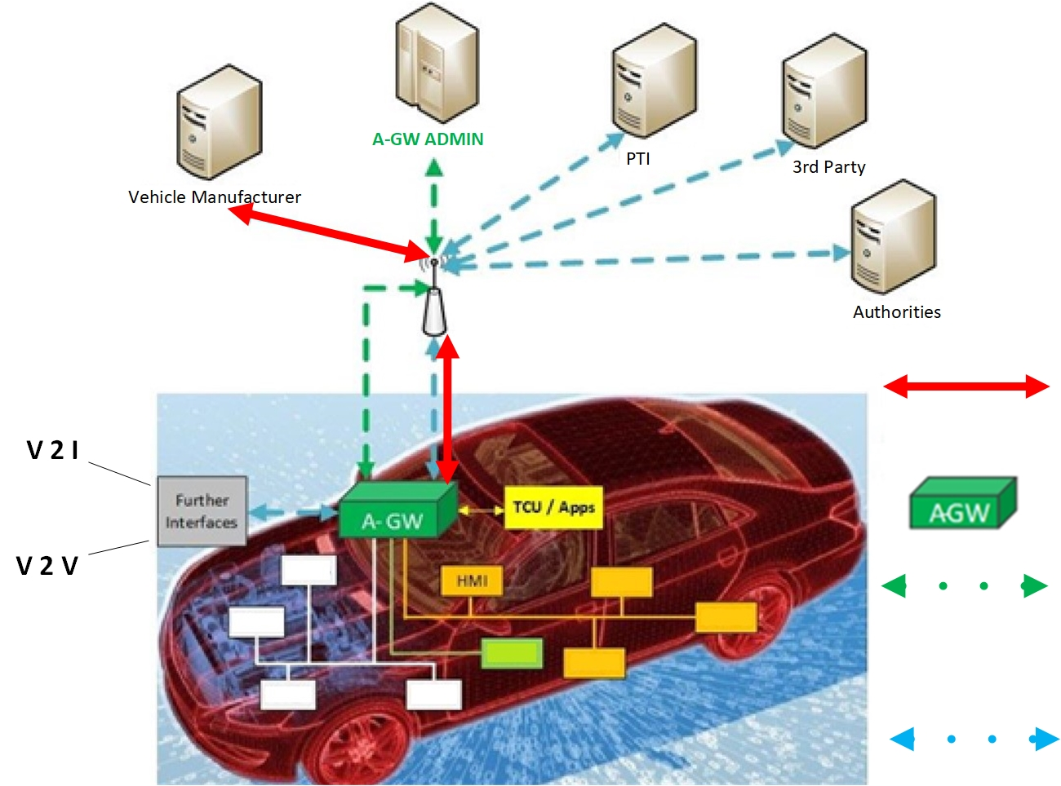
FIA Consumer Views on Automated and Connected Vehicles
A harmonized communication channel can ensure highest IT security over the lifetime,
e.g. an Automotive Gateway (A-GW)
The A-GW covers all use cases of an automated and connected vehicle, such as V2V and V2I as well as diagnostics
Software Updates OTA by VM
Harmonised Automotive Gateway, externally administrated (A-GW Admin) including firewall and authorisation concept
Authorisation, Authentication, Certification
Bi-directional transfer of vehicle data and functions, NO software changes

Slide 8
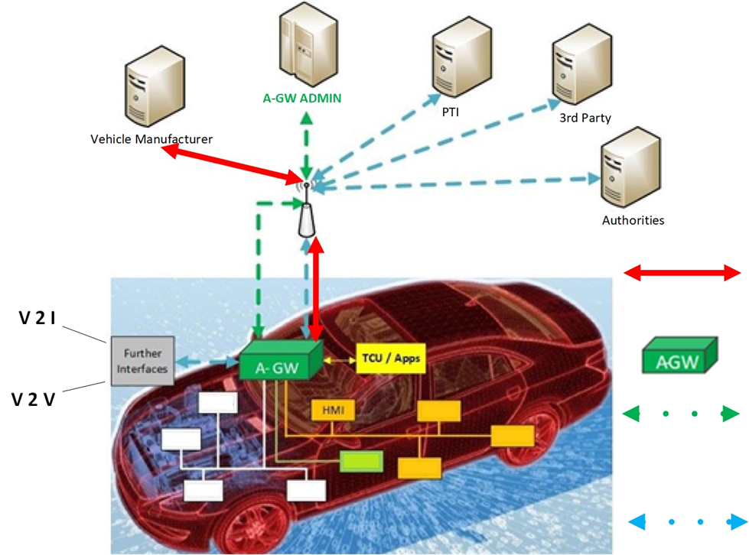
FIA Consumer Views on Automated and Connected Vehicles
A harmonized communication channel can ensure highest IT security over the lifetime,
e.g. an Automotive Gateway (A-GW)
Privileged Role for VM to update
software OTA
Software Updates OTA by VM
Harmonised Automotive Gateway, externally administrated (A-GW Admin) including firewall and authorisation concept
Authorisation, Authentication, Certification
Bi-directional transfer of vehicle data and functions, NO software changes

Slide 9
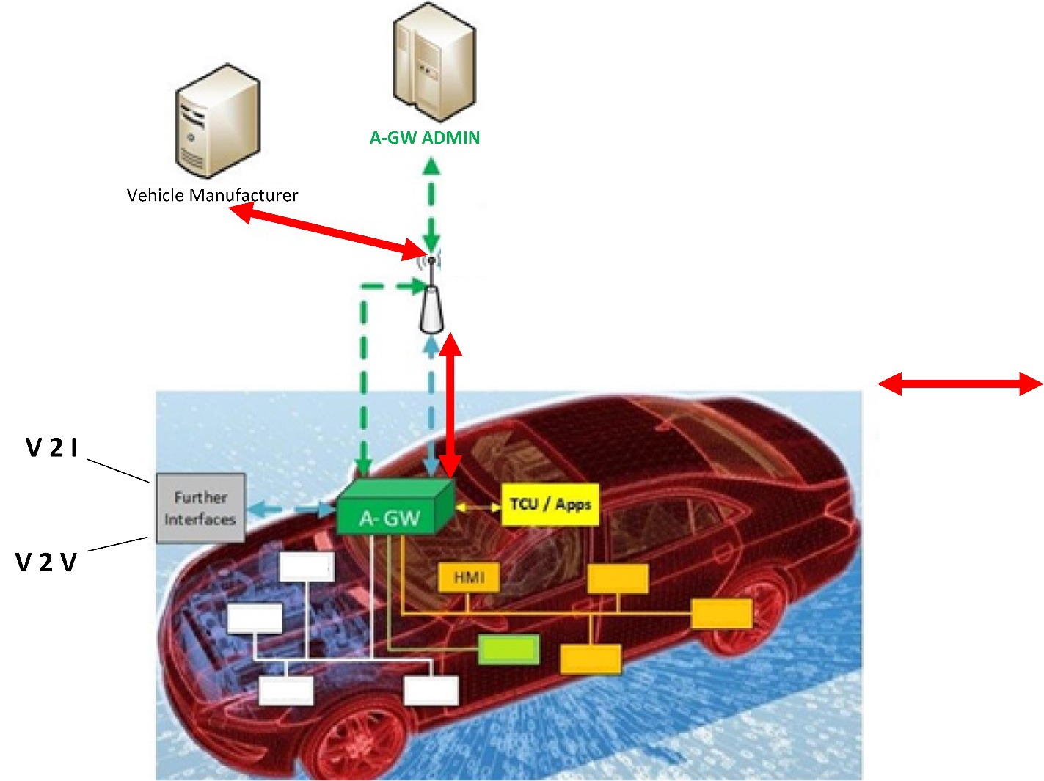
FIA Consumer Views on Automated and Connected Vehicles
A harmonized communication channel can ensure highest IT security over the lifetime,
e.g. an Automotive Gateway (A-GW)
After Cyber Attack
Example 1 : The VM updates the software of ECU(s) and the firewall of the A-GW by OTA update by his privileged role through a communication channel to the vehicle
Software Updates OTA by VM

Slide 10
FIA Consumer Views on Automated and Connected Vehicles
A harmonized communication channel can ensure highest IT security over the lifetime,
e.g. an Automotive Gateway (A-GW)
After Cyber Attack
Example 2 : The hardware is not any more powerful enough to tackle new cyber attacks.
The vehicle manufacturer decides to update the Automotive Gateway. It is the central unit that controls the data stream from / to the in-vehicle-network
A-GW 2
A-GW 2

Slide 11
FIA Consumer Views on Automated and Connected Vehicles
A harmonized communication channel can ensure highest IT security over the lifetime,
e.g. an Automotive Gateway (A-GW)
By using a harmonized communication channel from /to the vehicle, hardware updates over the lifetime of the vehicle are possible.
Even if the mobile network changes, a simple hardware update of the A-GW is sufficient to keep the vehicle securely connected.
A-GW 2

Slide 12
FIA Consumer Views on Automated and Connected Vehicles
FIA proposes WP 29 to mandate GRVA to regulate
IT Security over the Lifetime of a Vehicle
at UNECE level in the framework of the 1958 agreement

Slide 13
Thank you for your attention

